Slide 1
Unit 2 Topic 3
What can we do at home to protect the environment?
Section B
WWW.PPT818.COM

Slide 2
Let’s play a game.
Say a sentence with and, or, but & while like this one by one.
A : I like English and I’m good at it.
B: I am good at English while my good friend is
good at history.
C: My good friend is good at history but …

Slide 3
How do you sort the garbage you’ve collected
on your own Clean-up Day.
plastic bottles...
lunch boxes
reuse
reduce
paper bags
and cups...
soft drink cans, plastic bottles,
waste paper, glass, paper bags
and cups ...
batteries ...
recycle
others
Group work

Slide 4
What should you do if you would like to be a greener person?
You should sort the garbage.
=You ought to sort the garbage.
Language points
ought to 应该 情态动词
ought to +动词原形
ought not to + 动词原形

Slide 5
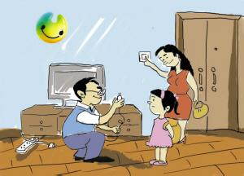
You should /ought to …
Language points
n.电，电能
shut off the electricity
关闭
e.g. You should / ought to shut off the electricity when you leave a room.

Slide 6
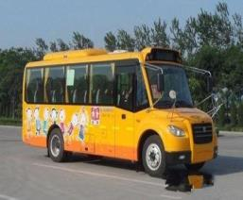
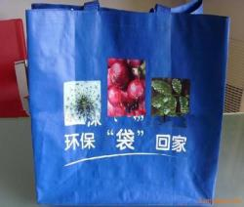
Language points
You should/ought to ride a bike to your school.
You should/ought to take a bus to school instead of taking a taxi.
You should/ought to take a cloth bag when you go shopping.

Slide 7
1b Listen to 1a and choose the correct answers.
1.Jane and Michael are mainly talking about _______.
why we should shut off the electricity when we leave
what we should use when we go shopping
how to be a greener person
2. Actions speak louder than words means ____.
words are not as loud as actions
to do well is better than to say well
actions can speak, but words can’t do it

Slide 8
Remember some English idioms and try to use them often.
Easier said than done.
说起来容易做起来难。
Actions speak louder than words.
行动胜于言辞。

Slide 9
1c Read 1a and complete the table.
To be a greener person
1._______________________________when you leave the room. 2. If you travel a short __________, you shouldn’t _________________ , but ________________. So this helps to ___________ and ____________. 3. When you go shopping, you’d better _____________ instead of using _____________.
You ought to shut off the electricity
distance
take a bus or a taxi
walk or ride a bike
save energy
reduce air pollution
take a cloth bag
plastic bags
Retell it

Slide 10
Retell 1a like this:
I would like to be a greener person.
First I ought to shut off the electricity when I leave a room.
Second, I’d better walk or ride a bike instead of taking a bus or a taxi if I travel a short distance. I will save energy and reduce air pollution.
Third, I will take a cloth bag when I go shopping. I won’t use plastic bags.
It’s easy to be a greener person.

Slide 11
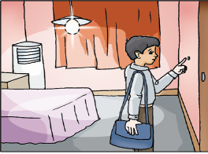
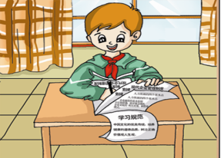
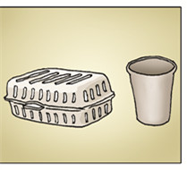
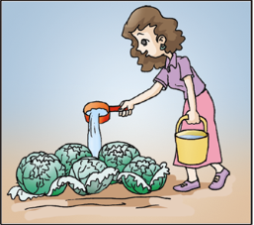
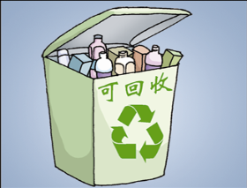
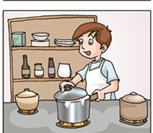
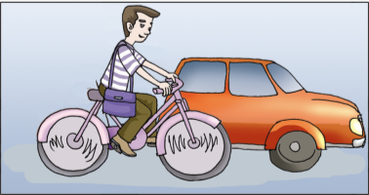
How can we become a greener person?

Slide 12
2 Choose the correct verbs or phrases to complete the statements. Then match them with the right pictures.
shut off reduce grow recycle ride cover use
Reduce
______ waste. Don’t buy cups or boxes which can be used only once.
Save electricity. ________ the electricity when you are not using it.
________ boxes and plastic bottles.
________ fruit and vegetables yourself.
Try to ________ a bike when you travel.
_________ both sides of the paper.
__________ pans when you are cooking.
Shut off
Recycle
Grow
ride
Use
Cover

Slide 13
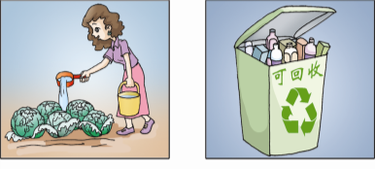
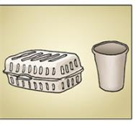
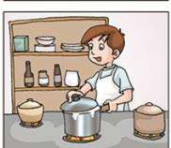
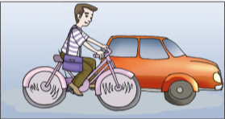
2 Match them with the right pictures.
①Reduce waste. Don’t buy cups or boxes which can be used only once.
②Save electricity. Shut off the lights when you are not using them.
③Recycle boxes and plastic bottles.
④Grow fruit and vegetables yourself.
⑤Try to ride a bike when you travel.
⑥Use both sides of the paper.
⑦Cover pans when you are cooking.

Slide 14
3 Read the passage and fill in the blanks with the correct words. Then listen and check. The first letter of each word is given.
The earth is our home. Some things we have done are good for the earth w_____ some are bad. We have polluted the earth, a______ it is sick now. We c_____ down too many trees, so lots of rich land has c_______ into desert. Factories p____ waste water into rivers. Pollution has caused many s_____ problems. The earth is crying for help.
What shall we do to save it? We should plant more trees, r_________ the waste we produce, r_________ the waste paper and soft drink cans, and ride bikes to reduce air pollution. I think we should try to be g_________ people to protect our earth. After all, we have only one earth. We should do e_________ to protect it, or we’ll be punished and lose our home.
hile
nd
ut
hanged
our
erious
educe
ecycle
reener
verything
毕竟，归根结底

Slide 15
4 Work in groups and survey your group members about what they do to be greener people. Then report it to your class. Pay attention to the stress, liaison, incomplete plosion and intonation.
Example:
A: `Wha(t) do you `often `do to be a `greener person ?
B: Well. `I `always `shut off the electricity when I `am not
`using it .
A: `Good. `What about you , `John?
C:…

Slide 16
Exercises
ought to
You ______ ______(应该) throw the rubbish into the garbage.
You should ______ ______(关闭)the electricity when you leave a room.
You’d better walk or ride a bike ______ _____ (代替) taking a bus or a taxi if you travel a short distance.
It’s so ______(容易) to be a greener person.
_______ _____ _____ _____ ________.
(行动胜于言辞)
shut off
instead of
easy
Actions speak louder than words

Slide 17
summary
We learn: 1. Some words: action, distance, electricity
2. Some phrases:ought to, shut off, after all
3. Some useful sentences:
(1)Would you like to be a greener person?
(2)First, you ought to turn off the lights when you leave a room.
(3)Easier said than done.
(4)Well, actions speak louder than words.
We Can: 1. Use the proper ways to protect the environment in our life.
2. Talk about the greener life style.

Slide 18
Assignment
Read 1a.
Memorize the useful expressions and key sentences that we learn today.
Finish Section B in your workbook.
Preview Section C.

