Slide 1
Unit 8 The magic words
WWW.PPT818.COM

Slide 2
Warming up
Brainstorm
When you see the word magic (魔术的),
what do you think of?
magic broom
magic wand
magic hat

Slide 3
magician

Slide 4
Leading in
Mr.G lived on a small island. He was
in trouble one day.
Let's watch the video.

Slide 5
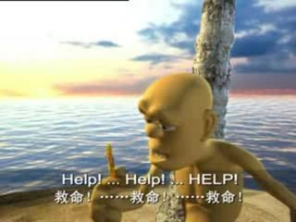
What do you learn from the video?
It's very important to say "please" and "thank you".

Slide 6
People always say that "please" and "thank you" are magic words.
Why ?
There is a story about it.

Slide 7
Let's learn the new words
Talk in groups:
Which words are difficult for you to read?
Can you help each other to read?

Slide 8
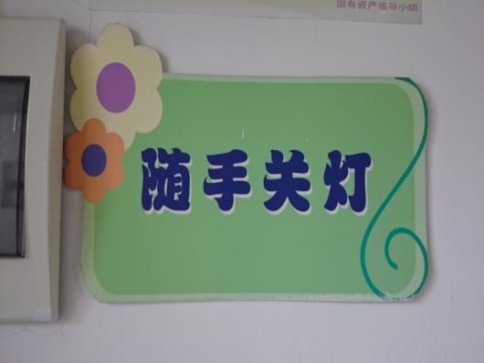
sign
There is a sign in our classroom.

Slide 9
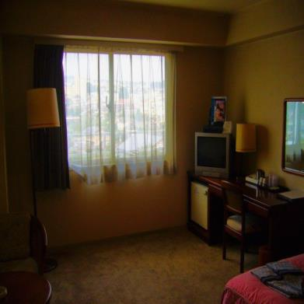
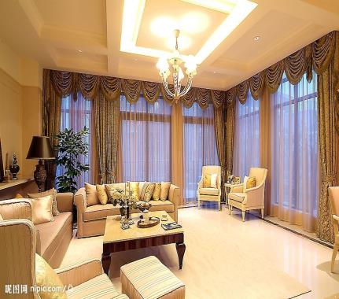
dark 黑暗的
bright 明亮的
The lights light up the room brightly.
lit up点亮 明亮地

Slide 10
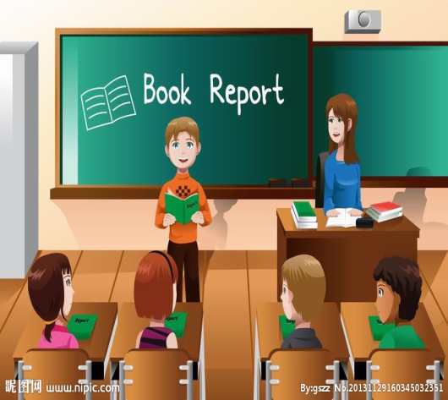
We are inside the classroom,except for___.
除……以外
inside 在里面
outside

Slide 11
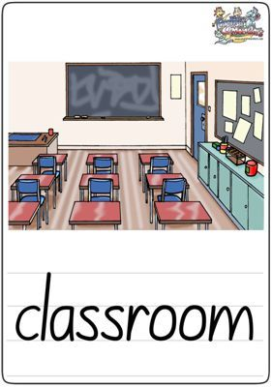
The pupils are having a PE lesson.
None of them are in the classoom.
他们中没有一个

Slide 12
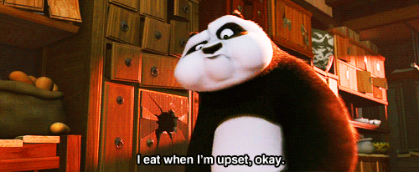
upset 失望的，难过的

Slide 13
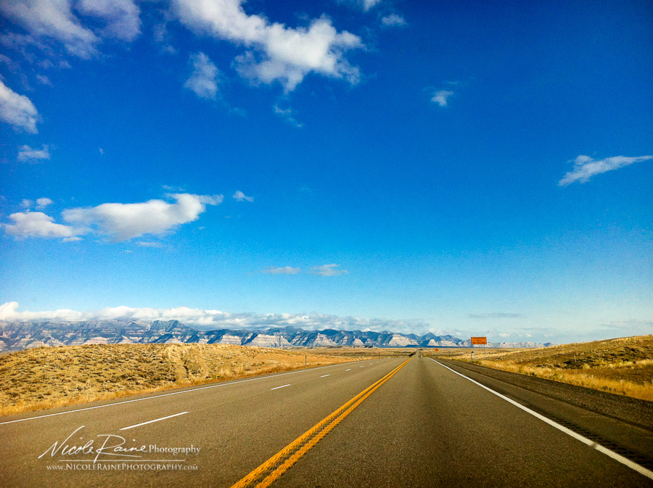
through
通过
road

Slide 14
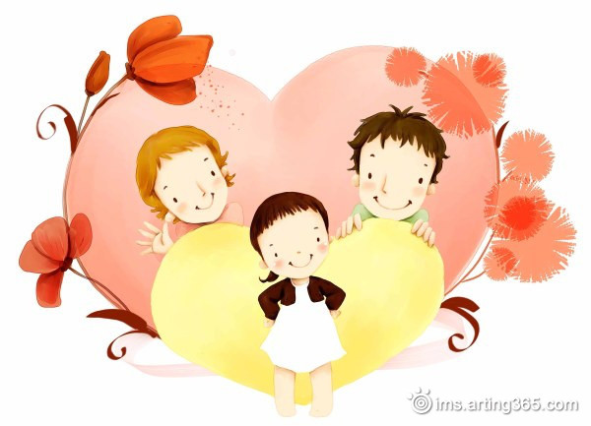
Read the rhyme
P42
I want to be good

Slide 15
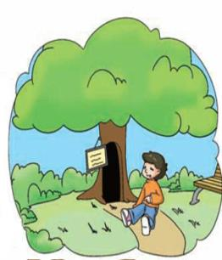
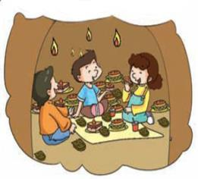
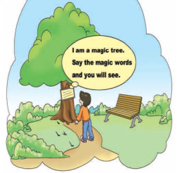
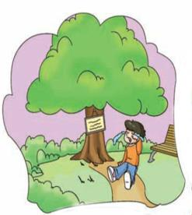
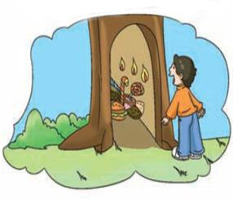
Let's guess
Pair work
故事会怎么发展？来预测排序吧！
5
1
3
4
2

Slide 16
Let's watch the story
故事中小男孩讲了几句话，哪些让魔法树有反应
了？请打勾。
( ) open
( ) hurry
( ) This is too difficult. Please, dear tree！
( ) Thank you, dear tree!

Slide 17
Answer the questions.
1. What did the boy see in the park?
He saw a tree with a sign on it.
2. Why was the boy upset?
Because his magic words didn't work.
3. How did the boy open the tree?
He said, "This is difficult. Please,
dear tree!"

Slide 18
4. What was inside the magic tree?
A room full of toys and chocolates.
5. What are the magic words?
"Please" and "thank you".

Slide 19
Let's learn more details
Any other questions in understanding?
Talk in groups:
Which sentences that you can't understand?

Slide 20
L4. He tried "open" "hurry",and many other
more,but none of them work.
他试了“打开” ”快点“，和很多其他的词，但是没一个起作用。
L9. With this, the inside of the tree lit up
brightly and showed a road. The road led to a
room full of toys and chocolates.
这话说完，树的里面点亮了，并呈现了一条路。这条路
通向了一个满是玩具和巧克力的房间。

Slide 21
Let's read the story.

Slide 22
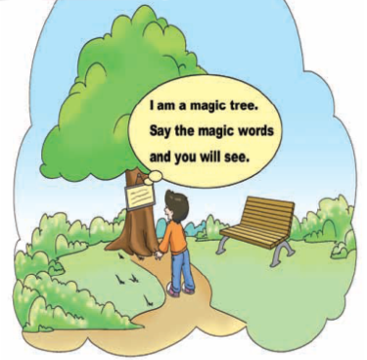
Let's retell
walking through a park
Long ago, a little boy was _______________. In_________ the park there was a tree _____ ________. The sign said, “I am a ________. Say the _________ and you will see.”
the middle of
with a
sign on it
magic tree
magic words

Slide 23
The boy tried to _________________. He tried “open”, “hurry”, and many more, but ___________ worked.
guess the magic words
none of them

Slide 24
upset
Tired and ______, the boy cried out, “This is too diffcult, ______, dear tree!”Suddenly, a big door opened _____________ the tree. Inside everything was dark, _____________. The sign said, “____________________.”
Please
at the bottom of
except for a sign
Carry on with your magic

Slide 25
Thank you, dear tree
Then the boy said, “_________________!” With this, _________ the tree ___________ and showed _______. The road led to a room _____________________.
the inside of
lit up brightly
a road
full of toys and chocolates

Slide 26
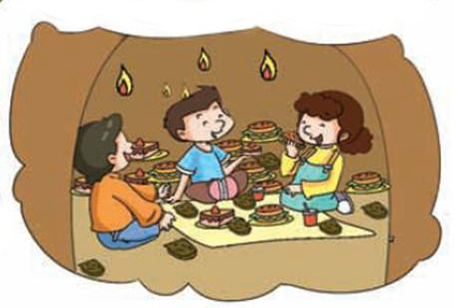
The little boy brought ___________ to the magic tree, and they had ______________. This is why people always say that
_____________________________________.
all his friends
the best party ever
“please” and “thank you” are the magic words

Slide 27
Homework
1. 抄写U8前12个单词 (到carry on)
2. 跟录音读U8单词和课文3次，
请注意模仿语音语调。
3. 做课本P46第2题。

