Slide 1
Unit 4
Don’t eat in class.
R 七年级下册
第4课时
WWW.PPT818.COM

Slide 2
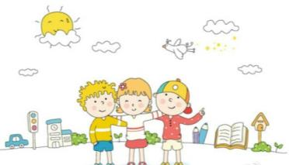
Lead-in
What rules do you have at school or at home?
Do you like them?
What rules do you have at home?
I can’t see friends on school days.
How do you think of it?
I really don’t like it.

Slide 3
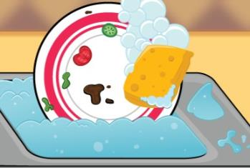
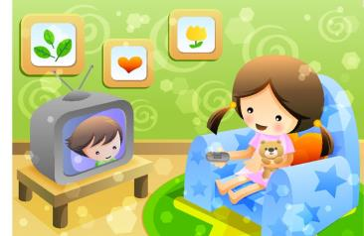
At home
do the dishes
can’t watch TV

Slide 4
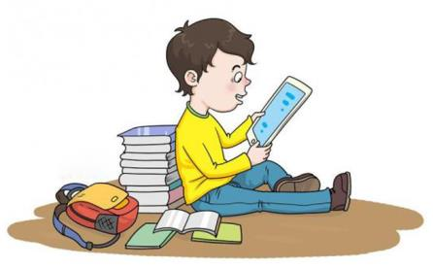
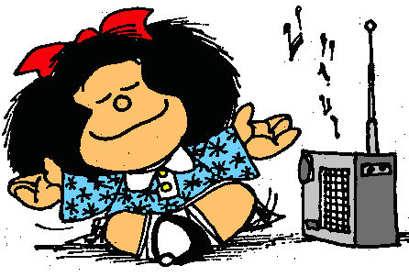
At school
can’t listen to music
can’t take mobile phone to school

Slide 5
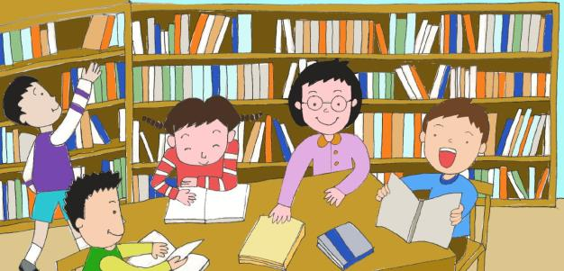
in the library

Slide 6
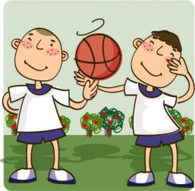
When you are unhappy about something, who do you like to talk to?
2a
Your best friends?

Slide 7
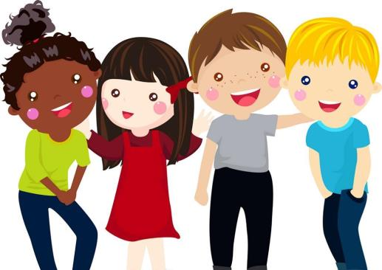
Your sister or your brother?

Slide 8
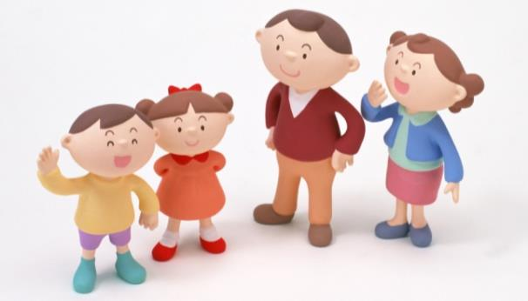
Your father or your mother?

Slide 9
Thinking and talking
When you are unhappy about something, why do you like to talk to your parents, your teachers or your friends?

Slide 10
2b
Read the letters. Underline the rules for Molly.
Dear Dr. Know，
There are too many rules! At 6:00a.m., my mom says，“Get up now and make your bed!” After breakfast, my mom always says, “Don’t leave the dirty dishes in the kitchen!” After that，I run to school because I can’t be late. At school, we have more rules — don’t be noisy，don’t eat in class, …

Slide 11
My dad says I can’t play basketball after school because I must do my homework. I can play only on weekends. After dinner, I can’t relax either. I must read a book before I can watch TV. But I have to go to bed before 10:00. Rules, rules, rules! It’s terrible! What can I do, Dr. Know?
Molly Brown, New York

Slide 12
Read the letters and answer the questions.
1.Are there many rules at Molly’s home?
2.How does Molly go to school?
3. How does Molly feel about the rules?
Yes, there are.
She runs to school.
It’s terrible.

Slide 13
Language points
1. There are too many rules！(我这儿）有太多的规则！
too many :太多
+ 可数名词复数
程度副词, 太,修饰形容词many
例: 每年北京有太多的游客。
There are too many visitors in Beijing every year.

Slide 14
辨析：too many, too much与much too
too many
+ 可数名词复数
太多的
too much
+不可数名词
太多的
(可作状语修饰动词)
much too
+形容词或副词
太
1. He spends __________ money every week.
2. He talks __________.
3. The little boy runs __________ fast.
too much
too much
much too

Slide 15
2. Don’t leave the dirty dishes in the kitchen!
别把脏碗留在厨房里！
leave此处作及物动词， “留下，剩下”
leave+宾语+地点状语 把某物忘在某地
leave sb. by oneself 把某人独自留下
例:昨天我把作业落在家里了。
I left my homework at home yesterday.

Slide 16
3. After dinner, I can’t relax either. 晚饭后我也不能放松。
relax(v.), 放松;休息。
第三人称单数形式：relaxes。
relaxing
形容词，修饰物，某事物是“令人放松的”。
relaxed
形容词，修饰人，人“感到轻松、放松的”。
例: The film is very _________.
He was ________ after listening to the music.
relaxing
relaxed

Slide 17
Dear Molly,
People always tell us,“Don’t do this!” or “You can’t do that!” But think about it, Molly. There are a lot of things you can do. You can play basketball on weekends. You can watch TV after you
主语
谓语
宾语从句
宾语从句需用陈述语序
I know how you feel.

Slide 18
read a book. Parents and schools are sometimes strict,
but remember, they make rules to help us. We have to follow them.
Good luck!
Dr. Know

Slide 19
Language points
4. Parents and schools are sometimes strict, but remember,
they make rules to help us. 父母和学校有时是严格的，
但是记住，他们制订规则是为了帮助我们。
strict(形容词) : 严格的，严厉的
常用短语:
be strict with sb. 对某人要求严格
be strict in sth. 对某事要求严格

Slide 20
remember(vt.) :记住，记起
常用短语:
remember to do sth. = don’t forget to do sth.
记得要去做某事(事情还没有做)
remember doing sth. 记得做过某事(事情已经做过)
例: 当你到那里的时候，记着打电话给我。
Remember to telephone me when you arrive there.

Slide 21
Read the letters again. Complete the sentences with have to/must, can or can’t.
2c
1. Molly ______ play basketball on school days, but she ______ play it on weekends.
2. Molly ______ do her homework first when she gets home.
3. Molly ______ read a book after dinner before she ______ watch TV.
can’t
can
must
must
can

Slide 22
4. At school, Molly ______ be noisy or eat in class.
5. Parents and schools make rules to help students. So
students ______ follow the rules.
can’t
have to

Slide 23
Exercise
( )1.I have _____ homework to do today.
A.too many B.too much
C.much too D.very much
( )2.I’m too busy every day, so I never have_____fun.
A.some B.many C.much D.a
B
C

Slide 24
( )3.My father _____ have to wash the dishes at home.
A.don’t B.not C.doesn’t D.can’t
( )4. ______ people make the city dirty.
A. Too many B. Much too
C. Too much D. Many too
C
A

Slide 25
( )5.It’s raining all day, so we_____stay at home.
A.have B.must C.can D.may
( )6. Don’t _____ your phone at home. When you get
there, please call me.
A. forget B. forgot C. leave D. left
B
C

Slide 26
( )7. We spent a _______ weekend.
A. relax B. relaxes C. relaxing D. relaxed
( )8. The skirt ______ soft as if it is made of silk.
A. sounds B. tastes C. feels D. smells
C
C

