Slide 1
Unit 9 Communication
Tips for Good Communication
WWW.PPT818.COM

Slide 2
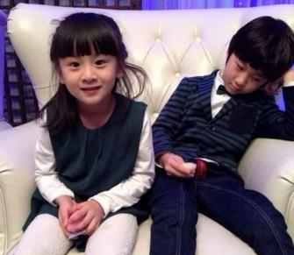
How do you communicate with a new friend?
In your opinion, what are the best ways to
communicate?

Slide 3
New words
interpersonal adj. 人际的；人际关系的
passport n. 途径；护照
proper adj.正确的；恰当的
listener n. 听者
contact v./n. 接触；联系
promise v.承诺；许诺
cancel v. 取消

Slide 4
New phrases
eye contact 眼神交流;目光接触
waste time doing 浪费时间做某事
keep one’s promise 遵守诺言;守信
on time 准时,按时
ahead of (时间、空间)在……前面

Slide 5
Read the text and find out main phrases and main sentences.
Main phrases:
·eye contact
·waste time doing
·keep one’s promise
·on time
·ahead of

Slide 6
Main sentences:
·Do you feel comfortable when talking to others?
·Have you ever found it hard to make new friends?
·Make a great effort to do this when you first meet someone new.
·Make sure you smile and greet others in a friendly way,especially the first time you meet them.
·Smiling can be a passport to good communication.

Slide 7
·The main thing is to find a topic you are both interested in.
·One simple way to show you are a good listener is to make eye contact.
·No one wants to waste time talking to someone who is not honest.
·Keep your promises.
·If you set a time to meet your friends,do your best to be on time.
·If you have to change your plan or cancel it,let your friends know ahead of time.

Slide 8
☆教材解读☆
1.Do you feel comfortable when talking to others?
when talking to others是带从属连词的动名词短语,在句中作状语,这时v.-ing的逻辑主语通常是主句的主语。这种状语可以转化为状语从句。有时v.-ing的逻辑主语不是主句的主语,要根据上下文判断。
2.Have you ever found it hard to make new friends?
◆句中it作形式宾语,to make new friends是真正的宾语。真正的宾语还可以用宾语从句形式。
◆“find it+形容词+to do sth.”为固定结构,意为“发现做某事是……的”,其中it是形式宾语,真正的宾语是后面的动词不定式(短语),该结构可与“find it’s+形容词+to do sth.”进行替换。
【拓展】 feel,make,keep,think也可用于这一固定结构中。

Slide 9
3.Make a great effort to do this when you first meet someone new.
◆make an/the effort to do/doing sth.意为“努力做某事”。
◆first在本句中用作副词,意为“第一次,首次”。
◆someone new意为“某个新人”,是“复合不定代词+形容词”结构,形容词修饰复合不定代词时,应后置。

Slide 10
4.Make sure you smile and greet others in a friendly way,especially the first time you meet them.
◆make sure意为“务必;确信”,主要用法有:
(1)“make sure+that从句”意为“设法保证,确保”。
(2)“make sure of/about sth.”意为“确保某事”。
(3)“make sure to do sth.”意为“一定要/务必做某事”。
◆本句中the first time用来引导时间状语从句。可用来引导时间状语从句的词(组)有the moment,the minute,the instant,the day,the year,
every time,next time,immediately,directly,
instantly等。

Slide 11
5.Smiling can be a passport to good communication.
a passport to意为“通往……的途径”。
6.The main thing is to find a topic you are both interested in.
◆句中的to find a topic you are both interested in是不定式用在系动词后作表语;其中的you are both interested in是定语从句,修饰前面的名词topic。
◆both在此处用作主语的同位语,意为“两者(都)”,常位于系动词、助动词和情态动词之后,实义动词之前。

Slide 12
7.One simple way to show you are a good listener is to make eye contact.
◆句中的to show you are a good listener为不定式短语作定语,修饰前面的名词way;不定式中的you are a good listener为宾语从句,作动词show的宾语;后面的不定式短语to make eye contact作表语。
◆make eye contact意为“眼神交流,目光接触”。
8.No one wants to waste time talking to someone who is not honest.
◆no one意为“没有人”,用作主语时,谓语动词用第三人称单数形式。

Slide 13
【辨析】 no one,none
no one | 没有人 | 用来指代人 | 其后不能接of短语;作主语时,谓语动词用单数形式 | 可回答who引导的疑问句
none | 没有人;没有东西 | 既可指人也可指物 | 其后可接of短语;作主语时,若指代复数名词,谓语动词用单复数皆可,若指代不可数名词,谓语动词应使用单数形式 | 可用于回答how many或how much引导的疑问句
◆waste time doing sth.意为“浪费时间做某事”,还可以用waste time on sth.表示。
◆who is not honest是定语从句,修饰先行词someone。

Slide 14
9.Keep your promises.
promise作名词,意为“许诺,诺言”。
【拓展】 (1)常见的短语:keep one’s promise(s)信守诺言;break a promise违背诺言;make a promise 许下诺言。
(2)promise也可用作动词,意为“许诺,答应,保证”。promise后可接不定式,也可接双宾语。
10.If you set a time to meet your friends,do your best to be on time.
set在本句中意为“确定”。
11.If you have to change your plan or cancel it,let your friends know ahead of time.
ahead of time/schedule意为“提前”。ahead of还有“在……前面;在……前头;领先,占优势”的意思。

Slide 15
Some people are talking about ways to communicate well.Listen to the interview and match the names with their suggestions.

Slide 16
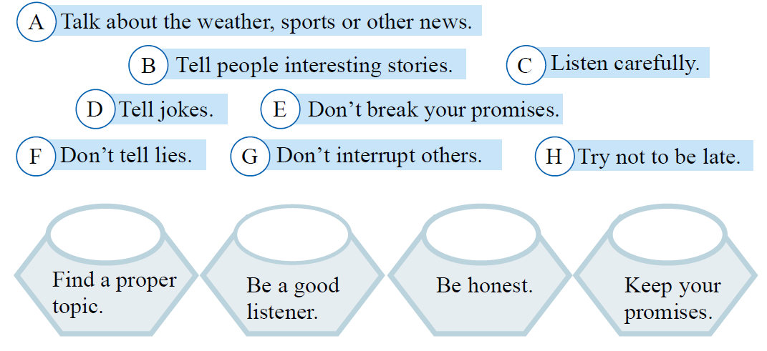
Group them into the baskets below.
A B D
C G
F
E H

Slide 17
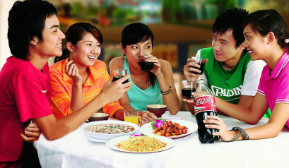
Work in pairs. Think about your family and friends. What makes you happy in the way they communicate with others? Talk about it.

Slide 18
Ⅰ.Fill in the blanks with the words in the box.
promise cancel proper passport
cancel
1.If you want to the meeting,you must inform us a week before.
2.She could not find a solution to this problem.
3.Zhang Jian plans to go abroad but he needs to get a first.
4.I can’t make a ,but I’ll try my best.
proper
passport
promise

Slide 19
Ⅱ.Choose the correct answers.
5.Please look over your paper carefully to
there are no mistakes.
A.find out B.think of
C.make sure D.try out
6.We should greet others a friendly way.
A.in B.on C.by D.of
7.—I will buy you a new bike if you learn how to swim this summer.
—Is that a ?I’m sure I’ll get the bike.
A.chance B.promise C.trick D.treat
C
A
B

Slide 20
8.The teachers hope all of us can hand our homework time every day.
A.up,in B.out,on C.on,in D.in,on
9.—How can I make friends in a new school?
—Say hello to today,and you can have a friend tomorrow.
A.new someone B.someone new
C.new anyone D.nobody new
10.The match had to due to the bad weather.
A.cancel B.be cancelled
C.put off D.cancel off
D
B
B

Slide 21
Ⅲ.Put the words in the correct order.
11.their,will,those,keep,promises,people,who,trust,always(.)
12.passport,communication,a,smiling,be,can,to,good(.)
13.communicate,I,difficult,to,it,with,a,foreigner,think(.)
14.topic,I,found,a,interested,both,we,are,in(.)
15.never,people,their,trust,those,who,always,break,
promises(.)
People will trust those who always keep their promises.
Smiling can be a passport to good communication.
I think it difficult to communicate with a foreigner.
I found a topic we are both interested in.
People never trust those who always break their promises.

Slide 22
Homework
1.Finish off the remaining exercises in the activity book.
2.The students are required to read the next text in the student’s book.

