Slide 1
Unit5 Topic 1
I usually come to school by subway.
Section C
WWW.PPT818.COM

Slide 2
Tell the time.
8:00
9:05
10:15
11:30
12:45
17:50
eight o’clock
nine o five
ten fifteen / a quarter past ten
eleven thirty / half past eleven
twelve forty-five/ a quarter to one
seventeen fifty / ten to eighteen

Slide 3
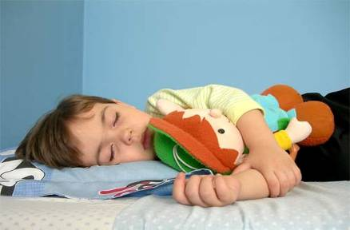
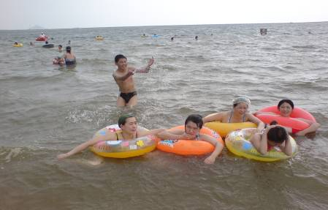
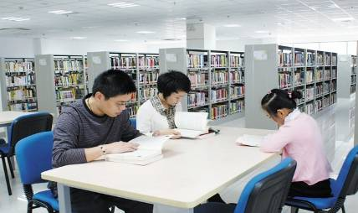
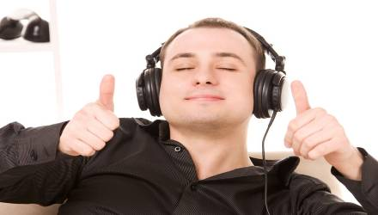
go to bed
go swimming
read books in the library
listen to music

Slide 4
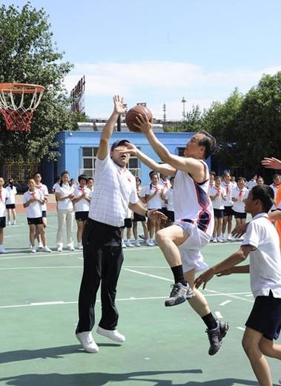
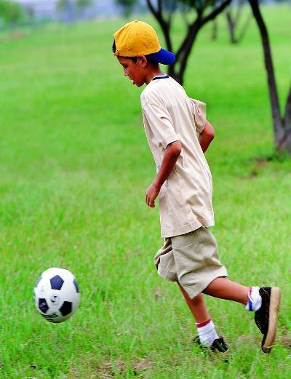
play basketball
play soccer

Slide 5
Read carefully and complete the table.
Time | Activity
6:20 a.m. | gets up
 | has breakfast
7:30 a.m.
12:10 p.m.
after school
 | gets home
after dinner
 | goes to bed
7:00 a.m.
goes to school
has lunch
plays soccer
5:30 p.m.
does her homework
9:45 p.m.

Slide 6
Read the passage and answer the questions.
(1)When do the classes begin?
(2)How many classes does she have in the morning?
(3)Where does she have lunch?
(4)When does she play soccer with her classmates?
(5) How does she go home?
Classes begin at eight.
She has four classes in the morning.
She has lunch at school.
She plays soccer after school.
She takes the subway home.

Slide 7
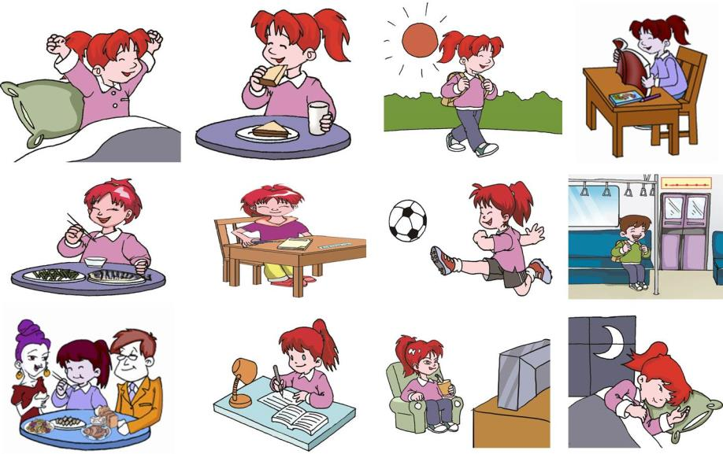
Work in groups of three. Discuss the following pictures and retell the passage in 1a.

Slide 8
Talk with your partner about your day with the help of 1a. Then report it to the class.
I usually get up at … in the morning. At … o’clock I have breakfast … … is my partner. He/She usually gets up at … in the morning …

Slide 9
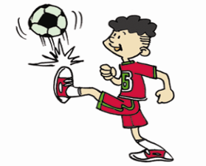
Pair Work
Hai Qing
play soccer
play basketball
A:__________________________
What does Hai Qing usually do after school?
He usually plays soccer, but he doesn’t play
basketball.
B:_______________________________________
_______

Slide 10
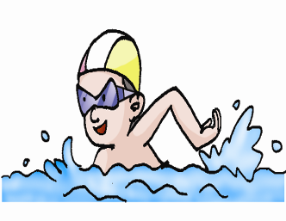
Wen Wei
go swimming
go fishing
What does Wen Wei usually do after school?
A:__________________________________________
B: He usually goes swimming, but he doesn’t go fishing.
B:____________________________________________

Slide 11
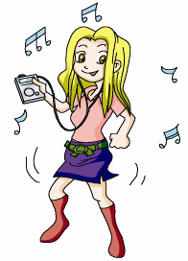
Ellen
listen to music
watch TV
A: What does Ellen usually do after school?
A:__________________________________________
B:______________________________________________
B: She usually listens to music, but she doesn’t watch TV.

Slide 12
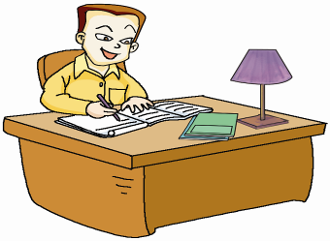
Wang Junfeng
do his homework
go to the park
A: What does Wang Junfeng usually do after school?
A:__________________________________________
B:__________________________________________
_____________
B: He usually does his homework, but he doesn’t
go to the park.

Slide 13
Pair Work
Make up new conversations with the words or phrases in the box.
Activity: meet friends watch TV listen to music
read books cook go to the zoo play soccer
Frequency: once a week twice a week three times a week
very often every day seldom never
Example:
A: Do you often read books in the library?
B: Yes, I do. / No, I don’t.
A: How often do you come to the library?
B: Three times a week.

Slide 14
Survey your classmates about how often they do the following things and fill in the table. Then report it to the class.
Activity name | watch TV in the evening | walk to school | play computer games | help your parents | play basketball
Wang Li | once a week
…

Slide 15
Report it to the class.
You may report it like this:
Wang Li watches TV in the evening once a week…

Slide 16
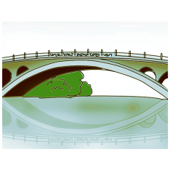
Read and write the words.
read
feet
head
great
bridge

Slide 17
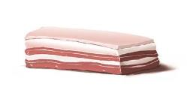
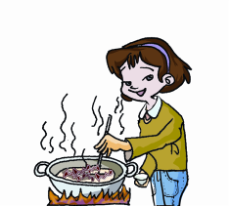
Read the following sentences aloud, paying attention to the rising tone( ) and the falling tone ( ).
1. The Chinese judge needs cheese, meat and bread.
2. The girl in jeans can cook great beef.

Slide 18
Summary
1. Learn adverbs of frequency.
2. Review the present simple tense.
3. Talk about the daily activities.

Slide 19
Homework
Write a passage about the daily activities of you and your best friends. (at least 50 words)

