Slide 1
Unit6 I like hamburgers.
人教精通版三年级上册
WWW.PPT818.COM

Slide 2
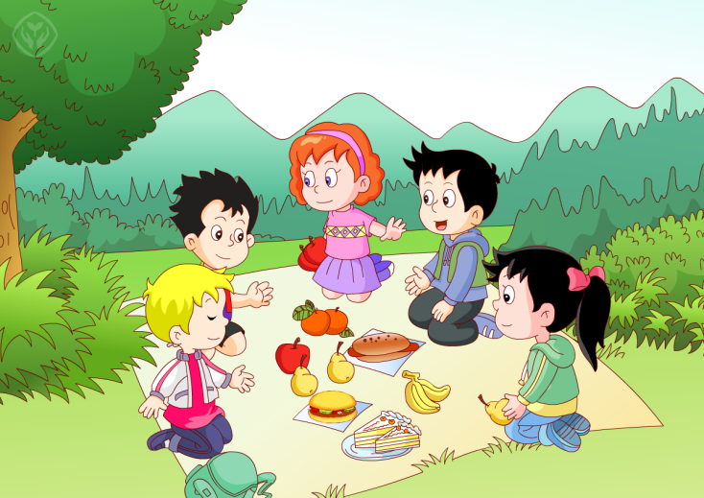
Review
Let’s chant

Slide 3
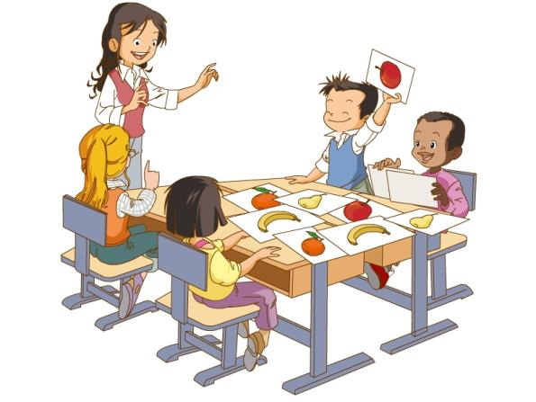
Review
Game
Listen and do
Show me an apple.

Slide 4
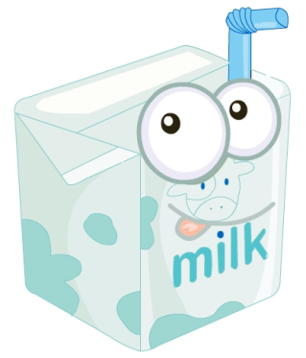
Presentation
Just learn
milk

Slide 5
Presentation
Just learn
juice

Slide 6
Presentation
Just learn
water

Slide 7
Practice
Game 1
Choose and say
1
2
milk
juice
3
water

Slide 8
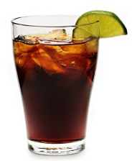
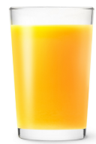
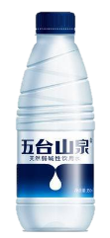
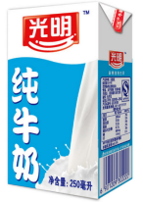
Practice
Game 2
What’s missing?

Slide 9
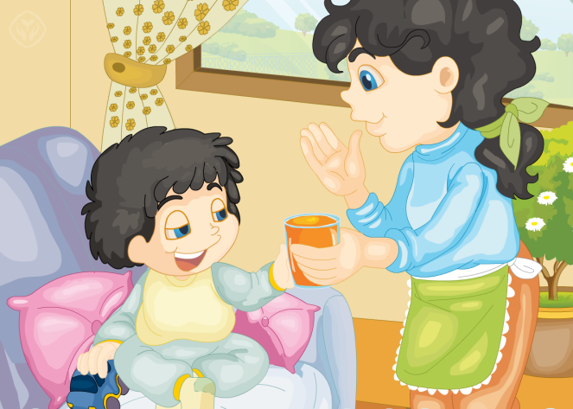
Presentation
Look and say
What are they talking about?

Slide 10
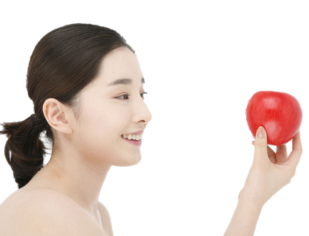
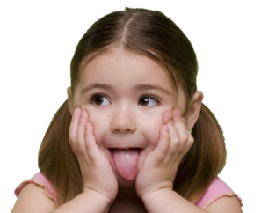
Presentation
Key points
Sure! Here you are.
Can I have an apple, please?
Thank you!

Slide 11
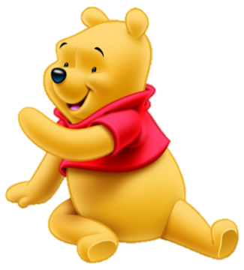
Presentation
Key points
Sure! Here you are.
Can I have some milk, please?
Thank you!

Slide 12
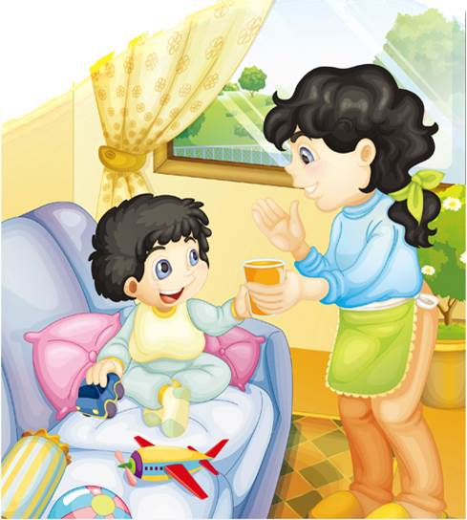
Presentation
Listen and imitate
Sure! Here you are.
Mum, can I have some juice, please?
That’s OK.
Thank you!

Slide 13
Practice
Let’s read
1
2
3
Read together.
(齐读)
Read in roles.
（分角色读）
Read in groups.
(分组读）

Slide 14
Show time
两人一组试着练习对话并表演，其他同学评价。
 | 模仿录音中的语音语调，有感情地朗读。
 | 可以脱离课本，适当改动其中部分，语音地道。
 | 适当添加内容，意思完整，有创新，表演生动。
Good
Great
Excellent

Slide 16
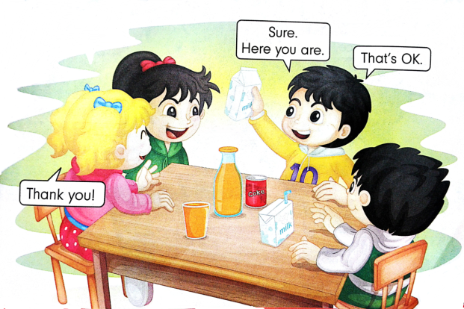
Practice
Let’s play
Can I have some milk?
Sure. Here you are.
That’s OK.
Thank you!

Slide 17
Summary
本课学习的饮料类单词有:
milk
juice
water

Slide 18
Homework
1.观看或跟读Just talk部分的课文动画或录音，并注意语音、语调。
2.查找书籍或网络，搜集更多关于饮料类的单词，并制作成单词卡片。
3.预习Lesson35。
Close

