Slide 1
Unit 5
What are the shirts made of?
Section A 3a-3c
WWW.PPT818.COM

Slide 2
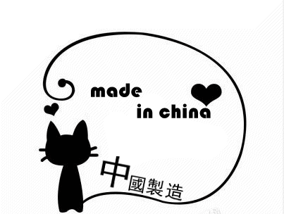
Warming up
As we know, there are so many things made in China in England. What about in America and other countries in the world?

Slide 3
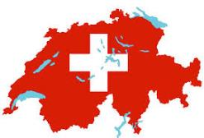
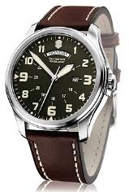
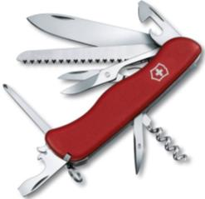
If you go to Switzerland, what would you buy?

Slide 4
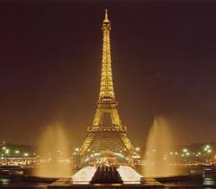
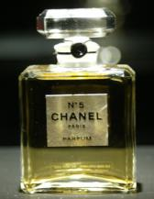
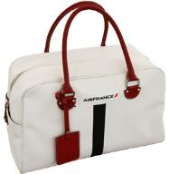
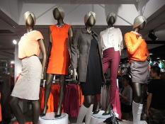
If you go to France, what would you buy?

Slide 5
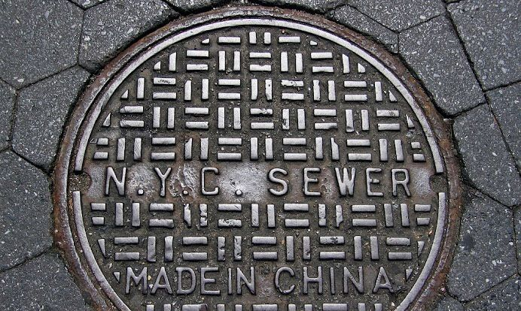

Slide 6
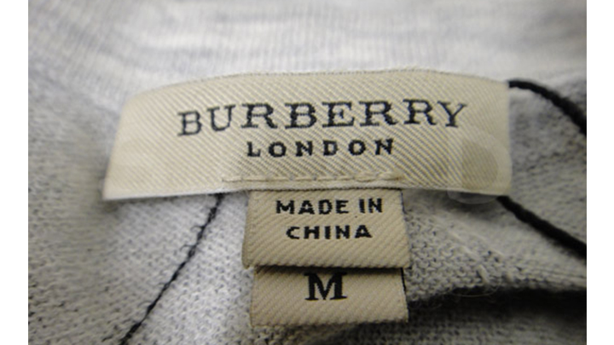

Slide 7
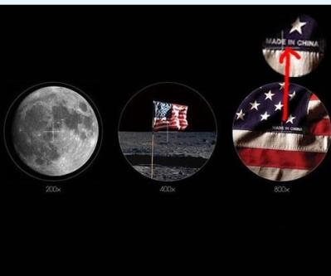
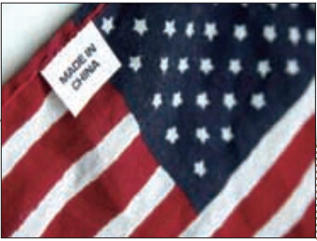
Now let’s read the passage of 3a. First, read quickly and find the answers to 3b.

Slide 8
3a Read the passage. What two things did Kang Jian want to buy in America?
Where were they made?
The Difficult Search for
American Products in the US
If you go to another country, what kinds of things would you buy? Would you buy a camera in Japan, some beautiful clothes in France, or a watch in Switzerland? No matter

Slide 9
what you may buy, you might think those products were made in those countries. However, you could be wrong. Kang Jian is a 17-year-old student from Shanghai. Last year he went to visit his aunt and uncle in San Francisco. He found it interesting that so many products in the local shops were made in China. “I wanted to buy a toy car for my cousin, but even though most of the toys were American brands, they were made in China.”

Slide 10
Toys are not the only things made in China. “I wanted to buy a pair of basketball shoes,” he explains. “But I had to visit five or six stores before finding a pair made in America!” He realized that Americans can hardly avoid buying products made in China. “In fact,” he continues, “there are many other things there made in China — footballs, handbags, pet food, mobile phones. Even American flags are made in China!”

Slide 11
Kang Jian thinks it’s great that China is so good at making these everyday things. However, he wishes that in the future China will also get better at making high-technology products that people can buy in all parts of the world.

Slide 12
3b Read the passage and answer the questions.
1.Where did Kang Jian go to visit his aunt
and uncle?
In San Francisco.
2. What did he discover in the toy stores?
He discovered that most of the toys were
made in China.

Slide 13
3. Why did he have to visit many stores
before buying a pair of basketball shoes?
Because he wanted to buy a pair of
basketball shoes made in America, but
most of them were made in China.
4. What did he realize after his shopping
experiences?
He realized China is so good at making
these everyday things.

Slide 14
5. Why do you think so many products in
America are made in China? How do you
feel about this?
I think Chinese people are great; they can
make many things and sell them to places
around the world. It shows that China is a
great and strong country.

Slide 15
3c Read the passage again and write what the underlined words in bold refer to.
No matter what you may buy, you might
probably think those products were made
in those countries.
those: ________________________________
_________
those: ___________________________________
(products) cameras, beautiful clothes,
watches
(countries) Japan, France, Switzerland

Slide 16
He found it interesting that so many products in the local shops were made in China.
it: ____________________________________
________________
3. I wanted to buy a toy car for my cousin, but even though most of the toys had American brands, they were made in China.
they: _______________
so many products in the local shops were made in China
most of the toys

Slide 17
Language Points
1. Would you buy a camera in Japan, some beautiful clothes in France, or a watch in Switzerland?
你会买日本产的相机，法国制作的漂亮衣服,还是瑞士产的手表？
(1) France 名词，意为“法国”，是国家名称。
► Have you ever been to France?
你去过法国吗？
French adj. 法国的;法国人的; 法语的;n. 法语

Slide 18
2. No matter what you may buy, you might
probably think those products were made
in those countries.
无论你可能会买什么，你或许会认为那些产
品就产于那些国家。
(l) no matter what意为“无论什么”，引导 步
状语从句，相当于whatever。
• No matter what/Whatever you say, I can not
agree with you,
无论你说什么，我都不会赞同你。

Slide 19
拓展：
与no matter what用法类似的还有：
no matter who = whoever 无论谁
no matter when = whenever 无论什么时候
no matter where = wherever 无论在哪儿
► No matter where /Wherever you go, don’t
forget your hometown.
无论你去哪里，都不要忘记你的家乡。

Slide 20
(2) product (a thing that is grown or produced,
usually for sale)名词，意为“产品；制品”，
可指农业加工品、工业产品及脑力劳动的
产物。
► They have no need to advertise our product.
他们没有必要为我们的产品做广告。
► The novel is the product of ten years of labor.
这部小说是十年努力的产物。

Slide 21
3. He realized that Americans can hardly avoid buying products made in China.
他意识到美 国人几乎不可避免会买到中国制
造的产品。
avoid (to keep away from sb./sth.) 作动词，意为“避免；回避”，后可接名词、代词、或动词-ing形式作宾语，但是不能接不定式作宾语。
译: 他对我的问题避而不答。
误：He avoided to answer my questions.
正：He avoided answering my questions.

Slide 22
Exercises
用括号中单词的适当形式填空。
1. One who goes to ______ (French) never fails to visit Paris.
2. How soon would you like to have these ___________ (product) done?
3. In the crowd, Sam looked aside to avoid _________ (see) Jane and Mary.
France
products
seeing

Slide 23
made
4. Is this kind of bicycle ______ (make)
in Shanghai?
5. The ______ (locally) government
listed him as an elderly person of no
home.
local

Slide 24
单项选择。
Most ____ turn yellow, red or brown in
autumn.
A. leaf B. leave C. leaves D. lives
2. All kinds of new machines are made _____
that factory.
A. of B. from C. into D. in
C
D

Slide 25
3. No matter _______ you say, I would not
believe you.
A. how B. what C. where D. when
4. — Excuse me, haven’t you learned the new
_____ law? Everyone in a car must wear
the seat belt.
— Sorry, we won’t do that again.
A. food B. traffic
C. medicine D. education
B
B

Slide 26
5. In autumn there are a lot of _____ in the
ground.
A. leaf B. leafs C. leaves
6. This pair of shoes_____ hand, and it _____
very comfortable.
A. is made with; is felt
B. are made from; is felt
C. are made of; feels
D. is made by; feels
C
D

Slide 27
7. —What languages _____ in that country?
— German and English.
A. are speaking B. are spoken
C. speak D. is spoken
8. Many trees _____ along the streets every
year. So the air is very fresh now.
A. plant B. are planted
C. planted D. were planted
B
B

Slide 28
9. Silver __________ a ring for money.
A. is usually made into
B. is usually made of
C. is usually made from
10. I like the dumplings made ________ my
mother best.
A. in B. from C. by
A
C

Slide 29
Homework
1. Read the passage several times after school.
2. Make sentences with these words:
no matter, be made in, find it + adj. that…, even though, avoid doing sth.,
everyday things.

