Slide 1
Unit 5 My Family
WWW.PPT818.COM

Slide 2
I love my family.

Slide 3
、】
The School’s Family Show on Halloween
Join us and have fun together
Step 1: General introduce your family
Step 2: Choose family members and fill in the information card
Step 3: Choose the programs
Step 4: Submit and introduce

Slide 4
Step 1
Introduce
Hello, I’m...
There are...people in my family.
They are my...
He/she is...

Slide 5
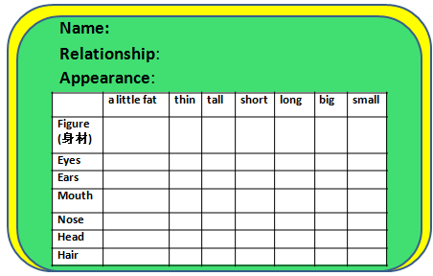
Step 2
Choose and fill in the information card

Slide 6
Who is he?
Name:
He Xi
father
Relationship:
Appearance:
 | a little fat | thin | tall | short | long | big | small
Figure (身材)
Eyes
Ears
Mouth
Nose
Head
Hair
√
√
√
√

Slide 7
f ther
a
a
a
a

Slide 8
I Read and circle ‘he, father’
Hello, I’m Joe. There are four people in my family. They are my father, mother, sister and me. Look, he is tall and thin. He has short hair. He has two big eyes. Guess, who is he? Yes, he is my father. His name is He Xi.

Slide 9
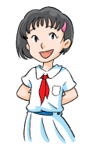
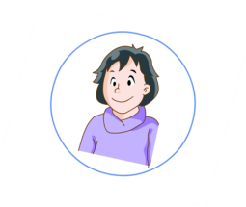
Who is she?
Name:
Yang Tiantian
Relationship:
mother
Appearance:
 | a little fat | thin | tall | short | long | big | small
Figure (身材)
Eyes
Ears
Mouth
Nose
Head
Hair
√
√
√
√

Slide 10
Nothing loves more than a mother loves her son.
o
o
o
o
o
o
m ther

Slide 11
II Read and circle ‘she, mother’
Hello, I’m Alice. There are three people in my family. They are my father, mother and me. Look, she is short and a little fat. She has short hair. She has a big mouth. Guess, who is she? Yes, she is my mother. Her name is Yang Tiantian.

Slide 12
Hello, I’m Kitty. There are four people in my family. They are my father, mother, brother and me. Look, he is tall. He has black hair. He has a small nose and big head. Guess, who is he?
brother
Yes, he is my brother.
His name is Li Wei.

Slide 13
o
br ther

Slide 14
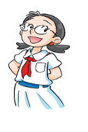
brother
big
little
哥哥
弟弟
10
8

Slide 15
III Read and fill in the information card
Name:
Li Wei
Relationship:
brother
Appearance:
 | a little fat | thin | tall | short | long | big | small
Figure (身材)
Eyes
Ears
Mouth
Nose
Head
Hair
√
√
√

Slide 16
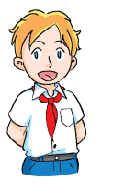
Who is she?
7
9
Little sister 妹妹
Yes, she is my little sister. Her name is Sally.
Yes, she is my sister. Her name is Sally.

Slide 17
i
s ster

Slide 18
Indian
in
six
big
pig
fish
little

Slide 19
IV Look at the picture and fill in the information card
Name:
Relationship:
Appearance:
 | A little fat | thin | tall | short | long | big | small
Figure (身材)
Eyes
Ears
Mouth
Nose
Head
hair
She is…
Her name is…
She is…
She has…

Slide 20
Play a game
sister
i

Slide 21
Play a game
mother
o

Slide 22
Play a game
father
e

Slide 23
Play a game
brother
r

Slide 24
brother
mother
father
sister

Slide 25
V Fill in the information card and introduce
S1:Hello, I’m…
There are… people in my family.
They are my …
Look,…is…and…
…has …and...
Guess, who is …?
S2: Is he /she your…?
S1: Yes/No…is my…
His/her name is…
Name:
Relationship:
Appearance:
 | a little fat | thin | tall | short | long | big | small
Figure (身材)
Eyes
Ears
Mouth
Nose
Head
Hair

Slide 26
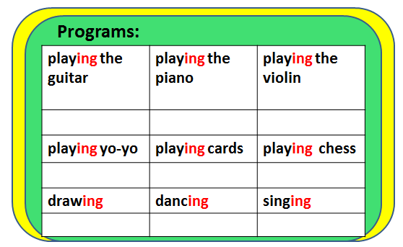
Step 3
Choose the program

Slide 27
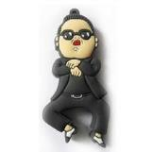
I can dance.
I like dancing.
I can dance very well.
I’m good at dancing.

Slide 28
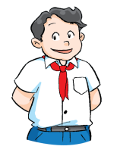
My father is good at playing the guitar.
I am good at playing the guitar too.
So we like playing the guitar at the Family Show.
Programs:
playing the guitar | playing the piano | playing the violin
playing yo-yo | playing cards | playing chess
drawing | dancing | singing
√

Slide 29
VI Choose the program
My…is good at…
I am good at…
So we like…(ing)...
Programs:
playing the guitar | playing the piano | playing the violin
playing yo-yo | playing cards | playing chess
drawing | dancing | singing

Slide 30
Who is he/she?
He /She is my…
He /She is good at…
I am good at…too.
So we like …at the Family Show.

Slide 31
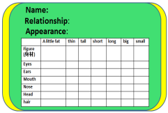
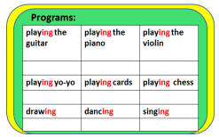
Step 4
Submit and introduce

Slide 32
worksheet
VII Circle ‘he or she’ , complete the passage and introduce
Hello, I’m . There are______ people in my family. They are my , , and . Look, he/ she is my . His /Her name is . He/ She is ____________. He/ She has _____________.
is good at___________. I am good at________________ too. So we like ______________________at the Family Show.

Slide 33
规范书写歌
句子开头一定要大写，
姓名称呼也不忘记。
缩写标点符号写上去，
就不怕老师来找你。

Slide 34
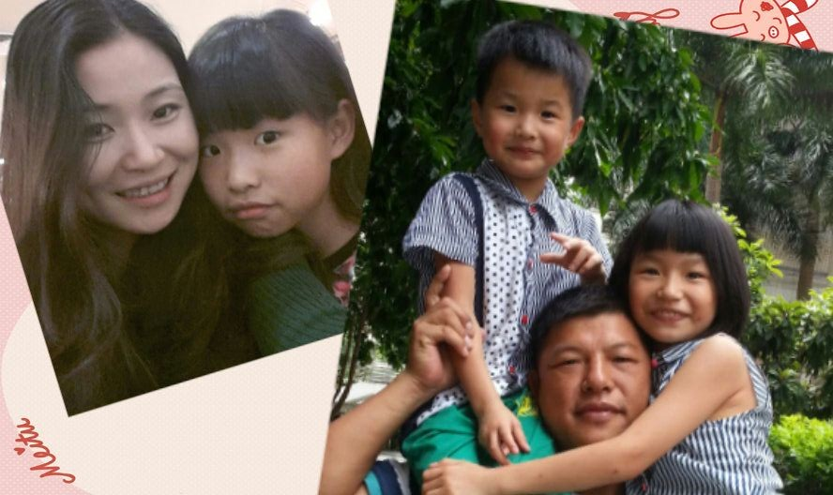
I love my family. I also love my classmates. We study together. We play together too. We are a big family.

Slide 35
HOMEWORK
Fill in the information
card and introduce by
using these sentences:
He / She is my…
He / She is …
He / She has…
He / She is good at…
Follow the structure, then
write an essay about your family

Slide 36
My family
There are…people in my family.
They are my…
Look, he / she is my…
His / Her name is …
He / She is…
He / She has…
He / She is good at…
I love my family.
Photo

