Slide 1
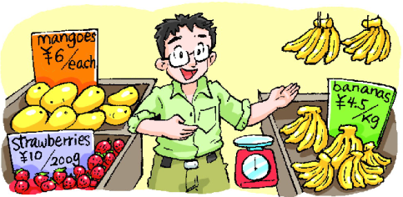
At the fruit shop
8
第三课时
WWW.PPT818.COM

Slide 2
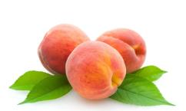
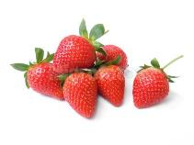
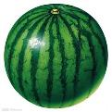
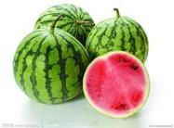
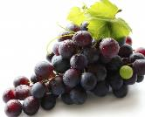
Point and say
peach peaches
strawberry strawberries
watermelon watermelons
grape grapes

Slide 3
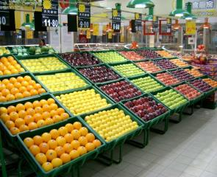
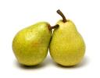
Say and act
Can I help you?
How much is it?
At the fruit shop
_____, please.
How much are they?
I like ____(s).
Thank you.
___ yuan, please.
Here you are.

Slide 4
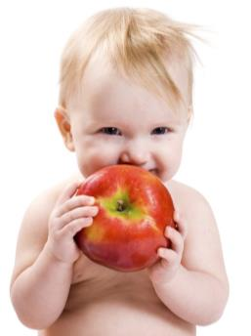
Let’s chant
Big apple, small apple,
One and two.
Big apple, small apple,
For you and me.
A big apple!
A small apple!

Slide 5
Let’s chant
Big _____, small _____,
One and two.
Big _____, small _____,
For you and me.

Slide 6
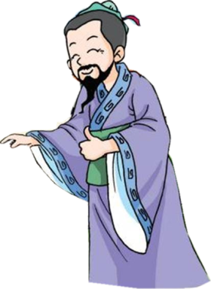
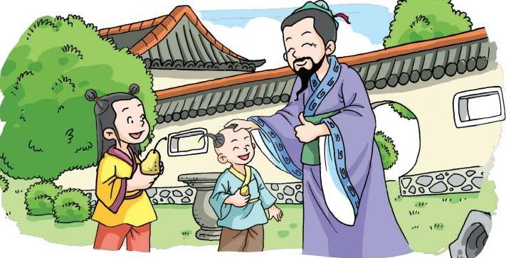
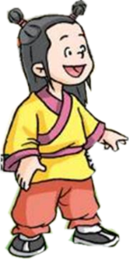
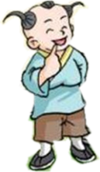
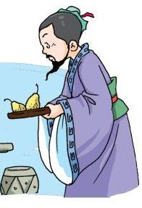
Ask and answer
Q1: Who are they?
Q2: What fruit are they?
Q3: Which one is for Kong Rong/his brother?
The big pear!
pears
Kong Rong
Brother
Dad
The small pear!

Slide 7
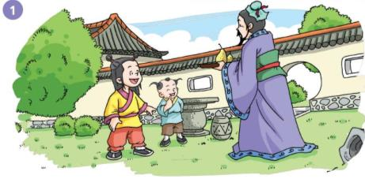
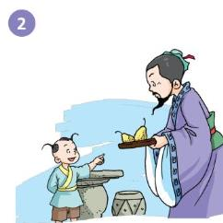
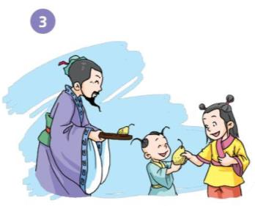
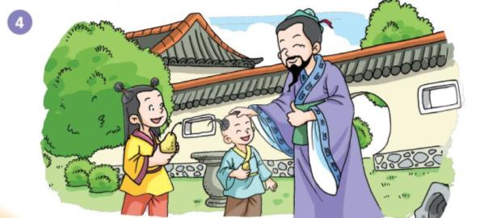
Say and act

Slide 8
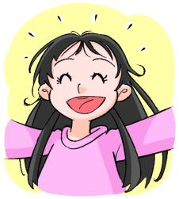
Point and say
M m
E e
A a
B b
C c
D d
E e
F f
G g
I i
D d
C c
K k
H h
I i
J j
K k
L l
M m
N n
H h
J j
C c
G g
L l
A a
F f
N n
B b

Slide 9
O
o

Slide 10
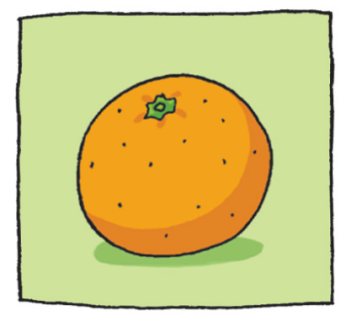
orange
o-r-a-n-g-e

Slide 11
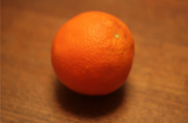
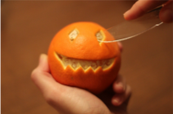
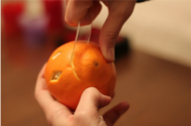
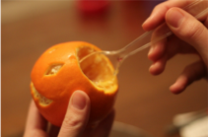
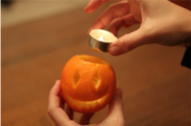
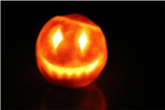
Make an orange lantern
Take a big orange.
Cut a face.
Cut out a circle. Don’t throw it away!
Take out the inside.
Put a candle inside your orange and light it.
Now you have your own orange lantern.

Slide 12
P
p

Slide 13
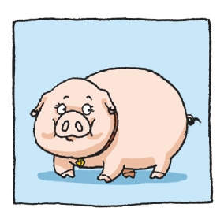
pig
p-i-g

Slide 14
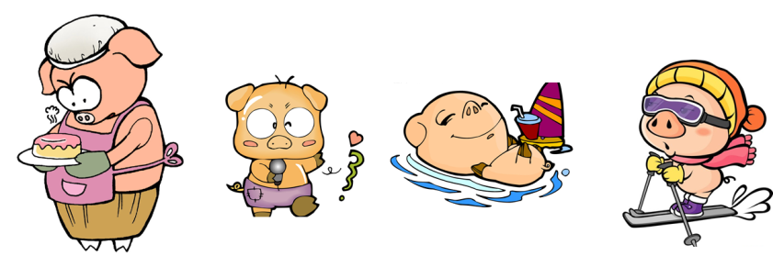
A Superpig!
It can ...
cook
sing
swim
ski

Slide 15
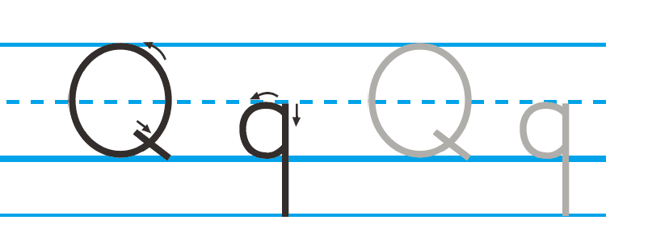
Q
q

Slide 16
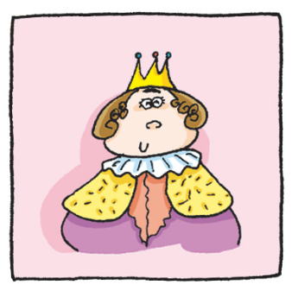
queen
q-u-e-e-n

Slide 17
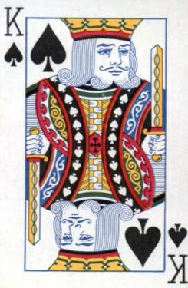
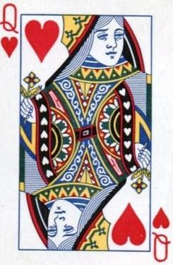
Queen
King

Slide 18
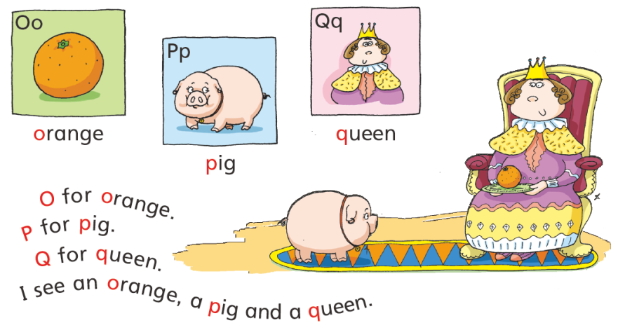

Slide 19
Match and say
P
D
O
B
Q
C
G
b
q
g
p
d
o
c

Slide 20
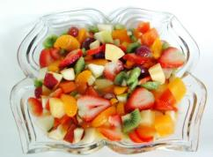
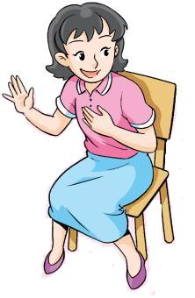
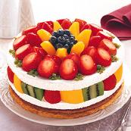
Say and act
I want to make ______. I need some fruit. Can you help me?
a fruit salad
some juice
a fruit cake

Slide 21
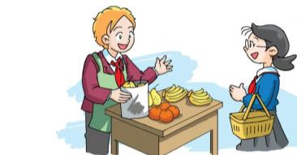
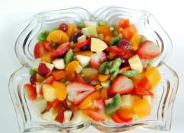
Say and act
Step 1 Discuss and write.
Step 2 Say and act.
some fruit salad
a fruit cake
some juice

Slide 22
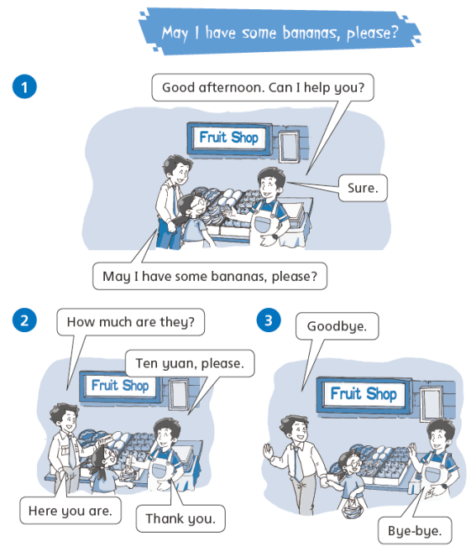
Let’s learn more!

Slide 23
Homework
1 Copy the letters and words.
O o P p Q q
good here how much it they
2 Read the story on Page 40.
3 Make an orange lantern.

