Slide 1
Unit 2 This is my sister.
Section B (2a～3b)
WWW.PPT818.COM

Slide 2
1．Here are two nice photos of my family.这有两张我的漂亮的全家福。
(1)英语中，把东西给对方时，常用Here be(is/are)…这一倒装句型。其中be动词的单复数并不取决于here，而是由其后真正的主语决定，主语是可数名词单数形式时用is；主语是名词复数形式时用are。eg：
Here's a book.这儿有一本书。
但是，如果主语是代词时，则主语还是位于动词前。eg：
Here you are.给你。
Here it is.东西在这儿。
(2)the photo of my family我的家庭照
也可以说成my family photo。of表示“……的”，它常用来表示无生命类名词的所有关系。

Slide 3
2．These are my parents，Alan and Mary.这是我的父母，艾伦和玛丽。
句中的parents和Alan、Mary是同位语关系。Alan和Mary是用来进一步说明my parents。同位语指一个名词在另一个名词的后面，进一步说明前一个名词代表的是谁或什么事物。

Slide 4
3．重点词组归纳：
in the first photo
在第一张照片里
in the next photo
在下一张照片里
these two girls
这两个女孩
in my family
在我家中

Slide 5
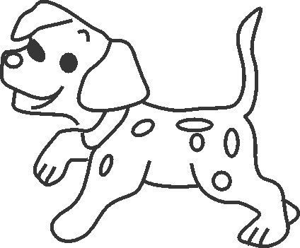
一、根据句意及汉语提示写单词完成句子。
1．________(这儿)is your pen.It is blue.
2．This is a _________(照片)of my family.
3．In the ________(下一个)photo are my mother and brother.
4．My good friend is a _______(女孩)．
5．—What's this in English?
—It's a ________(狗)．
Here
photo
next
girl
dog

Slide 6
二、用所给词的适当形式填空。
6．Are _________(that) your parents?
7．These _________(be) my friends.
8．They are his ________(son)．
9．In the _________(one) photo are my sisters.
10．Those are their _________(photo)．
those
are
sons
first
photos

Slide 7
三、单项选择。
11.Here ______ two nice photos ______ my family.
A．is，of B．are，of
C．am，of D．are，in
12．My father's ______ is my uncle.
A．sister B．son
C．brother D．father
13．In ______ first photo are my brothers，Bob and Eric.
A．/ B．a
C．the D．an
B
C
C

Slide 8
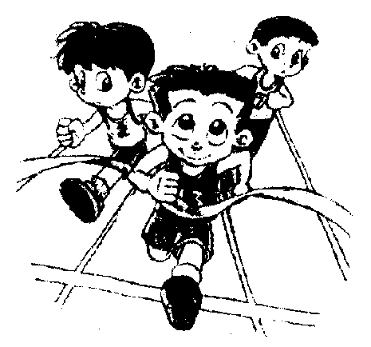
14．______ are my sister and my cousins.
A．Three these girl
B．These three girl
C．These three girls
D．Three these girls
15．______ the picture are my three friends，Dale，Jack and Mike.
A．Of B．In
C．To D．And
C
B

Slide 9
四、根据汉语完成句子。
16．这些是我的朋友。
______________my friends.
17．那是一张我的家庭照。
That is ________________my family.
18．这里有五本书。
________________five books.
19．那是我的两个兄弟。
Those are my _________________．
20．Big Big是我家狗的名字。
Big Big is the name __________________．
These are
a photo of
Here are
two brothers
of my dog

Slide 10
五、完形填空。
Look！Here is a photo 21. _____ my family.I have(有) a big family.My 22.______are very old now.My grandfather is 70 years old and my grandmother 23. _____ 69 years old.I have an 24.________．He's my father's 25. ______.I have two 26. ________．They're my mother's sisters.I have 27. _______ cousins—a boy and a girl.They are my uncle's 28. _______ and daughter.I have a sister，too.But(但是) she 29. ______ in the photo.I am in a big 30. _______．I love my family.
B
A
C
C
A
B
B
C
A
B

Slide 11
21．A.at B．of C．in
22．A.grandparents B．parents
C．grandfather
23．A.am B．are C．is
24．A.eraser B．orange C．uncle
25．A.brother B．father C．sister
26．A.sons B．aunts C．brothers
27．A.one B．two C．three
28．A.boy B．girl C．son
29．A.isn't B．are C．is
30．A.school B．family C．Class

