Slide 1
Unit 5 Let’s celebrate! Grammar
WWW.PPT818.COM

Slide 2
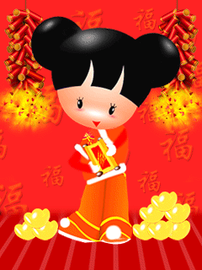
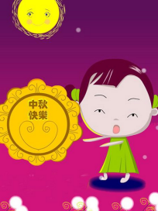
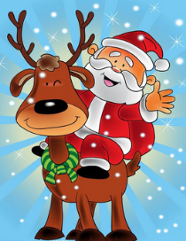
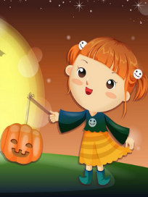
Free talk
Your favourite festival
What? When? Why?

Slide 3
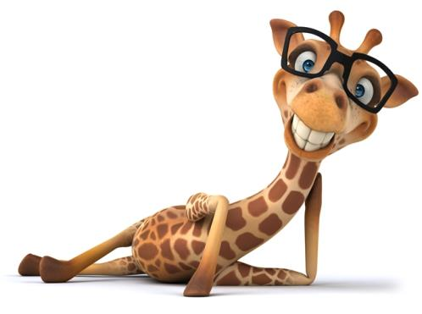
How many “wh-” words do you know?
what
which
who
whose
when
where
why
how

Slide 4
Work in pairs
Use “wh-” questions to ask information about your partner.
What do you like to do at weekends?
Which lesson do you like best?
Who is your best friends?
When is your birthday?
Where do you live?
How do you go to school every day?
…

Slide 5
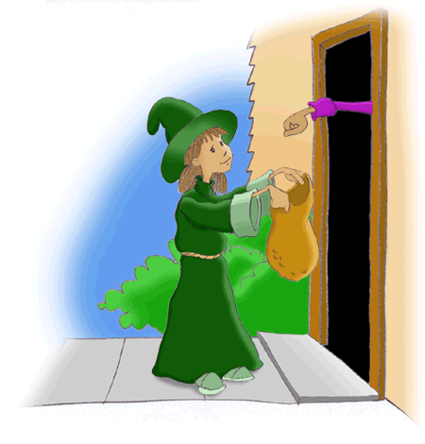
What do you do for Halloween?
We play a game called “trick or treat”.
What’s this?
It’s a pumpkin lantern.

Slide 6
Which would you like?
√
I would like this red one.

Slide 7
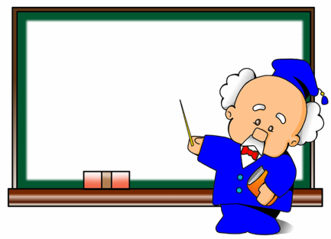
Who is Mr Wu?
Mr Wu teaches us English.
He is our English teacher.

Slide 8
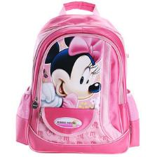
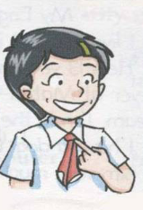
Whose bag is this?
It’s Millie’s.
Millie

Slide 9
When is his birthday？
It’s on 18 May.

Slide 10
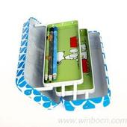
Where are the pencils?
They are_______________.
in the pencil case

Slide 11
Why is he so happy?
Because it’s his birthday.

Slide 12
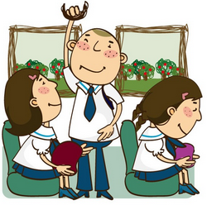
How does the students go to school?
They go to school
________.
by bus

Slide 13
Let’s see the family of “how”
How many
How much
How old
How long
How often
How tall
How far
多少（可数名词 ）
多少（不可数名词）
多大岁数（年龄）
多长时间（时间长度）
多久……一次（频率）
多高（高度）
多远（距离）

Slide 14
Have a try
1._________ is the dog? 10 days old.
2._________ does Lily watch TV? Twice a week.
3.__________ cups of coffee are there? Only one.
4._________ is the river? Twenty miles (英里).
5.__________ coffee is there? There isn’t any.
6._________ do you exercise every day?
For one hour.
7._________ is Millie? 1.37m tall.
8._________ is your school from your home?
About 10 minutes’ walk.
How old
How often
How many
How long
How much
How long
How tall
How far

Slide 15
We use “wh-” questions to ask for information about someone or something.
“Wh-” word | Use in questions
What | To find out activities or things
Which | To ask about things or persons
Who | To find out persons
Whose | To ask about possession
When | To ask about time
Where | To ask about places
Why | To ask about reasons
How | To find out ways of doing sth

Slide 16
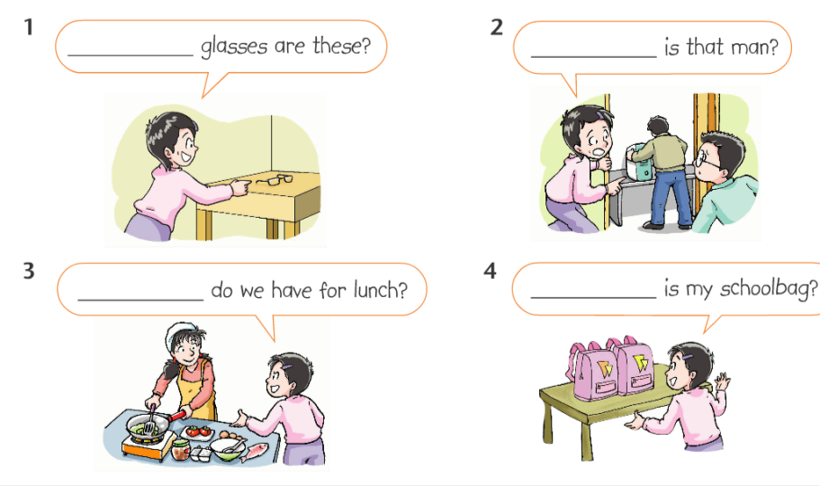
Part A
Whose
Who
What
Which

Slide 17
Practice 1
Ask and answer in pairs:
Questions Answer
______ is she? She is my cousin.
______ does she do? She is a teacher.
______ does she work? She works in Nanjing.
______ does she work in a school?
Because she likes children.
5.______ does she go to work? By bus.
6.______ does she go to work? At 7 o’clock.
Who
What
Where
Why
How
When

Slide 18
Part B
Where
It’s on the ground floor.
_______ is your classroom?
_______ mask is this?
_______ is that girl?
_______ does he want for
Christmas?
_______ present is for
Daniel?
6. _______ do you celebrate
Christmas?
7. _______ is your birthday?
8. _______ do you want rice
dumplings?
Whose
It’s Amy’s.
Who
That’s Kitty.
What
He wants a toy train.
Which
The blue one.
Family members get together and give each other presents.
How
When
It’s on 1 August.
Why
Because the Dragon Boat Festival is coming.

Slide 19
Practice 2
Turn these statements into “wh-’ questions.
1. This room is Tom and Bob’s.
___________________________________
2. Miss Green is my English teacher.
____________________________________
3. I buy this card because I like the picture.
____________________________________
4. We celebrate Christmas by giving presents.
___________________________________
5. The shoes in the box are for Jack.
___________________________________
Whose is this room?
Who is Miss Green?
Why do you buy this card?
How do you celebrate Christmas?
Which shoes are for Jack?

Slide 20
Part C
Millie: What a nice cake! _______ birthday is it today?
Amy: It’s my birthday, Millie.
Millie: Happy birthday, Amy! _______ do you usually celebrate
your birthday?
Amy: We go out for a birthday dinner.
Millie: ______ goes to your birthday dinner?
Amy: My grandparents, aunts, uncles, and cousins.
Millie: I see. _______ do you have the dinner?
Amy: At a restaurant near my home.
Millie: _______ do you get as birthday presents?
Amy: Books, clothes, shoes, toys, and some other nice things.
Whose
How
Who
Where
What

Slide 21
Work in pairs and ask as many questions as you can.
Millie’s Party
Birthday: 5th December
Day: next Sunday
Time: 4 p.m.
Place: her home
…

Slide 22
Discussion
What can we do for Millie’s party?
What do you want to buy?
Where can we buy the presents?
How do we go to her party?
When do you want to go shopping?
How do we celebrate her birthday?

Slide 23
Homework
Remember all the wh-
words.
2. Work in pairs. Use wh- questions to talk about festivals.

