Slide 1
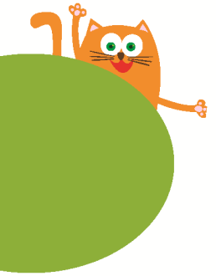
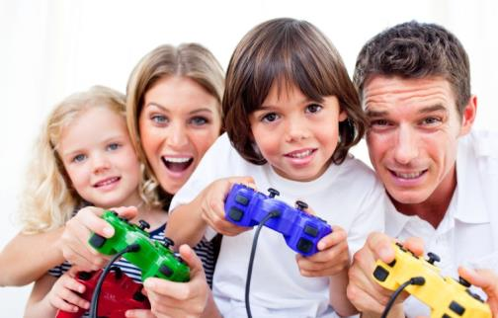
6
My parents
WWW.PPT818.COM

Slide 2
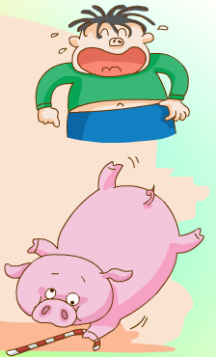
Jim has a pig.
His pig is big.
His pig is pink.
The big pig is playing
with a stick.
Jim

Slide 3
Read and judge
kite pig ( )
stick picture ( )
lion is ( )
ride nine ( )
this swim ( )
biscuit nice ( )
F
T
F
T
T
F

Slide 4
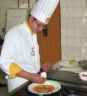
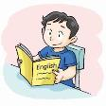
Guess the riddles
He drives a bus every day. What does he do?
2. He cooks nice and yummy food. What does he do?
3. She goes to school and studies (学习) every day.
What does she do?
4. She goes to school every day too.
But she isn’t a student.
She has many students. What does she do?
5. She works in a hospital (医院). But she isn’t a doctor.
She helps the sick people. What does she do?

Slide 5
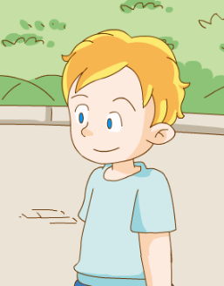
Let’s chant
What does your father do?
What does your father do?
He is a teacher. He is a teacher.
What does your mother do?
What does your mother do?
She is a doctor. She is a doctor.

Slide 6
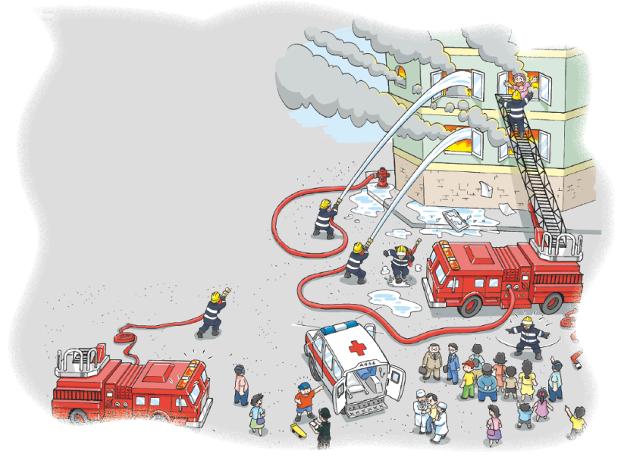
Look and learn
fire
fire engine
firemen

Slide 7
T or F?
F
1. The fire is small. ( )
2. People are not afraid. ( )
3. The fire engine is coming. ( )
4. The firemen can put out(扑灭) the fire. ( )
F
T
T

Slide 8
Watch and answer
1. Where do the students and their teacher go?
2. Who works there?
3. What can they see?
4. Can children play with fire?
5. Does Mr Xu like his job?

Slide 9
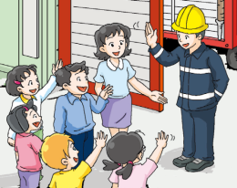
Think and answer
1. Where do the students and their teacher go?
2. Who works there?
3. What can they see?
4. Can children play with fire?
5. Does Mr Xu like his job?
They go to a fire station.
Mr Xu works at the fire station.
They can see a big fire engine.
No, they can’t.
Yes, he does.

Slide 10
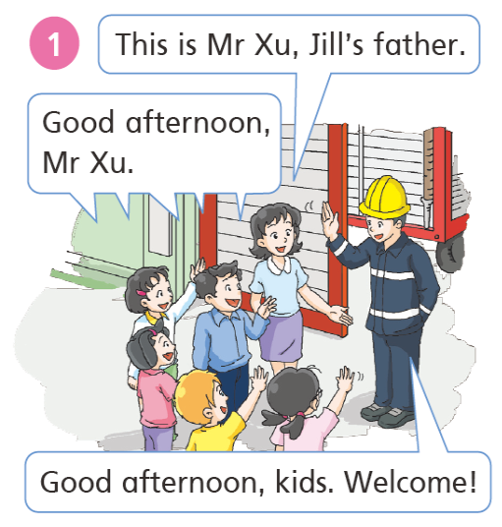
Look , read and answer
Where are they?
2. Who is this man?
3.What does he do?
In the afternoon, the students visit a fire station with their teacher, Miss Fang. Mr Xu is Jill’s father. He works there. He is a fireman.
They are at a fire station.
He is Mr Xu, Jill’s father.
He is a fireman.

Slide 11
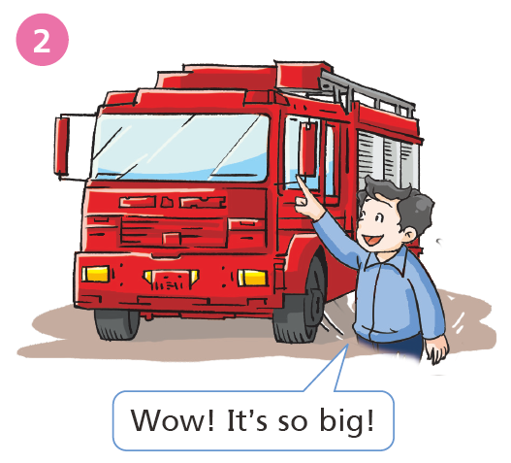
Look , read and answer
What is this?
2. How is it?
It’s a fire engine.
It’s so big.
They can see a big fire engine at the fire station.

Slide 12
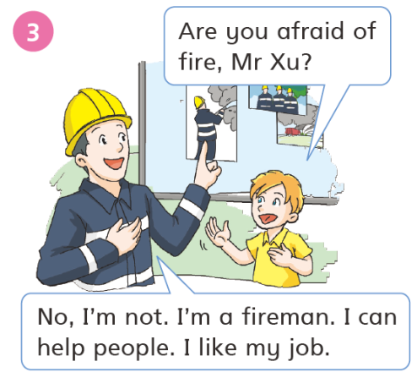
Look , read and answer
Mr Xu is a fireman. He isn’t afraid of fire. He is very brave.
He likes his job, because he can help people.
Is Mr Xu afraid of fire?
Why?
No, he isn’t.
He’s a fireman.
He’s brave.
He likes his job.

Slide 13
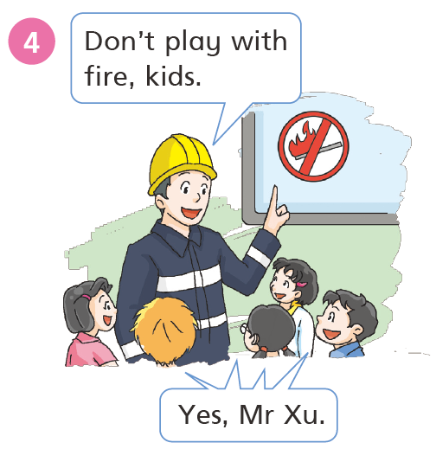
Look , read and answer
What does Mr Xu say?
Why?
Don’t play with fire, kids.
It’s dangerous.
Students shouldn’t play with fire.
It is dangerous.

Slide 14
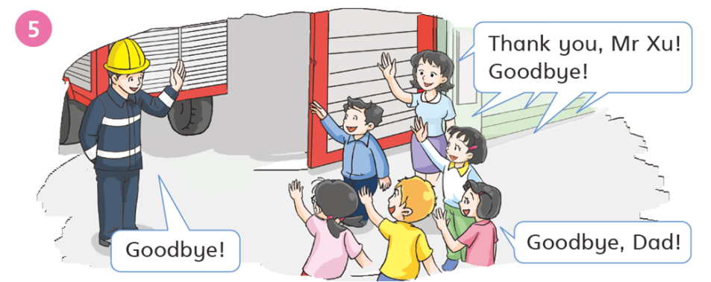
Look and read
The students learn a lot about fire.
They have a great day.

Slide 15
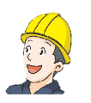
In the afternoon, the students do not have any classes. They want to visit the fire station. Jill’s father, Mr Xu, works there.
This is Mr Xu. Jill’s father.
Good afternoon, Mr Xu.
Good afternoon, kids. Welcome!
Wow! It’s so big.
Are you afraid of fire, Mr Xu?
No, I’m not. I’m a fireman. I can help people. I like my job. Don’t play with fire, kids.
Yes, Mr Xu. Thank you, Mr Xu! Goodbye!
Goodbye!
Goodbye, Dad!

Slide 16
Read and complete
Visiting a fire station
_______________________________
In the ________, the _______ visit a fire station with their teacher, Miss Fang. Mr Xu is Jill’s ______. He works there. He is a ______.
In the fire station, the students can see a big fire _______. Mr Xu isn’t _______ of fire. He _______ his job, because he can _______ people. Mr Xu tell the kids not to __________ fire. The students have a ________ day today!
afternoon
students
father
fireman
engine
afraid
likes
help
play with
great

Slide 17
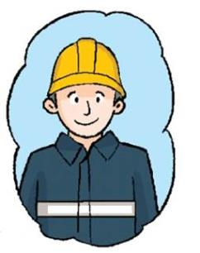
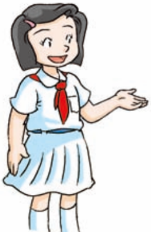
Look and read
My father’s job
This is my father.
He is tall and thin.
He is a fireman.
He works at the fire station.
He is brave.
He can put out a fire.
He can help people.
He likes his job.

Slide 18
Think and write
My _____’s job
This is my _______.
He/She is ___________.
He/She is a _________.
He/She works at a ______.
He/She can ________.
He/She likes his/her job.

Slide 19
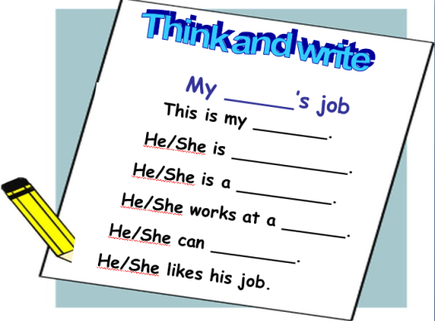
Homework
听读并背诵P28。
完成写话。(1号本，周二早上交)
提醒：周二带活动手册。

