Slide 1
七年级上册
Starter Unit 3
What color is it?
第2课时
WWW.PPT818.COM

Slide 2
学习目标
1.能够地描述物体的颜色,同时进一步拓展创新,运用到实际生活中。
2.学会26个字母的读音
3.把26个字母按/eI/ /i:/ /e/ /ju:/ /aI/读音归类

Slide 3
知识回顾
What colour is it?
green
black
blue
red

Slide 4
知识回顾
What colour is it?
white
yellow
purple
brown

Slide 5
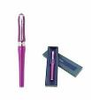
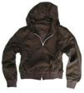
知识回顾
purple
A: What’s this?
[ə:]
B: It’s a/an….
A: What color is it?
[ʌ][ə]
red
B: It’s ….
[e]
brown
[ai]
[au]
white
[e][əu]
green
yellow
[i:]
black
[æ]
blue
orange
[C]
[i]
[u:]

Slide 6
新课学习
26个字母的读音
Aa/ei/ Bb/bi:/ Cc/si:/ Dd/di:/ Ee/i:/ Ff/ef/ Gg/dʒi:/ Hh/eitʃ / Ii/ai/ Jj/dʒei/ Kk/kei/ Ll/el/ Mm/em/ Nn/en/ Oo/əu/ Pp/pi:/ Qq/kju:/ Rr/a:(r)/ Ss/es/ Tt/ti:/ Uu/ju:/ Vv/vi:/ Ww/'dɅblju:/ Xx/eks/ Yy/wai/ Zz/zi:/或/zed/

Slide 7
分组活动
小组讨论
1 组
2 组
3 组
4 组
学生观察字母发音的规律,然后进行归类。

Slide 8
新课学习
把26个字母按读音归类
/ei/
/i:/
/e/
/ai/
/ju:/
Oo
Rr
Aa Hh Jj Kk
Bb Cc Dd Ee Gg Pp Tt Vv Zz
Ff Ll Mm Nn Ss Xx (Zz)
Ii Yy
Qq Uu Ww
五个元音字母： Aa Ee Ii Oo Uu

Slide 9
听力训练
3a.Listen and color the things.

Slide 10
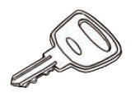
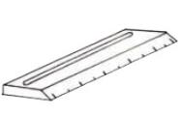
听力训练
3b. Listen again. Complete the sentences.
The key is yellow .
blue
The ruler is .
red
The cup is .

Slide 11
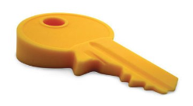
口语训练
3d. Make conversations using the things in 3a-3c.
What's this in English?
It's a key.
Spell it, please.
K-E-Y.
What color is it?
It's yellow.

Slide 12
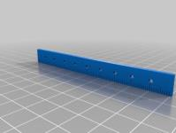
口语训练
Pair work
3d. Make conversations using the things in 3a-3c.
What's this in English?
It's a ruler.
Spell it, please.
R-U-L-E-R.
What color is it?
It's blue.

Slide 13
口语训练
Pair work
3d. Make conversations using the things in 3a-3c.
What's this in English?
It's a cup.
Spell it, please.
C-U-P.
What color is it?
It's red.

Slide 14
分组活动
小组讨论
1 组
2 组
3 组
4 组
总结本课自己的收获，小组内交流。

Slide 15
本课总结
把26个字母七个家
/ei/
/i:/
/e/
/ai/
/ju:/
Oo
Rr
Aa Hh Jj Kk
Bb Cc Dd Ee Gg Pp Tt Vv Zz
Ff Ll Mm Nn Ss Xx (Zz)
Ii Yy
Qq Uu Ww

Slide 16
作业布置
1.主题讨论：仿写对话根据Starter Unit 3 3d.
2.背诵字母A到Z。
3.预习Unit 1 1a-1d (Unit 1 Section A（1a-1c）导学案）
4.听101名师微课My name’s Gina.-Section A核心词汇

