Slide 1
Module 3
Unit 1 The sun is shining.
WWW.PPT818.COM

Slide 2
Learning goals
能够掌握单词: cry, cow。
能够用现在进行时描述正在发生的事情。
能够用现在进行时描述照片或图片中的场景。

Slide 3
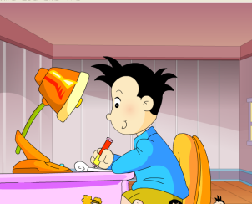
Lead-in
What is Daming doing?
A. Writing a letter.
B. Reading a letter.

Slide 4
What is Lingling doing?
A. Writing a letter.
B. Reading a letter.

Slide 5
What is he doing?

Slide 6
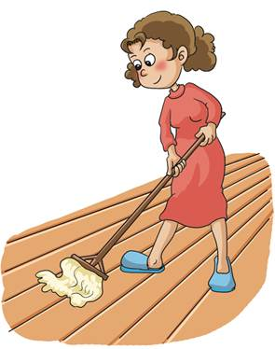
What is she doing?

Slide 7
课文学习
1 Look, listen and say.
Look at the naughty bird.
It's flying.
Look at the little dog.
It's crying.

Slide 8
2 Listen and read.
Dear Lingling,
How are you? I had a very interesting day on Saturday.
We had a picnic in the park. I am sending you some
photos.
I miss everyone in China. Please write to me soon.
Love,
Daming

Slide 9
Look at these photos!
In this photo, the sun is shining. The birds are singing in the tree. We are looking at some ducks. They look hungry.

Slide 10
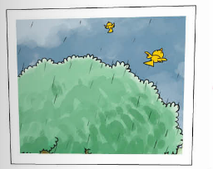
In this photo, it's starting to rain and the birds are flying away.

Slide 11
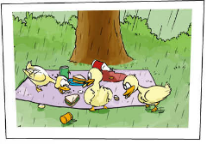
And just look at this! The ducks are eating our sandwiches!

Slide 12
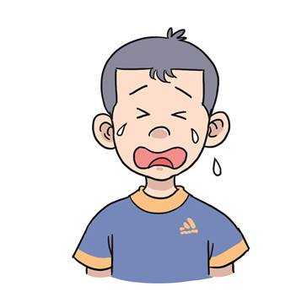
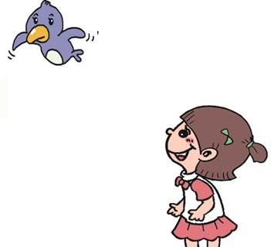
New words
shine
cry
fly away

Slide 13
课文理解
Read and answer.
1. What is Daming sending?
He is sending some photos.
2. Where are the birds singing?
The birds are singing in the tree.
3. What are the ducks eating?
The ducks are eating the sandwiches.

Slide 14
补充学习
重点语法
现在进行时
主语+ am / is / are + 动词-ing+其他.

Slide 15
Example
reading
He is _________ a book.

Slide 16
are listening
They ______________ to music.

Slide 17
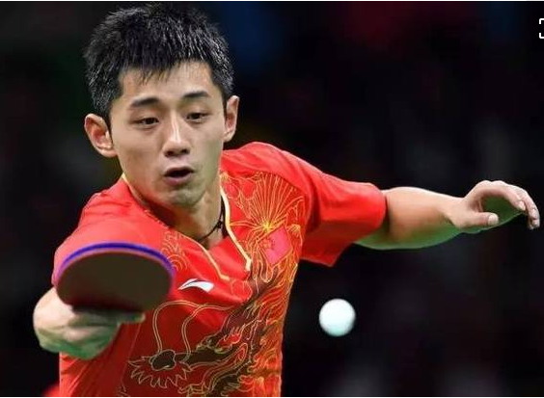
is playing table tennis
He _____________________________.

Slide 18
is taking pictures
She _____________________________.

Slide 19
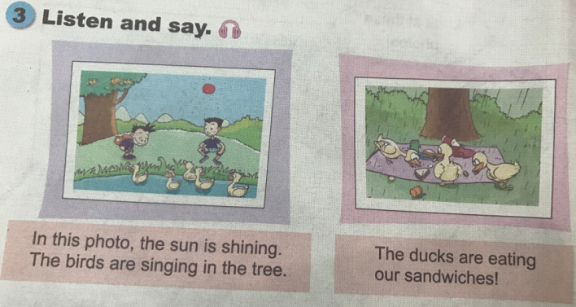
课文学习

Slide 20
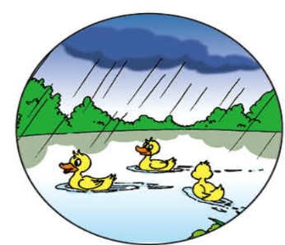
4. Practise.
In this photo, it’s__________. The ducks __________________on the pond.
raining
are swimming

Slide 21
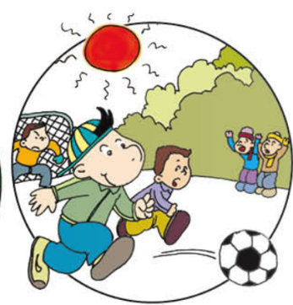
In this photo, it’s__________. The boys __________________________.
sunny
are playing football

Slide 22
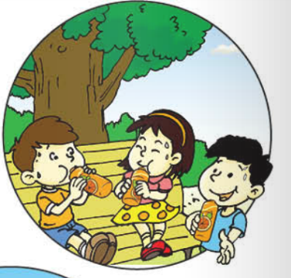
In this photo, it’s__________. The children _________________________________.
hot
are drinking orange juice

Slide 23
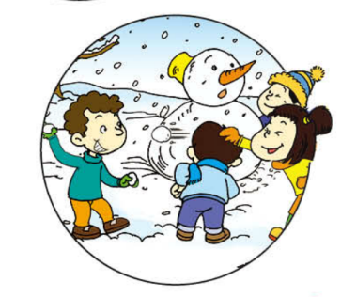
In this photo, it’s__________. The children ____________________________.
snowy
are playing in the snow

Slide 24
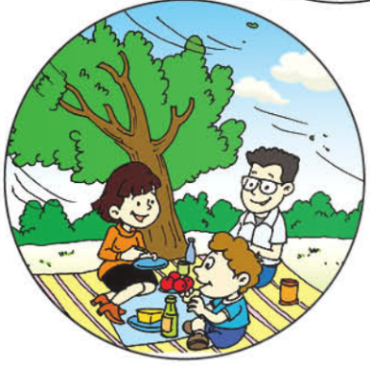
In this photo, it’s__________. The family __________________________.
windy
are having a picnic

Slide 25
Exercise
用下列词的正确形式填空。
I am (swim) now.
He (be) doing homework now.
3. We are (look at) some ducks.
4. The sun is (shine).
5. They (have) a birthday party.
swimming
is
looking at
shining
are having

Slide 26
Homework
Read the text to your family.
Choose a photo and describe it to your partner.

