Slide 1
Unit 6 Topic 3
I will remember our friendship forever.
Section D
WWW.PPT818.COM

Slide 2
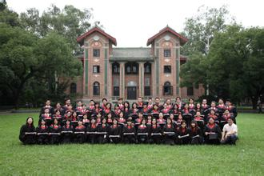
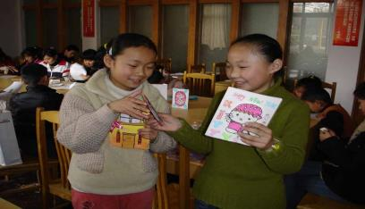
What will you do during the graduation ceremony?

Slide 3
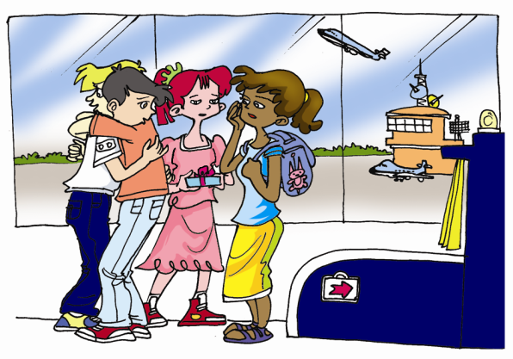
Talk about your feelings when you say goodbye to each other.

Slide 4
1a Can you put the following sentences back in
the proper places?
A. Jane comes in a hurry.
B. Kangkang is seeing Jane, Michael and Maria off at the airport.
C. Jane, Michael and Maria give big hugs to Kangkang.

Slide 5
1b Read 1a and mark T ( True) or F ( False).
Jane is almost late for her plane. ( )
Jane’s family set off late for the airport because they said goodbye to so many people. ( )
Kangkang doesn’t like to write, so Maria asks him to promise to write e-mails to them. ( )
We can conclude that Michael often did crazy things on his skateboard. ( )
Jane’s flight is the one that leaves first. ( )
T
T
F
T
T

Slide 6
Key points
1. Kangkang is seeing Jane, Michael and Maria off at the airport.
see … off 为……送行
eg：I will see you off when you go back home.

Slide 7
Key points
2. Jane, Michael and Maria give big hugs to
Kangkang.
热烈拥抱某人

Slide 8
Key points
3. I’m sure she’ll join us any minute now.
很快；随时

Slide 9
Key points
4. You must promise to send e-mails to us often.
v. 许诺，保证
promise sb. to do sth. 承诺某人做某事
eg. The little boy promised her mother to finish his homework in 20 minutes.

Slide 10
Group work：
Act out the conversation in groups.

Slide 11
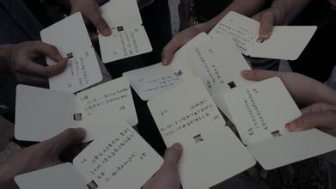
Let’s make graduation cards.

Slide 12
Project
Making an Address Book
Collect information from your classmates and friends. The following details should be included：
name/photo/nationality/age/telephone number/address/ postal code/e-mail address/star sign/hobby/motto/ favorite color/appearance/…

Slide 13
You can make a chart and fill it in.
Name
Address
Telephone number
E-mail
Motto
Star sign
Hobby

Slide 14
Summary
hug n. 拥抱 give a big hug 热烈拥抱
in time 及时 on time 按时
conclude v. 推断出
promise v.& n. 许诺，保证
promise to do sth. 许诺做某事
But you must promise to send e-mails to us often.

Slide 15
Functions
● Take it easy. We have worked so hard that we will
be able to pass it easily.
● I hope our friendship will last forever. I’m sure it will
be more and more valuable as time goes by.

Slide 16
中考链接
( ) He promised ______ his old friend during
his stay in Tianjin. (2013 南京)
A. see B. seeing
C. saw D. to see
D

Slide 17
Homework
Get your schoolmates to fill in your address book.

Slide 18
Should auld acquaintance be forgot, And never brought to mind? Should auld acquaintance be forgot, And days of auld lang syne.
And here's a hand, my trusty friend, And give a hand of thine, We'll take a cup of kindness yet, For auld lang syne.
For auld lang syne, my dear, For auld lang syne, We'll take a cup of kindness yet. For auld lang syne.
Auld Lang Syne
《友谊地久天长》歌曲

