Slide 1
Unit 7 Days and Months
Seasons and Weather
WWW.PPT818.COM

Slide 2
New words
n.星期一
adj.多雨的
n.星期二
n.星期三
n.游泳
adv.&prep.在外面
n.星期四
adj.下雪的
v.滑冰
Monday
rainy
Tuesday
Wednesday
swimming
outside
Thursday
snowy
skate

Slide 3
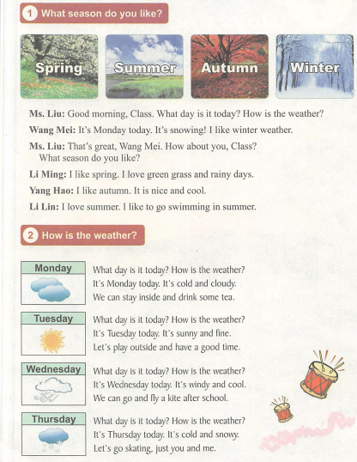
Listen and read

Slide 4
New Phrases
阅读课文找出下列短语
1.你喜欢什么样的季节?___________________
2........怎么样？___________________
3.我喜欢..._________
4.凉快_____________
5.我爱....______________
6.今天星期几？__________________
What season do you like?
How is the
I like....
Nice and cool
I love....
What day is it today?

Slide 5
Language points
◆ What day is it today? 今天星期几?
本句用来询问今天是星期几，常用答语是“It's+表星期几的单词. ”。
－What day is it today? 今天星期几?
－It's Monday. 今天星期一。

Slide 6
Language points
◆ How is the weather? 天气怎么样?
①本句用来询问天气情况，相当于“What's the weather like?”当询问某地的天气情况时，可在后面加“in／at+地点”。答语为：“It's+表天气的单词. ”。
－How is the weather in Beijing?=What's the weather like in Beijing?
－It's fine. (天气)晴朗。
② weather 是不可数名词，前面不能用不定冠词a或an。
I like nice weather. 我喜欢好天气。

Slide 7
Language points
◆ have a good time 玩得高兴
have a good time 为固定短语，后接动词时，用动词-ing形式，相当于have a great time，have fun或enjoy oneself等。
We have a good time in the park. 我们在公园玩得很高兴。

Slide 8
Language points
◆ go skating 去溜冰
“go+v. -ing”表示做体育运动或娱乐消遣，v. -ing前不能用数量词或some等修饰。
go shopping 去购物
go climbing去爬山

Slide 9
自主学习要求
学习以上内容，认真完成
1、预习案上的习题
2、老师布置的讨论作业
How many seasons are there in a year? What are they?
Which season do you like? Why?

Slide 10
再见

