Slide 1
Unit 8 Topic 2
The summer holidays are coming.
Section B
WWW.PPT818.COM

Slide 2
Review
Do you remember Kangkang's and his friends' holiday plans?
Kangkang wants to go to Canada.
Michael plans to go to Australia. He wishes to travel around the country and take pictures.
Maria wants to go back to Cuba. She hopes to get together with her grandparents.
Jane would like to visit some places of interest in China.

Slide 3
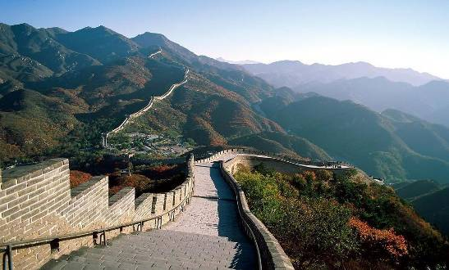
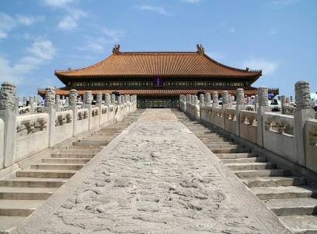
the Palace Museum
The Great Wall
There are so many places of interest , such as the Great Wall, the Palace Museum, West Lake and so on in our country.
Where do you want to go?

Slide 4
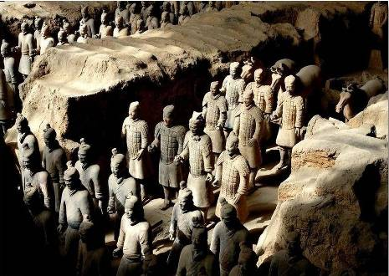
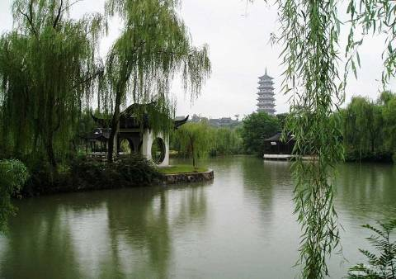
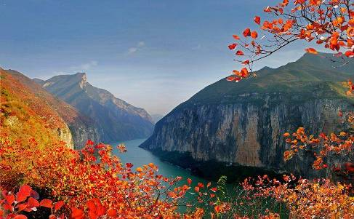
Terra-Cotta Warriors
West Lake
The Three Gorges

Slide 5
What would you like to take for your trips?
I want to take a bag. I can put many things in it.

Slide 6
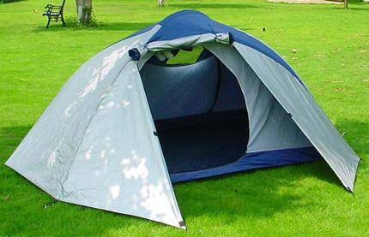
I plan to take a tent,
because I can sleep outdoors.

Slide 7
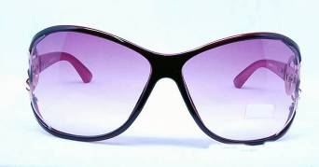
The sun shines brightly in summer.
I want to take a pair of sunglasses.

Slide 8
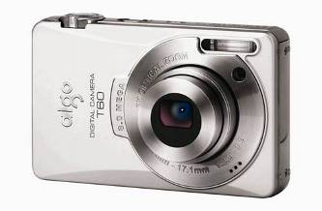
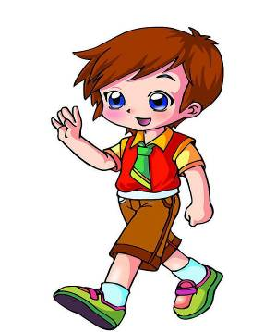
I want to have a camera with me.
I can use it to take pictures.

Slide 9
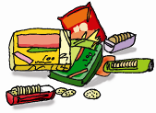
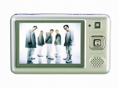
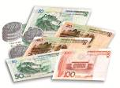
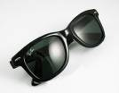
Listen and check(√) the things they want to take.
√
√
√
bag
food
camera
MP4
√
√
√
√
money
water
tent
umbrella
√
√
raincoat
book
sunglasses
map

Slide 10
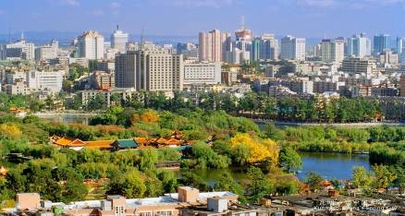
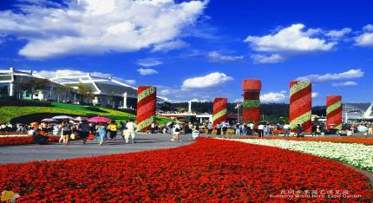
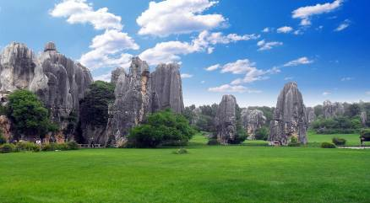
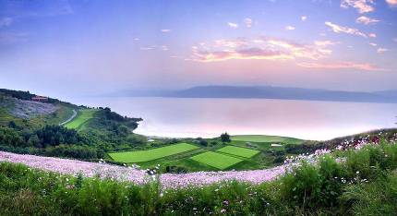
What's the best time to go there?
Kunming———the Spring City
We can go there anytime.
Because the weather there is fine all year round.

Slide 11
Listen and answer.
1.Is Zhou Weilun's hometown in Yunnan?
Yes, it is.
2. What places of interest should Jane visit there?
She should visit Dali and Lijiang. And she shouldn't miss Xishuangbanna.
3. What should Jane take to Yunnan?
She had better take a camera, a pair of sunglasses, a map and so on.

Slide 12
Listen to 1a and complete the table.
Best time to visit Yunnan | Places of interest | Things to take
anytime | Kunming, Dali, ______and________ | a map, _________ _______________ and so on
a camera
Lijiang
Xishuangbanna
a pair of sunglasses

Slide 13
Language notes:
1. What’s the best time to go there?
It is the best time to do sth.
正是干某事的最好时间。
2. I think you can go anytime. The weather there is always fine all year round.
anytime意为“在任何时候，随便什么时候”
all year round “一年到头”
3. You shouldn’t miss Xishuangbanna.
should, 情态动词, 意为 “应该”, 表示劝告, 建议、命令等。否定形式为shouldn’t。

Slide 14
Work in pairs and practice 1a. Then make up a new conversation about your hometown. Pay attention to the ways of asking questions and making suggestions.
Questions
...,can you tell me something about...?
What's the best time to go there?
What places should I visit in...?
What should I take with me?
Suggestions
You should visit...
You shouldn't miss...
You'd better take...
You'd better not take...

Slide 15
Suppose you're going on a trip. Work in groups and discuss the following questions.
1.Where would you like to go?
2.What's the weather like there?
3.How do you plan to go there?
4.Who would you like to go with?
5.What places of interest would you like to visit?
6.How much money do you plan to take?
7.What else would you like to take for your trip?

Slide 16
Write a short passage with the help of the questions in 3a.
You may begin like this:
The summer holidays are coming soon. I plan to go to
____________________________________________________________________________________________________________________________________________________________________________________________________________________________________________________________________________________
Beijing with my parents. I want to go there by train. I like the weather there . It’s sunny. I wish to visit the Great Wall, the Palace Museum and some other places of interest. I plan to take ¥2000 and I’d like to take a camera, a pair of sunglasses, a map, a bag and so on. I hope we’ll have a good time there.

Slide 17
Summary
主+should/shouldn’t+动词原形
It’s the best time to do sth.
You’d better+动词原形
Important phrases:
all year round
and so on
take sth. with sb.

Slide 18
Homework
1. Recite 1a.
2. Finish Section B in your workbook.
3. Preview Section C.

