Slide 1
Unit4 Do you like candy?
人教精通版三年级下册
WWW.PPT818.COM

Slide 2
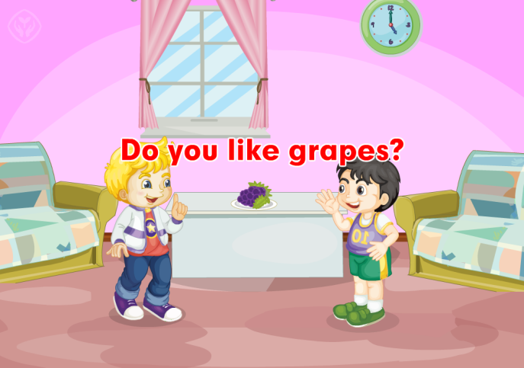
Review
Let’s sing

Slide 3
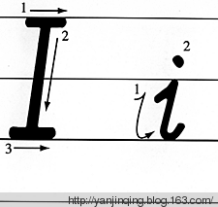
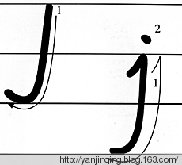
Presentation
Let’s learn

Slide 4
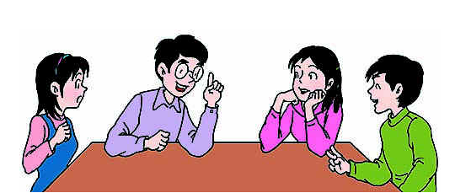
Presentation
Discussion
我们学过的哪些单词含有字母i或j呢？
girl five six chair
nice nine……

Slide 5
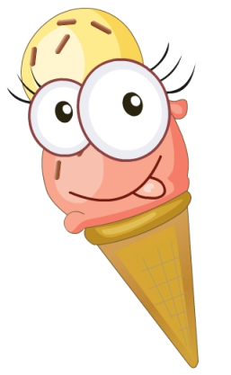
Presentation
Let’s learn
ice cream
Do you like ice cream?

Slide 6
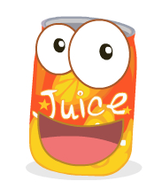
Presentation
Let’s learn
juice
Do you like juice?

Slide 7
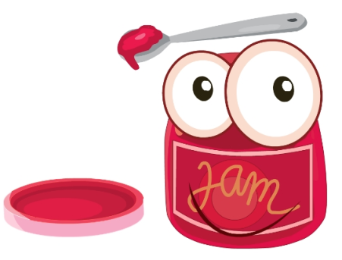
Presentation
Let’s learn
jam
Do you like jam?

Slide 8
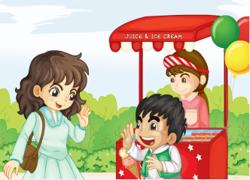
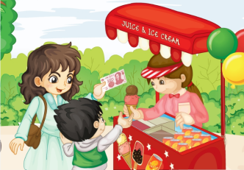
Presentation
Listen and say
1. Does Yang Ming like juice?
2. What does Yang Ming like?
No, he doesn’t.
He likes ice cream.

Slide 9
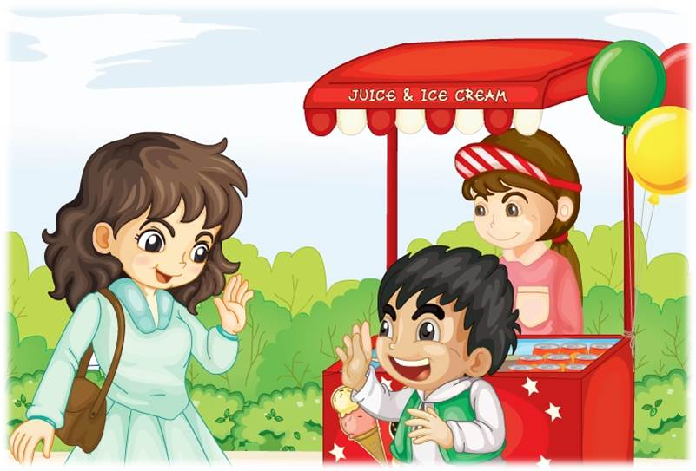
Presentation
Let’s learn
Yang Ming, do you like juice?
No, I don’t. I like ice cream.

Slide 10
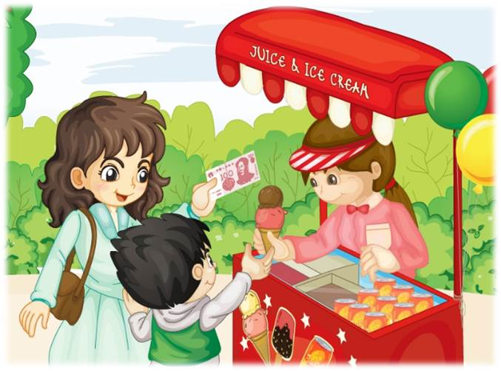
Presentation
Let’s learn
OK. An ice cream, please.
All right. Here you are.
Thank you!

Slide 11
Presentation
Let’s learn
All right 表示 “好的，知道了” 的意思。
想要买什么东西的时候，可以简单地说“… please.”

Slide 12
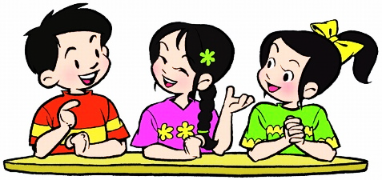
Practice
Role-play
分角色朗读对话，注意模仿语音语调。
三人一组，试着表演出来吧。

Slide 13
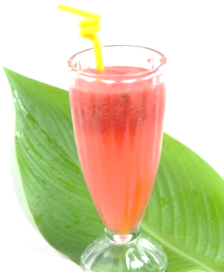
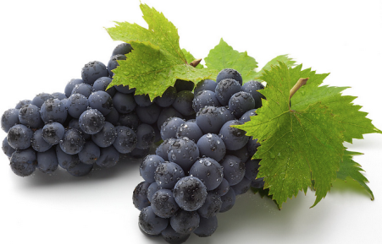
Practice
Let’s do
I ______ grapes.
I _______ juice.
like
don’t like

Slide 14
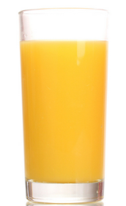
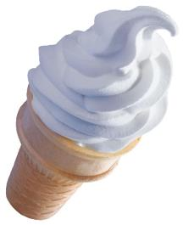
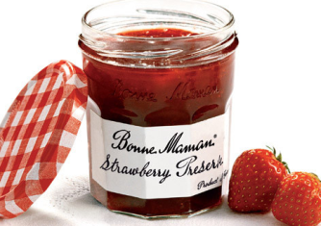
Practice
Ask and answer
Do you like …?
Yes, I do.
No, I don’t.

Slide 15
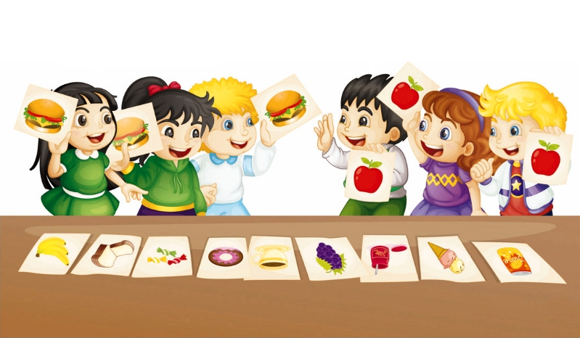
Practice
Let’s play
I like hamburgers. I don’t like bread.
I like apples. I don’t like mangoes.

Slide 16
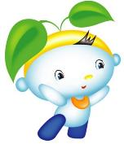
Summary
本课学到的重点单词：
ice cream juice jam
本课学到的重点句型：
—Do you like …?
—Yes, I do. / No, I don’t.

Slide 17
Homework
1. 跟读课文Just talk部分的录音，注意语音、语调。
2. 制作字母和单词卡片，并能熟练背诵字母Aa至Jj。
3. 预习本单元Lesson 23的内容。
Close

