Slide 1
These are pandas
Animals
WWW.PPT818.COM

Slide 2
教学目标
1．能正确认读和书写字母O-Q
2．能听懂、会说、认读动物及相关的单词：go, tiger、elephant、zoo、these、those, panda,并能结合句型灵活运用；
3．能听懂、会说、认读谈论动物的句型:“These are pandas.”

Slide 3
Let’s sing
What are you wearing?
Jenny’s wearing a red dress(a blue cap), red dress(blue cap),red dress(blue cap).
Jenny’s wearing a red dress(blue cap) all day long.

Slide 4
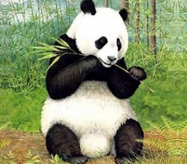
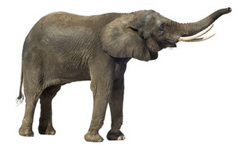
panda
elephant

Slide 5
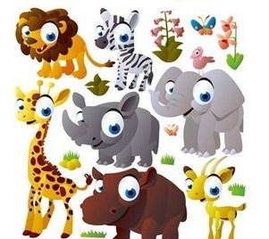
Animals

Slide 6
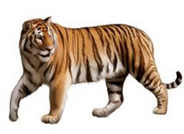
tiger

Slide 7
Listen and say
Jenny: Let’s go to the zoo.
Danny: Yeah!

Slide 8
Danny: What’s this?
Jenny: It’s a tiger.

Slide 9
Li Ming: These are pandas.
Danny：They’re lovely.

Slide 10
Li Ming: Those are elephants.
Danny：So big!

Slide 11
these: 这些，指离自己比较近的
those: 那些，指离自己比较远的

Slide 12
Try to act.
让我们一起表演对话吧。
ips:
看看哪位同学演的发音又准、演的又棒！

Slide 13
Read in roles together.
让我们一起分角色朗读课文吧。
ips:
同学们要读出每个角色的不同语气哦！

Slide 14
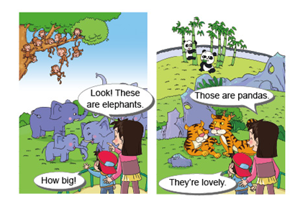
Pratice
So big!

Slide 15
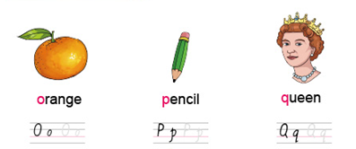
Let’s copy.
panda

Slide 16
Homework:
1、听本课录音，模仿跟读
2、画一画动物园的图，用英文介绍每种动物，下节课向全班展示。

