Slide 1
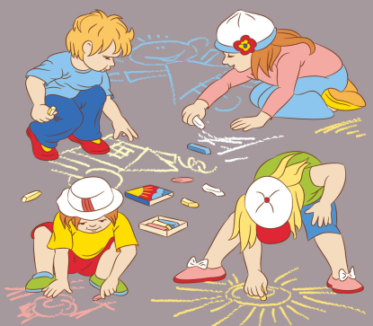
Hobbies
第二课时
WWW.PPT818.COM

Slide 2
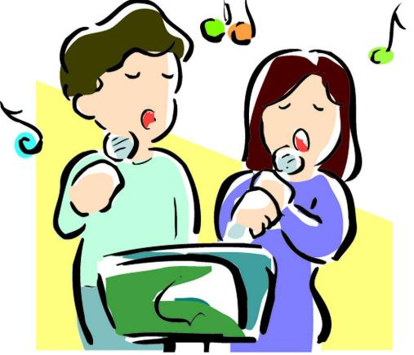
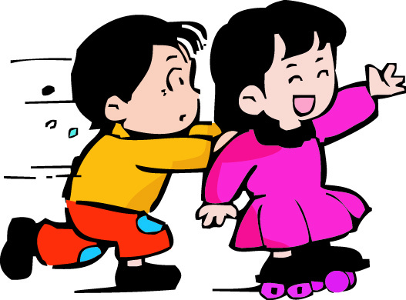
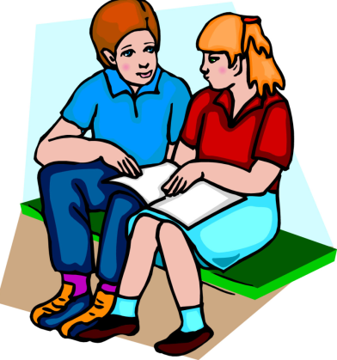
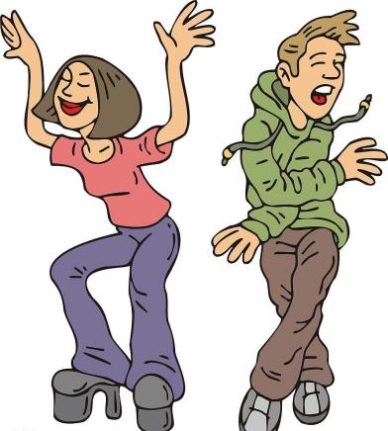
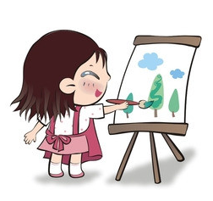
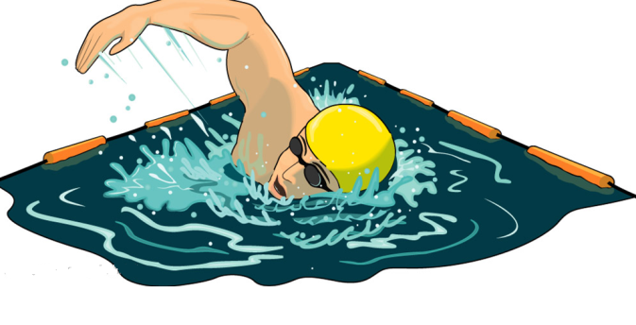
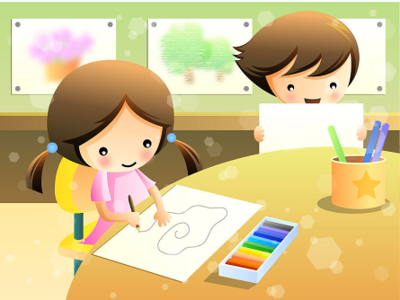
Ask and answer
What do you like (doing)?

Slide 3
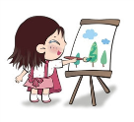
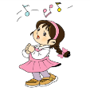
Look and spell
reading
skating
painting
singing
dancing
swimming
read
skate
paint
sing
dance
swim

Slide 4
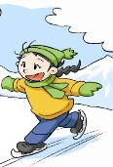
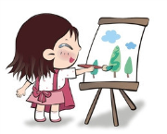
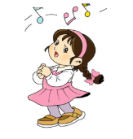
Read and write
I am Peter. I like ________ books.
My name is Jane. I like _________ in winter.
I like _________ pictures.
— What do you like? — I like ________.
reading
skating
painting
singing

Slide 5
Read, choose and write
singing
sing
I like ________. I can ______ very well.
( sing, singing )
2. I can ______ books. I like _______ books at home.
( read, reading )
3. What do you like? I like ________. I can ______ nice pictures.
( paint, painting )
4. I like ____________ in summer. It is cool. I can ______ fast in the water.
( swim, swimming )
read
reading
painting
paint
swimming
swim

Slide 6
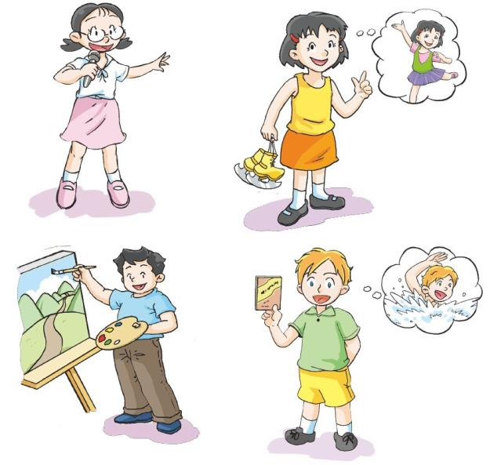
Read and talk

Slide 7
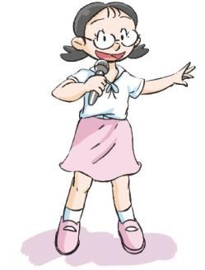
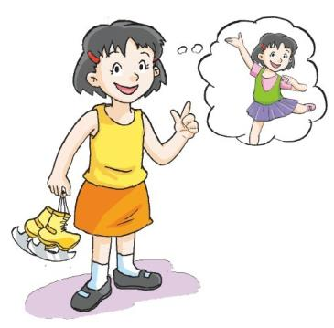
Think and say
I like singing.
I like skating.
I like dancing too.
I like skating and dancing.

Slide 8
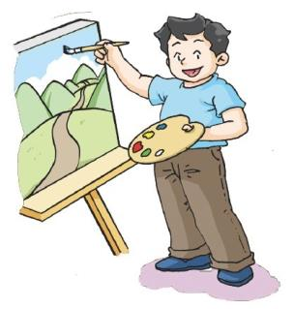
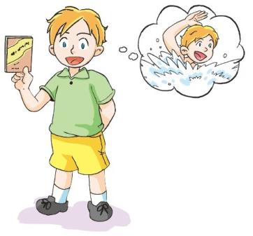
Think and say
I like painting.
I like reading and swimming.

Slide 9
Listen and circle
Peter likes __________ and ___________.
Jane likes __________. She likes __________ too.

Slide 10
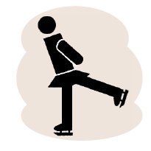
Think and act
What about you?

Slide 11
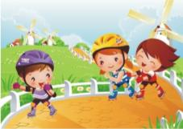
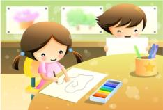
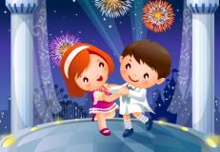
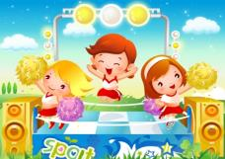
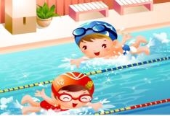
Make a dialogue
What do you like (doing)?
What about you?
I like (doing) …
I can …

Slide 12
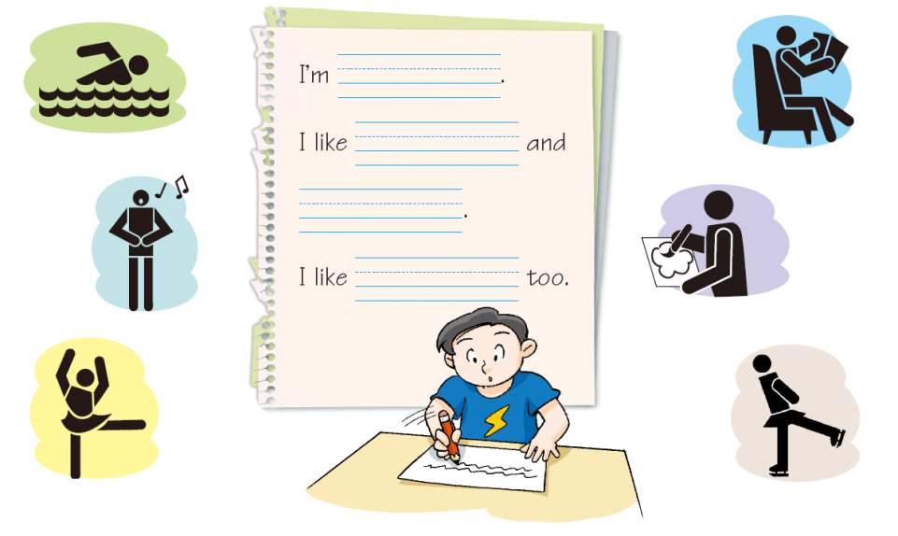

Slide 13
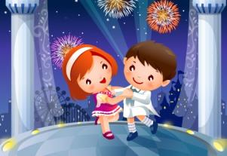
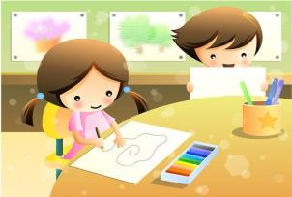
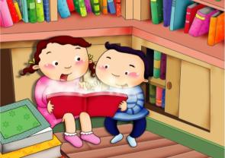
Choose and write
My colourful life
Hello, I am …
I like …
I like …
I can ...

Slide 14
Choose and write
My colourful life
Hello, I am Jane.
Look, this is me.
I like drawing.
I like painting too.
I can paint nice pictures.
I am a super girl.

Slide 15
Look and write
My colourful life
Stick your pictures
Write
Read
Your picture
here!

Slide 16
Look and write
My colourful life
Hello, ...
Look, this is me.
I like ...
I like ...
I can ...
I am …
Your picture
here!

Slide 17
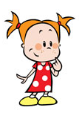
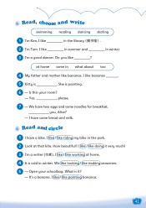
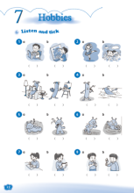
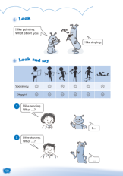
Homework
1 Talk about your hobbies.
2 Write about one of your hobbies.
3 Complete Workbook pages 38, 40 and 41.

