Slide 1
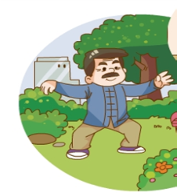
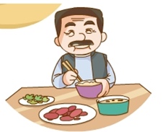
Unit 6
The secret to good health
WWW.PPT818.COM

Slide 2
本课时目标：
复习本课所学的单词、短语和句子；
学习并拓展一些有关健康生活的谚语；
会根据某类人的年龄特点或不良生活习惯，为特定他们制定健康海报，并用所学的语言进行描述。

Slide 3
Let’s Recite
通过提示，让学生背诵短文，复习并检测学生对文本熟练的程度。
Mr Li is not a doctor or a nurse, but he knows the secret to good health. He is 80 years old but looks only 60. He says you can do some simple things to stay healthy. First, get plenty of sleep, at least 8 hours each night, so you will feel good for the next day. Second, keep a good diet. Eat more vegetables and less meat. Don’t eat too much sweet or oily food. And drink tea or water, not coke or coffee. Third, take plenty of exercise. Mr Li walks for one hour in the park every morning and sometimes dances with his friends there. Finally, Mr Li thinks the most important thing for a healthy life is to be happy. He never worries too much and always has a smile on his face. That’s why, even 80, his hair is still black and not white.

Slide 4
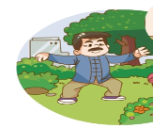
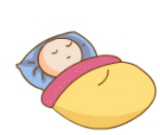
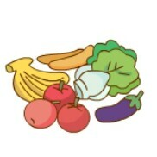
What can we do to stay healthy?
… ?
… ?
smile
… ?
wash my hands often
stay healthy
通过问题引导学生回忆，紧扣Unit6的文本，巩固how to stay healthy 的有关学习。
have enough sleep
… ?
… ?
take plenty of exercise
eat lots of vegetables and fruit

Slide 5
Let’s listen and match.

Slide 6
听力材料的文字稿
Ms White: Jiamin, what do you do to stay healthy?
Jiamin: I sleep a lot. I don’t feel well when I don’t have enough sleep.
Ms White: And you, Janet?
Janet: I take plenty of exercise. I run in the park every morning.
Ms White: Great ideas. Ben, what do you do?
Ben: I eat lots of fruit and vegetables. What about you, Xiaoling?
Xiaoling: I wash my hands often.
Janet: Ms White, what do you do?
Ms White: Well, I try to stay happy.
All: Yes, you smile all the time!

Slide 7
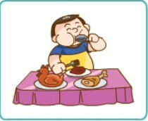
Look and say
We know something about staying healthy. What’s the matter with the people in the pictures? Can you give them some advice?
eat too much meat
教师示范如何讨论健康并给出适当的建议。
红色字体是身体状况和病因，蓝色字体是建议
too heavy
eat more vegetables and fruit
Bill is too heavy. He eats too much meat. He
should eat more vegetables and fruit and less meat.

Slide 8
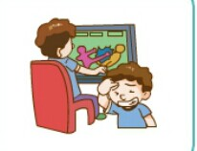
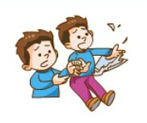
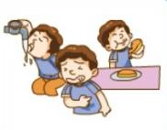
Talk about the pictures in pairs.
watched TV too much
…has a …
He /She …
He/ She should …
have a headache
take a good rest
have a stomachache
hurt his finger
fell down
drank too much cold water
see a doctor or take the medicine
be more careful
学生根据关键词句的提示讨论图片

Slide 9
Let’s read
Jiamin is a twelve-year-old boy. He doesn’t do well at school these days. First, he plays computer games too much, at least three hours each day. So he often has a headache. And he has no time to take exercise. Second, he eats too much. He likes ice cream, chocolate and candy. And his favourite drink is coke. He sometimes has ice cream and coke for meals. So he is very heavy and he has a toothache.
本练习选自《学习与评价》第30页

Slide 10
Let’s read
Third, he goes to bed and gets up very late. He is usually late for school. Sometimes he sleeps in class and can’t finish his homework on time. Finally, he often does something dangerous. He climbed trees at school and fell down from a tree and hurt his leg last week. He played with a knife and broke his finger this morning. Jiamin’s parents and teachers are angry with him. And they all worry about him very much.
So, what should Jiamin do?

Slide 11
Exercise 1: true (T) or false (F)
T
( ) 1. Jiamin usually plays computer games for at least three hours each day.
( ) 2. Jiamin likes tea very much.
( ) 3. Jiamin doesn’t do well in class.
( ) 4. Jiamin hurt his leg when he played with a knife.
( ) 5. Jiamin is very healthy.
F
coke
T
F
finger
T
unhealthy

Slide 12
Exercise 2: Complete the form according to the story
Bad habits （坏习惯） | Suggestion （建议）
 | should do | shouldn’t do
1. play computer games too much | take a good rest | don’t play computer games too much
2. no time to take exercise
3. go to bed and get up late
4. eat too much

Slide 13
Let the kids discuss the meanings of the proverbs
Read proverbs and match
An apple a day keeps the doctor away.
食多病多
Health is better than wealth.
健康胜于财富
早睡早起使人健康、富有又聪明
Many dishes, many diseases.
A light heart lives long.
心胸开朗，使人寿长
Early to bed and early to rise, makes a man healthy, wealthy and wise.
每日一苹果, 医生远离我

Slide 14
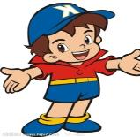
There are different kinds of
people around us, some are
too fat, some worry too much,
some stay up too late.
What advice shall we
give them?

Slide 15
This is Janet. She works hard, and she always worries about her job too much. She has no time for sports and sleeps too late. She eats lots of meat and little fruit every day. What should she do? Let’s give her some advise.
play badminton
ride a bike
go swimming…
eat more vegetables and fruit
eat less meat
play sports
eating habits
go to bed early and
get up early
be happy
good timetable
Smile all the time
Don’t worry too much

Slide 16
Work in groups, design
a health poster.
Step 1: Choose one kind of people you are going to talk about.
Step2: choose the advice you want to give.
Step 3: choose a proverb and make your poster better.
三个制作流程的超链接，之后进行海报制作，
在本子上完成也可以。再点右下角的按钮跳至最后的环节

Slide 17
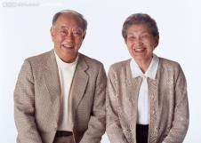
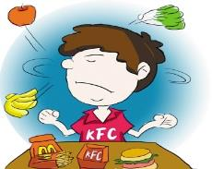
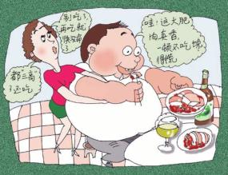
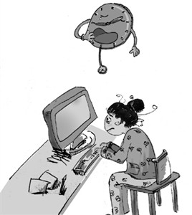
Choose one kind of person and design a personal health poster.
For old people
For kids
For heavy people
For students

Slide 18
Here are some tips for you to choose.
Playing sports
Eating habits
have sports
eat more fruits and more vegetables
drink milk and eat an apple every day
eat less meat
eat four kinds of foods every day
drink lots of water
take exercise every
day to keep fit
ride a bike
play ball games
swim

Slide 19
Here are some tips for you to choose.
Mood （情绪）
Good timetable
have sports
go to bed early
get up early
sleep at least 8 hours a day
take a nap at noon （午休）
take a rest when you are tired
not be sad and
stay happy
not worry too much
smile
talk to the others people

Slide 20
Here are some proverbs about health.
Choose three more and write them down.
An apple a day keeps the doctor away.
Never eat too much food.
Exercise can make you strong. It can be fun and won’t take long.
A good rest is half the work.
Laughter is the best medicine.
People who think they have no time for exercise will soon find time for illness.
Early to bed, early to rise, makes a man healthy, wealthy and wise.
Go to bed thirsty, rise healthy.
A healthy man wears his winter clothes in summer.
A simple diet keeps a man in good health.
在做任务的时候，
学生可参考课本35页。

Slide 21
My poster is for…
They always…
They have…
They shouldn’t …
They should …
…
Let’s stay healthy!
请学生在班上汇报展示所做的健康海报。

Slide 22
Homework
1. 朗读课文，要求能够流利朗读、发音准确、语调自然；
2. 设计并完成一张健康海报。

