Slide 1
Unit 6 Topic 1
I have some exciting news to tell you.
Section A
WWW.PPT818.COM

Slide 2
Talk
What do you usually do when you feel bad?
Listen to music
Play sports
Go to the movies
Read books
Talk to friends/parents, …
Play computer games
Go traveling
…

Slide 3
Talk
How are you feeling at the pictures?
Do you like traveling?
How do you go traveling?
On foot
By bike/bus/train/subway/ship/plane/car
Which is the best way to go traveling?

Slide 4
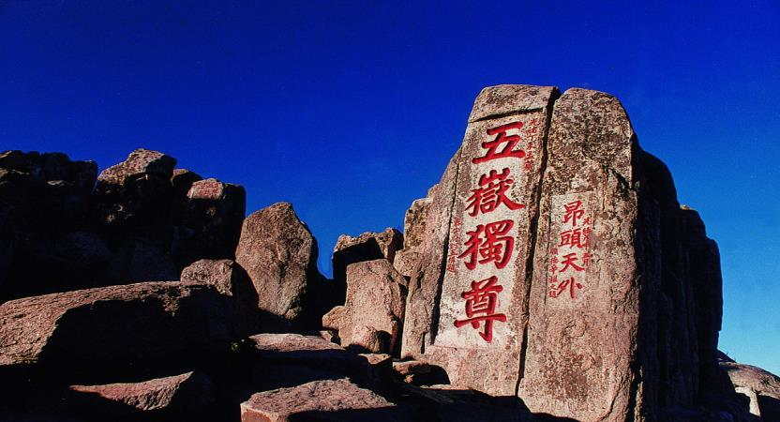
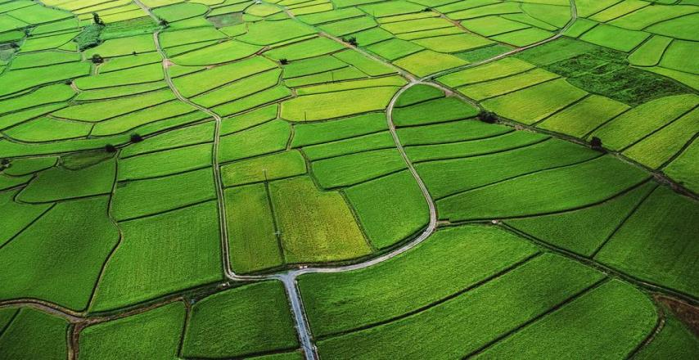
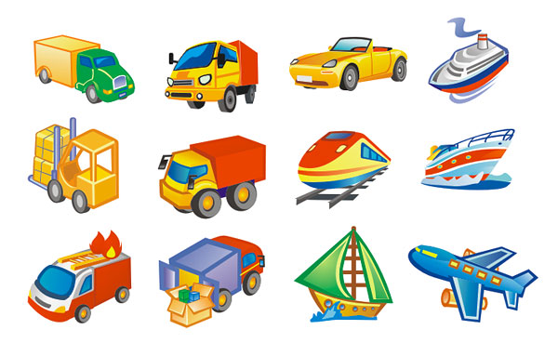
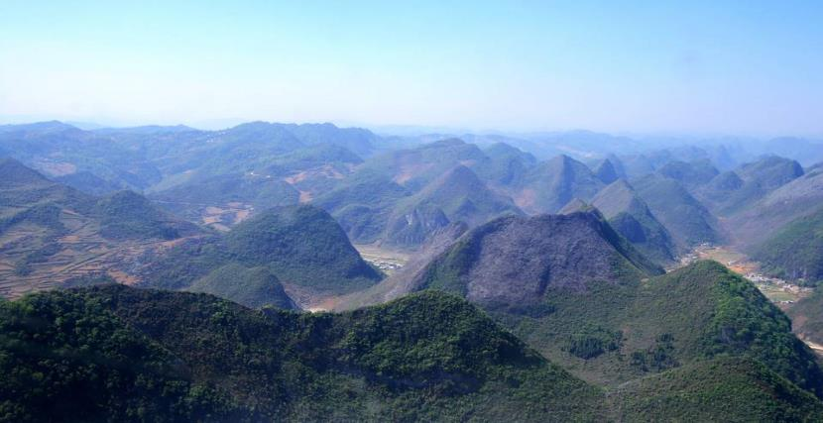
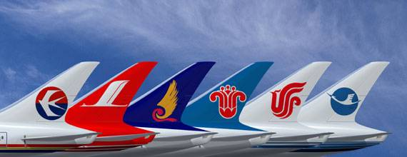
Learn the new words
vehicle
airline
Mount Tai
field
mount

Slide 5
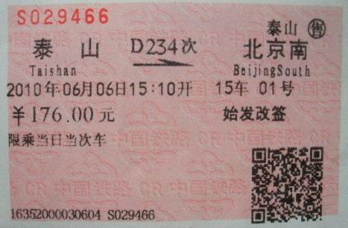
price
¥ 176×5= ¥ 880
total price

Slide 6
Listen to 1a and answer the questions.
1. Where are they going on a three-day visit?
They’re going to Mount Tai.
2. Will they cycle there?
No, they won’t.
zX.x.K

Slide 7
Listen to 1a and mark T (True) or F (False).
1b
For their spring field trip, they’re going on a three-day visit to Mount Tai. ( )
It will take them a few days to get there by bus. ( )
Kangkang and Michael will find the cost for the train. ( )
Helen will find the cost for the plane. ( )
Miss Wang will decide on the best way to travel. ( )
T
F
T
F
F

Slide 8
Read 1a again and match the persons with their activities.
Kangkang
find the cost by bus
Jane
find the cost by train
Michael
give some tasks to the students
Miss Wang
ask the airline over the phone
Helen

Slide 9
Key point
spring field trip 春游
go on a three-day visit to
go on a visit to 去……旅行/参观
a three-day visit 三天的旅游
It takes sb. some time to do sth.
make a/the decision 做决定
= decide
over the phone 通过电话
= on the phone
= by phone

Slide 10
decide on (upon) sth 对某事做出决定
我们正在设法选定一所学校。
We are trying to decide on/upon a school.
decide to do sth. 决定做某事
他决定留下来照顾母亲。
He decided to stay and look after his mother.

Slide 11
Fill in the blanks according to 1a.
The students will go on a __________ visit to Mount Tai. Michael wants to _______ there, and it will ______ them a few days. So it’s _______ far for them ____ go there by bike. Miss Wang asks them to make the ________ together. There are other __________for them to choose. Miss Wang wants them to find out the _______ for train, bus and plane. They will _____ ____ the best way to go on their ______ ______.
three-day
cycle
take
too
to
decision
vehicles
cost
decide on
field trip

Slide 12
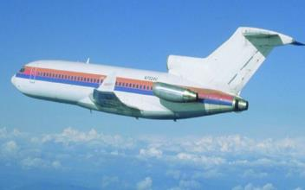
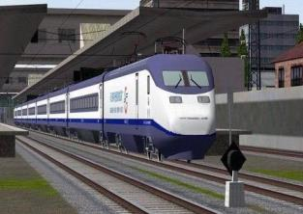
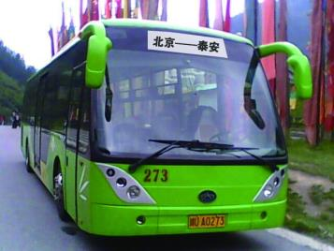
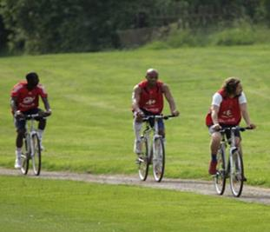
Which is the best way to travel?
Price: ¥ 700
Total time:1 hour
Price: ¥ 145
Total time:7 hours
Price: ¥ 200
Total time:8 hours
Price: ¥ 0
Total time:2 days
zX.x.K

Slide 13
Work in pairs and discuss the best way to travel.
2
Example:
A: How much does it cost to get to Mount Tai by …?
B: It costs…
A: How long does it take to go there by … ?
B: It takes …
A: The best way to get there is by … because …
B: I think so. / …

Slide 14
A. Listen to the notice and complete the table.
4
Where to go | When to leave | How | How long to stay | Things to take
Xiangshan Park | _______ | by ______ | _______ hours | enough _______ proper _______ and__________
water
7:00 a.m.
eight
clothes
bus
sports shoes

Slide 15
B. Listen again and tick what the children will do in the park.
4
√
go climbing
√
have a picnic
√
have an English corner
go swimming
√
take photos
sing under the tree

Slide 16
Exercise
Translation:
去黄山5日游
go on a 5-day trip to Mount Huang
选择其它的交通工具
choose other vehicles
总价
total price
秋游
autumn / fall field trip
它将要花费我们几天时间骑自行车到那儿。
It will take us a few days to get there by bike.
坐飞机去北京要花¥1500。
It will cost 1500 yuan to get to Beijing by plane.

Slide 17
Exercise
Complete the sentences:
When spring comes, there are all kinds of beautiful flowers in the f______.
The p________ of the dictionary is ¥23. We need 10 of them. So the t_______ cost is ¥ 230.
Where shall we spend the weekend ? Let’s make the d_________ together.
We should deal with the problem in a p_______ way. Or it may bring us t______.
The students are having a meeting to d_______ on the best place for their trip.
ield
rice
otal
ecision
roper
rouble
ecide

Slide 18
Read 1a again and find out sentences with
infinitives ( to do ).
1. I have some exciting news to tell you.
2.It will take us a few days to get there by bike.
3.There are other vehicles for us to choose.
4.Do you know the best way to get there?
5. It’s hard to say.
6.You two find out the cost to go by train?
7.Your task is to find out the cost by bus.
8.I’d love to go by airplane.
9. We’ll decide on the best way to go on our field trip.

Slide 19
动词不定式 具有名词、形容词、副词的特征
没有人称和数的变化
肯定式： to +动词原形
构成
否定式： not to +动词原形
学好英语不容易。
To learn English well is not easy.
It is not easy to learn English well.
你帮助我真好。
It’s kind of you _______ me.
to help

Slide 20
我想吃午饭。
to have
I want_________ lunch.
我们决定乘火车去那里。
We decide to go there by train.
她的愿望是出国。
Her wish is________ abroad.
我们的主要任务是学好英语。
Our main task is to learn English well.
to go

Slide 21
去那旅行的最好方式是乘火车。
The best way ________ there is by train.
to go
我有很多作业要做。
I have a lot of homework to do.
want 想要
wish 希望
hope 希望
learn 学会
decide 决定
plan 计划
would like …… 想要
to do
something to eat
something to drink

Slide 22
( )1. —What about going shopping together?
—Sorry, I have a lot of homework ____.
A. do B. to do C. doing D. did
( )2. It’s impossible for us ____ there on foot in two hours.
A. to get B. get C. getting D. got
( )3. —Though Mike is ____ boy, he can say many words.
—How clever!
an-one-year-old B. a one-year-old
C. an one-year old D. a one-year old
B
A
B

Slide 23
( )4. —What did the teacher say just now?
—He asked them ____ the math problem.
discussing B. discussed
C. to discuss D. discuss
( )5. —I’ll go on a visit to Mount Huang.
—____
A. Thank you. B. Have a good trip!
C. Never mind. D. My pleasure.
C
B

Slide 24
Summary①
We learn:
Words and phrases:
field, proper, total, price
Useful expressions:
How much does it cost to get to Mount Tai by…?
It costs about a hundred yuan.
How long does it take to go there by… ?
The infinitive: to + v. :
plan to…, need to find out, it takes …to get to…
the best way to travel

Slide 25
Summary②
We can:
Talk about transportation and the cost:
It’s too far to cycle.
But it will take us a few days to get there by bike.
I’d love to go by plane.

Slide 26
Project
Suppose you want to make a weekend-trip to the zoo near your home. Make conversations similar to 1a.
Talk about the vehicles you would like to choose and the reason.

Slide 27
Homework
1.Review the new words and useful expressions in Section A.
2. Plan your own trip to some places.
3. Preview the new lesson, Section B of Topic 1.

