Slide 1
Great storybooks
第二课时
WWW.PPT818.COM

Slide 2
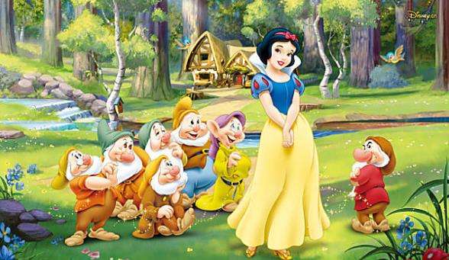
Presentation
What are your classmates’ favourite stories?

Slide 3
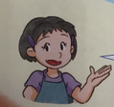
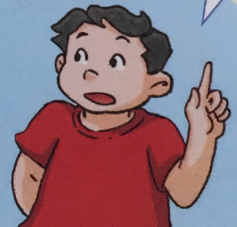
Presentation
Joe’s favourite story is the ugly duckling.It’s about an ugly duckling.The duckling becomes a beautiful swan.Andersen wrote the story.

Slide 4
Practice in pairs
What are your classmates’ favourite stories?Talk with your partners.
Story | Writer | What is it about?

Slide 5
Presentation
Learn the sounds

Slide 6
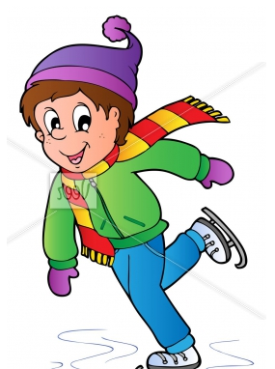
Presentation
Do you like skating?
Yes,I do.

Slide 7
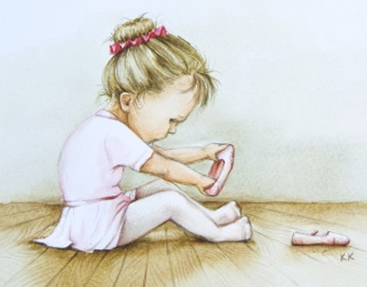
Presentation
Do you like dancing?
NO,I don’t.

Slide 8
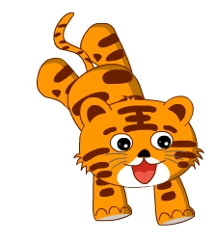
Presentation
What animals do you like?
I like tigers.

Slide 9
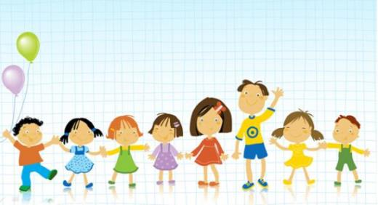
Presentation
When is Children’s Day?
It’s on 1st June.

Slide 10
Presentation
Listen and say

Slide 11
Presentation
Are these pens yours?
Yes,they are.

Slide 12
Presentation
Did you play basketball yesterday?
No,I didn’t.

Slide 13
Presentation
Where do you live?
I live on May Street.

Slide 14
Summary
本课重点：掌握句子语调
Do you like skating?
Yes,I do.
What animals do you like?
I like tigers.
朗读一般疑问句时要用升调；朗读肯定句、否定句、特殊疑问句和陈述句用降调。

Slide 15
The End

