Slide 1
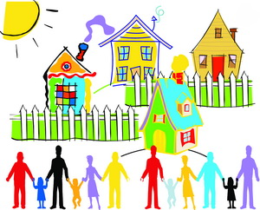
Around my home
第二课时
WWW.PPT818.COM

Slide 2
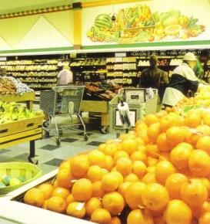
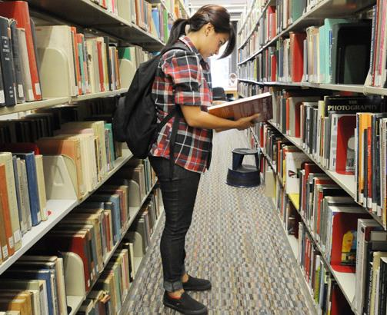
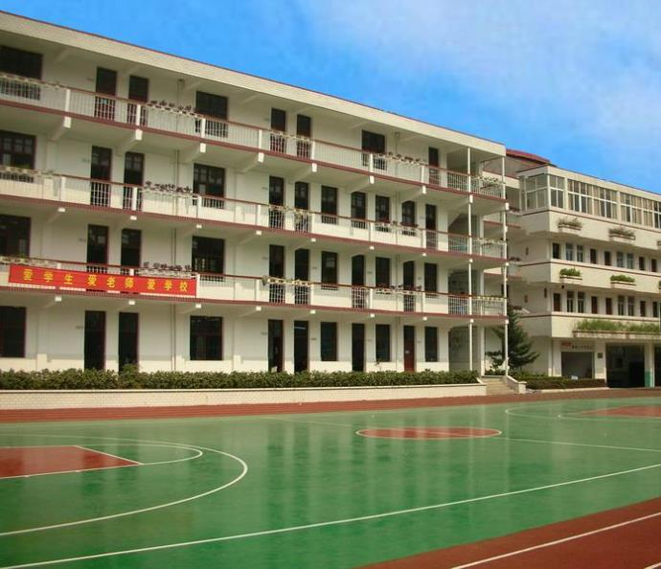
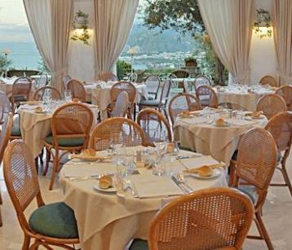
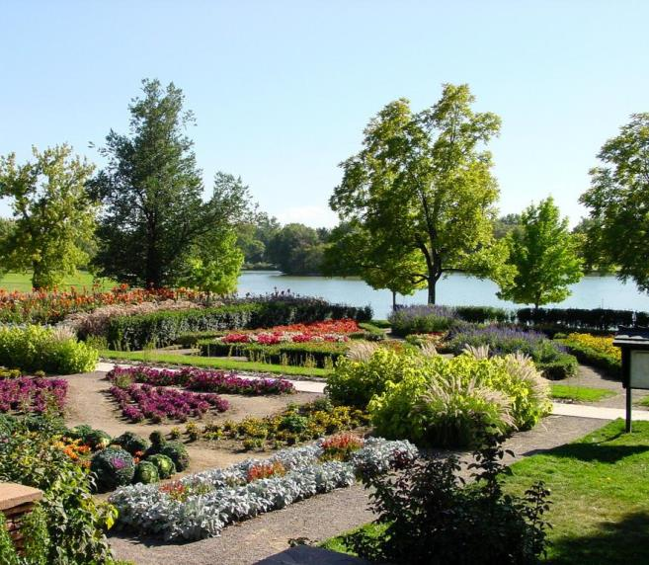
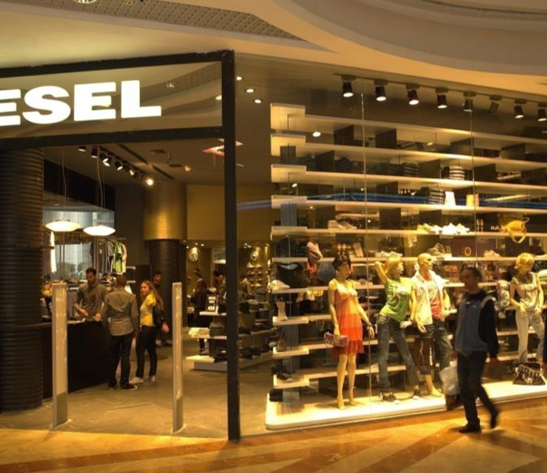
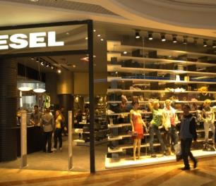
Look and say
supermarket
restaurant
park
library
shop
school

Slide 3
Think and say
There is a … near my home.
It’s …
There is …
There are …
There is a park near my home.
It’s beautiful.
There is a big lake in it.
There are trees and flowers too.

Slide 4
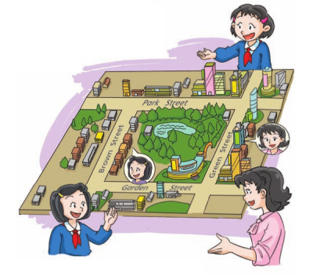
Read and judge
1 Jill’s home is on Brown Street. ( )
√
2 There is a park behind Alice’s home. ( )
X
Jill
3 There is a shop on Green Street. ( )
X
4 There are some shops and restaurants
near Miss Fang’s home. ( )
supermarket
√
5 The park is on Brown Street. ( )
X
Green

Slide 5
Read and complete
A. Are there any restaurants near your home? B. It’s on a busy street. C. Is there a park near your home? D. Is your home on Green Street?
Alice: Where is your home, Jill?
Jill: It’s on Brown Street.
Alice: ____________________________________
Jill: Yes. There’s a park behind my home.
Jill: Where is your home, Miss Fang?
Miss Fang: _____________________ There are some shops, a supermarket and a park on that street.
Jill: _____________________________________________
Miss Fang: Yes, there are.
Jill: ___________________________________
Miss Fang: Yes, it is.
Is there a park near your home?
It’s on a busy street.
Are there any restaurants near your home?
Is your home on Green Street?

Slide 6
There be+名词（+其它）.
表示：事物存在的状态，即“……有……”
Be的形式由后面的名词决定：不可数名词或单数可数名词时，be 为is/was;复数可数名词时，be为are/were.

Slide 7
There be 句型的一般疑问句形式为：
Be there + 其它？
答语：Yes, there be + 其它.
Is there a park near your home?
Yes, there is a park behind my home.

Slide 8
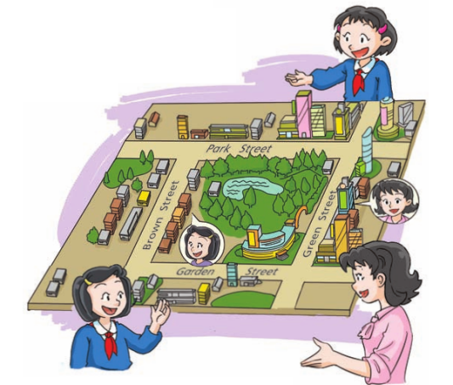
Quick response
Is there a supermarket on Brown Street?
Is there a park behind Jill’s home?
Is there a park on Brown Street?
Are there any restaurants near Jill’s home?
Are there any shops on Green Street?
No, there aren’t.
No, there isn’t.
Yes, there are.
Yes, there is.
No, there isn’t.

Slide 9
Ask and answer
Park Street
Brown Street
Green Street
Garden Street
— Is there …?
— Yes, there is./No, there isn’t.
— Are there …?
— Yes, there are./No, there aren’t.

Slide 10
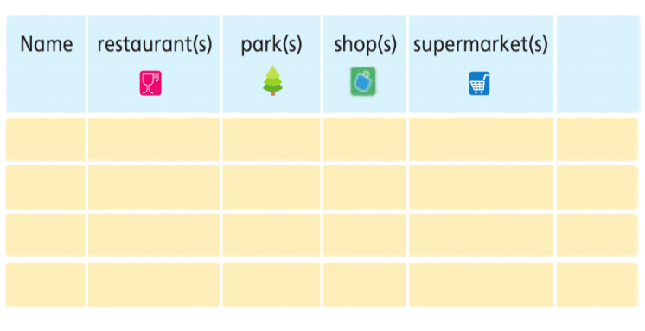
school(s)
…
S1: Is there a … near your home?
S2: Yes, there is./No, there isn’t.
S1: Are there any …(s) near your home?
S2: Yes, there are./No, there aren’t.

