Slide 1
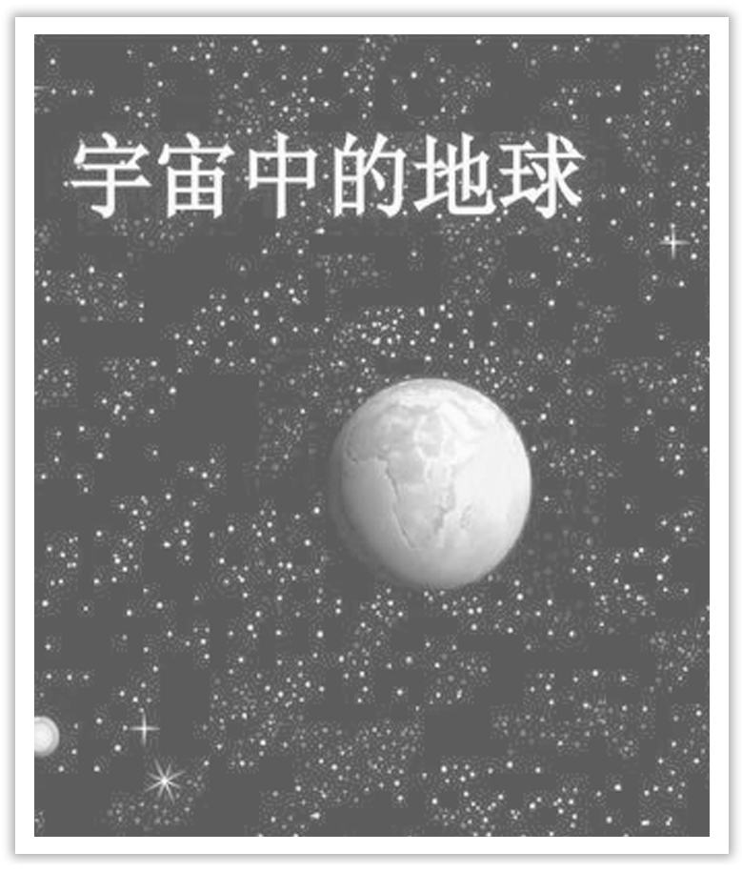
Unit 4 Space Exploration
Section Ⅷ Assessing Your Progress
WWW.PPT818.COM

Slide 2
Ⅰ.单词拼写
1.People could hear on radio and television the talk between the ____________ (宇航员) and the flight controllers.
2.Proper physical and ____________ (精神的) exercise can increase your chances for health and wealth.
astronaut
mental

Slide 3
3.The ____________ (卫星) enables us to calculate their precise location anywhere in the world.
4.All glass bottles which can’t be refilled can be ____________ (回收利用).
5.Time is your most valuable ____________ (资源)，especially in examinations.
6.A fresh egg will sink and an old egg will ____________ (漂浮).
7.Going away to college has made me much more ____________ (独立自主的).
8.The details of today’s flights are displayed on the ____________ (显示屏).
satellite
recycled
resource
float
independent
monitor

Slide 4
Ⅱ.单句语法填空
1.It’s difficult to meet the demands of my job and the desire ____________ (be) a good father.
2.He was studying in the hope of _______________ (admit) to an engineering college.
3.Judging from his conduct，I assume he is ____________ (lack) in education.
4.He tried to be not involved in this endless ____________ (argue).
to be
being admitted
lacking
argument

Slide 5
5.Millions of people are threatened with starvation as a result ____________ drought and poor harvests.
6.He ____________ (regular) drove from his home to his place of employment.
7.Young children have a ____________ (limit) attention span and can’t concentrate on one activity for very long.
8.For further information，please contact us on the ____________ (attach) form.
of
regularly
limited
attached

Slide 6
Ⅲ.补全句子
1.I have to work hard ______________________ (过正常的生活) but it has been worth it.
2.________________________ (为了使之更容易) to get in touch with us，you’d better keep this card at hand.
3.I stopped the car ________________________ (为了短暂休息一下) as I was feeling tired.
4.We turned the lights off ________________________________ (为了不浪费电).
5.________________________(为了在晚上保持温暖)，I would fill the woodstove，then set my alarm clock for midnight so I could refill it.
to live a normal life
To make it easier
to take a short break
in order not to waste electricity
To stay warm at night

