Slide 1
Unit6
Touch your head
WWW.PPT818.COM

Slide 2
Which body part is the most important?
哪个身体部位是最重要的？

Slide 3
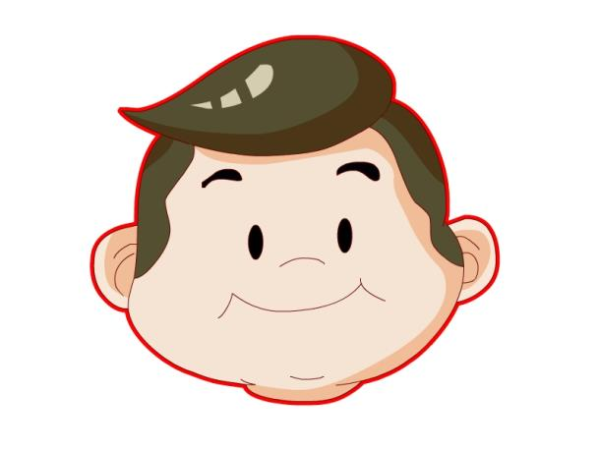
head
No head, be dead

Slide 4
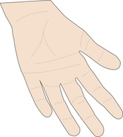
hand

Slide 5
hair

Slide 6
Listen and choose
( )a.nose b.face c.hand
( )a.face b.head c.hand
( )a.head b.hand c.hair
( )a.head b.hand

Slide 7
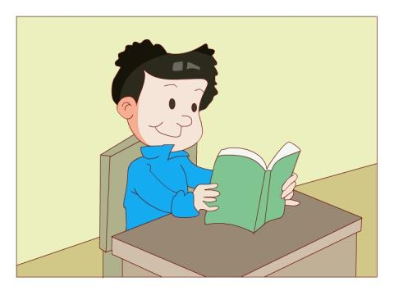
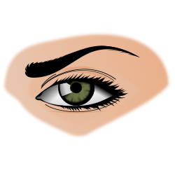
eye

Slide 8
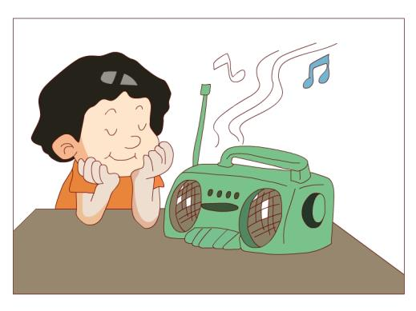
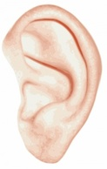
ear

Slide 9
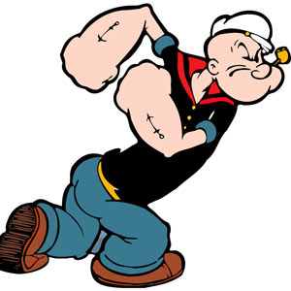
arm

Slide 10
every body part is important！
注意安全

Slide 11
Game Time
Let’s play a game, OK?

Slide 12
What’s missing？

Slide 13
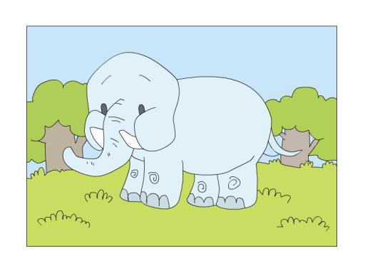
ear

Slide 14
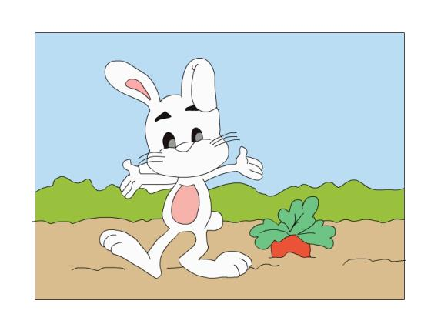
mouth

Slide 15
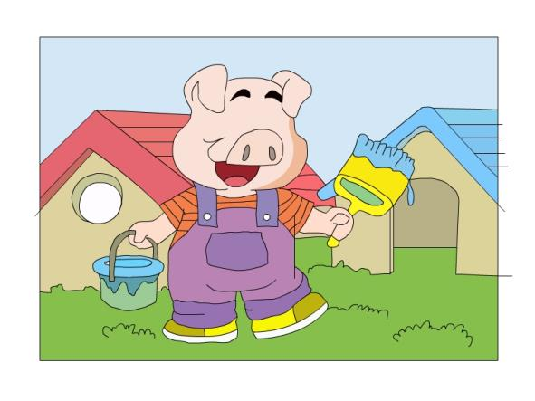
eye

Slide 16
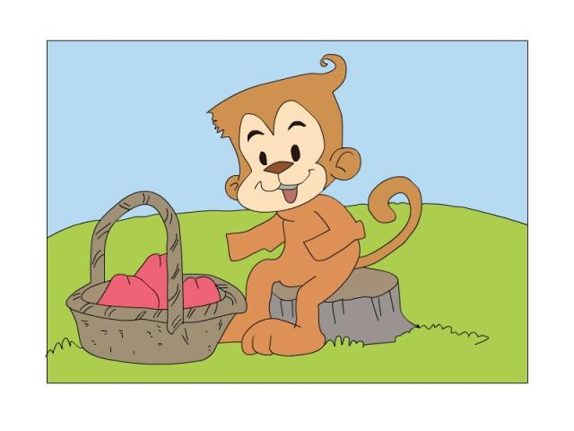
hand

Slide 17
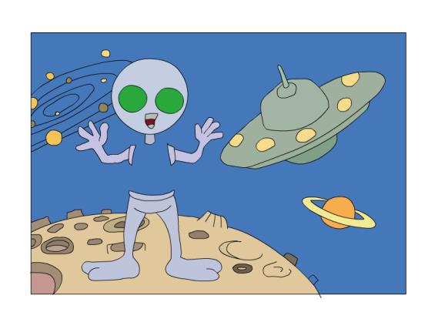
body

Slide 18
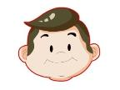
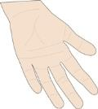
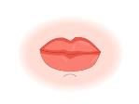
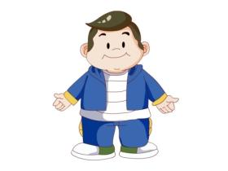
My body
Show time
Head, hair, face.
Eye, ear, nose.
Hand, arm, mouth.
————-——————

Slide 19
Simon says：
Touch your…

Slide 20
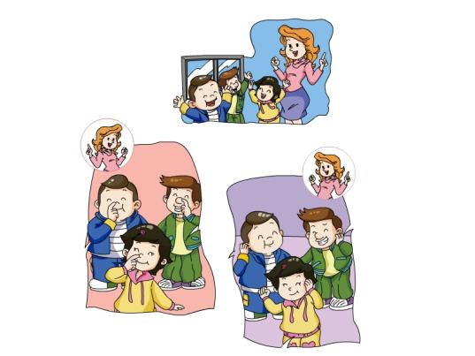
Jiamin and his friends
Play a game

Slide 21
Let’s watch
Who is wrong? Why?

Slide 22
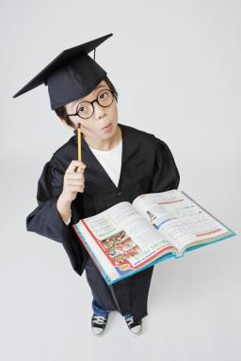
What do we learn today？ 今天我们学到了什么？

Slide 23
homework
1.听课文录音3次，跟读并背诵课文。
2.完成活动手册unit 6的单词抄写(P62)。
3.给爸爸妈妈表演“my body”。

