Slide 1

Module 1 Unit 1
I want a hot dog, please.
WWW.PPT818.COM

Slide 2
创设情境
Watch a video about
“advertisement for pizza”

Slide 3
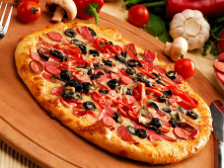
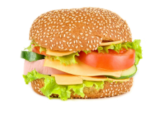
What is the advertisement for?
√

Slide 4
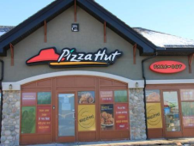

Where can we eat it?
√

Slide 5
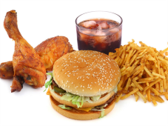

启发思考
fast food
fast food restaurant

Slide 6
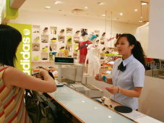
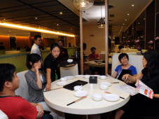
Who can we meet in a fast food restaurant?
cashier
guest

Slide 7
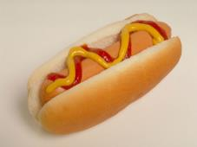
What can we have in a fast food restaurant?
pizza
hamburger
hot dog

Slide 8

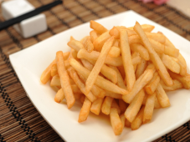
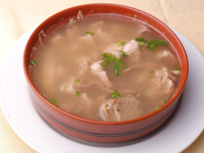
What can we have in a fast food restaurant?
cola
chips
soup

Slide 9
More food and beverage

Slide 10
自主或小组探究
What do you want?
I want a hamburger, please.
How much is it?
It’s three dollars and seventy-five cents.

Slide 11
What do you want to drink?
I want to drink cola
How much is it?
It’s one dollar and twenty-five cents.

Slide 12
What’s it?
It’s a hot dog
How much is it?
It’s two dollars.

Slide 13
+
How much is it?
It’s five dollars.

Slide 14

+
+
How much is it?
It’s nine dollars and fifty cents.

Slide 15
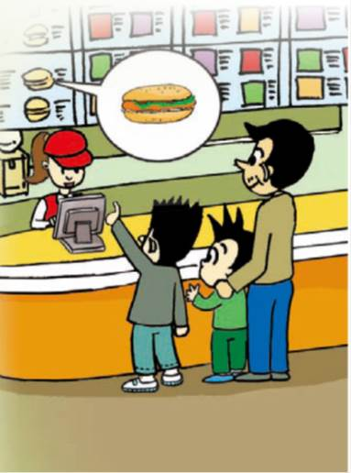
Let’s read
Cashier: Can I help you?
Simon: What do you want, Daming?
Daming: I don’t know. What’s a hot dog? Is it a ...
Simon: No, it isn't a dog. Look! That’s a hot dog.
Daming: lt looks good! I want a hot dog, please.
Simon: And I want a hamburger.
Simon’s dad: I want a hamburger, too.

Slide 16
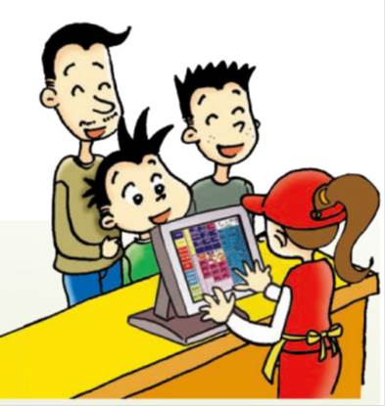
Cashier: And to drink?
Simon: Cola, please.
Daming: Can I have some soup?
Cashier: Sorry, we don’t have any.
Daming: All right, a cola for me.
Simon’s dad: And a cola for me, too.
Cashier: So, that’s two hamburgers, one hot dog and three colas.
Simon’s dad: That's right.

Slide 17
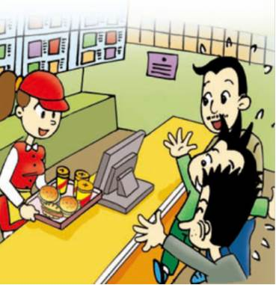
Simon’s dad: How much is it?
Cashier: It’s thirteen dollars and twenty-five cents.
Simon’s dad: Here you are.
Cashier: Thank you. Here’s your food. Enjoy your meal!

Slide 18
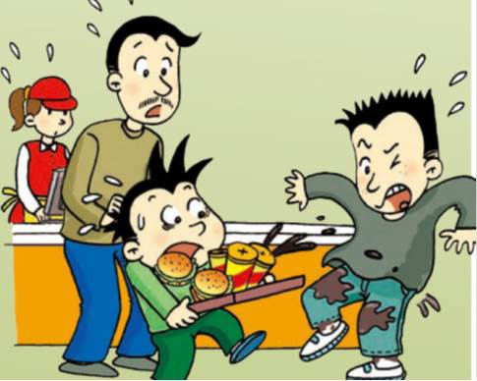
Daming: Let me take them.
Simon’s dad: Be careful!
Daming: Oh no! I’m sorry!
Simon: My new trousers!

Slide 19
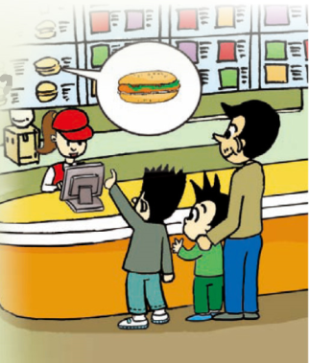
Let’s answer
What does Daming want to eat?
He wants a hot dog.
What does Simon want to eat?
He wants a hamburger.
What does Simon’s dad want to eat?
He wants a hamburger, too.

Slide 20
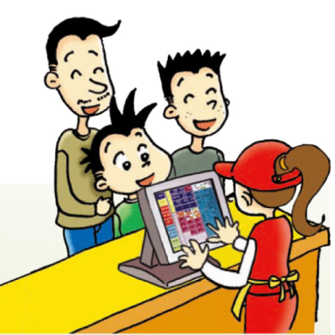
What do they want to drink?
They want colas.
How much is the meal?
It’s thirteen dollars and twenty-five cents.

Slide 21
Let’s observe
Cashier says:
Can I help you?
It’s thirteen dollars and twenty-five cents.
And to drink?
Here’s your food. Enjoy your meal!
So, that’s two hamburgers, one hot dog and three colas.

Slide 22
Guests say:
I want a hot dog, please.
How much is it?
Can I have some soup?
A cola for me.
Here you are.

Slide 23
协作交流
Role-play!

Slide 24


Slide 25
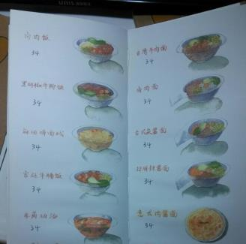
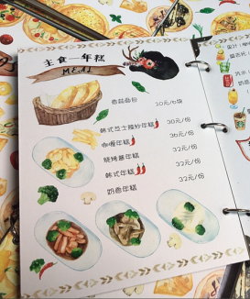
Let’s draw a menu!

Slide 26
总结提高
餐厅常用语
Can I help you?
Here you are!
I want a XXX, please?
Enjoy your meal!
How much is it (the meal)?
It’s XX dollars and XX cents.

Slide 27
Homework
1.完成 配套练习。
2.画出常见的食物，并标上英文名和价格，准备下节课小小餐馆活动。

