Slide 1
Unit 5
What will you do this weekend?
WWW.PPT818.COM

Slide 2
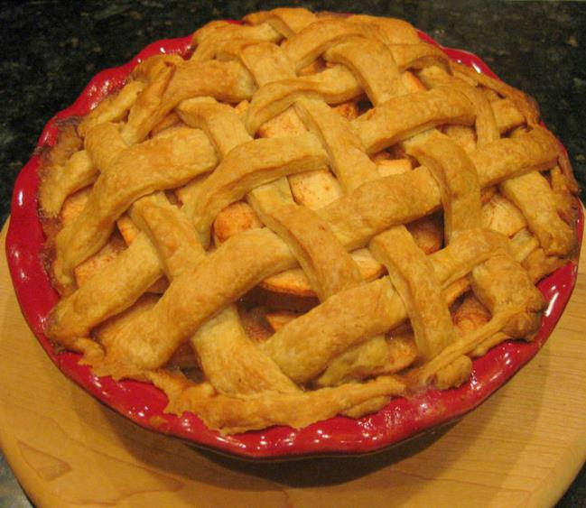
Would you like a pie?
No, thank you.

Slide 3
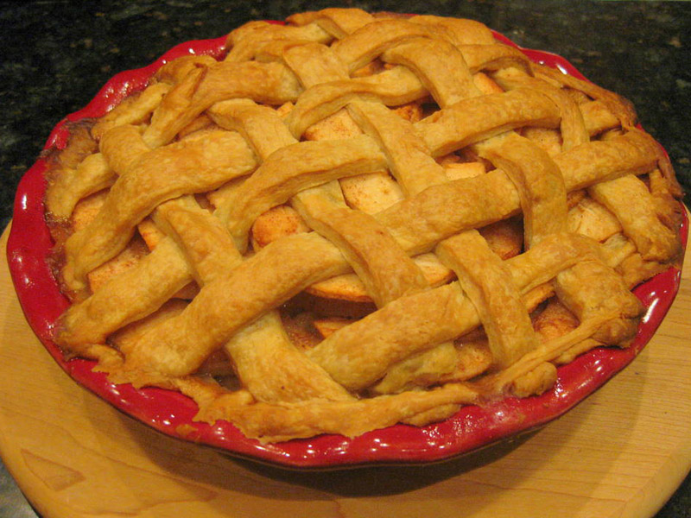
Would you like a pie?
Yes, please.

Slide 4
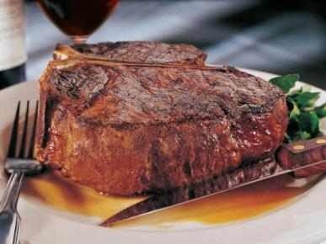
Would you like some beef?
Yes, please.

Slide 5
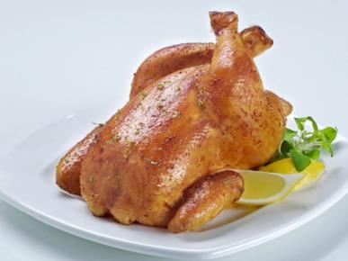
Would you like some chicken?
Yes, please.

Slide 6
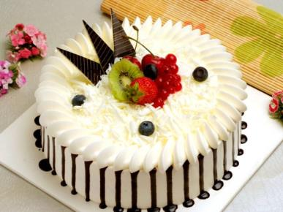
What would you like?
I’d like a cake.

Slide 7
Summary
Would you like …?
用来提问你想要…吗？

Slide 8
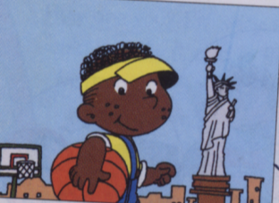
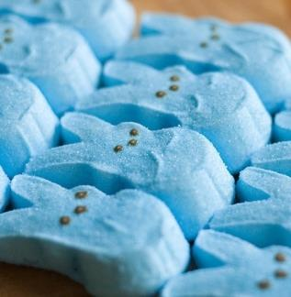
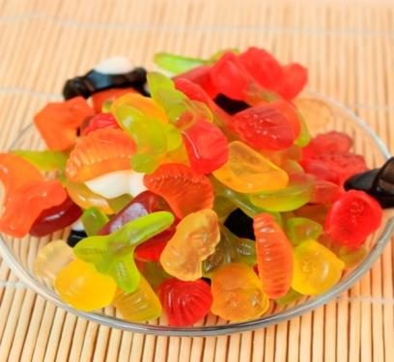
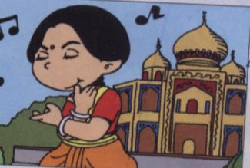
Would you like some sweets?
No, thanks.

Slide 9
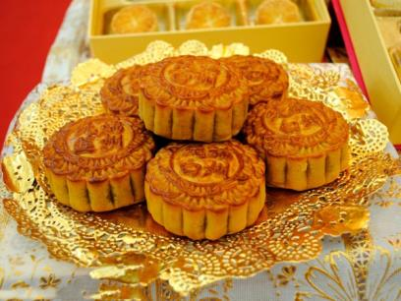
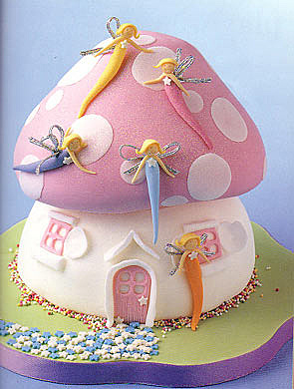
Would you like a cake?
Yes, please.

Slide 10
Let’s practice!

Slide 11
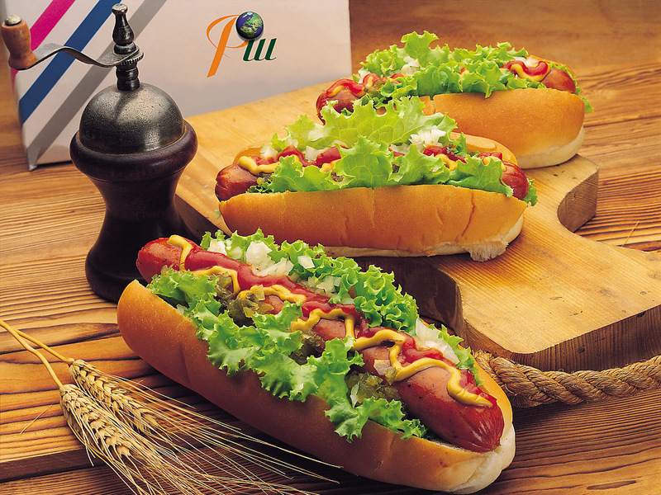
Would you like some sausages?
Yes, ....

Slide 12
...?
No, thank you.

Slide 13
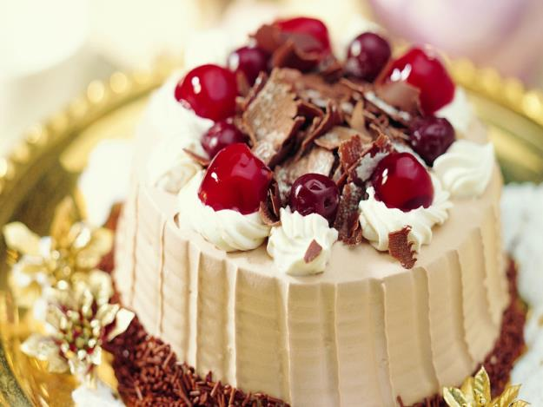
...?
No,…

Slide 14
Would you like some beef?
Yes, ...

Slide 15
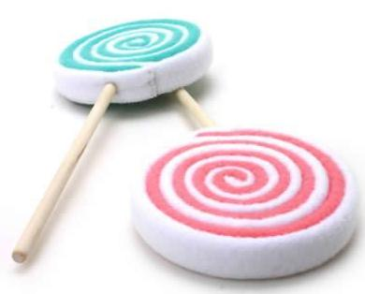
Would you like some sweets?
No, ...

Slide 16
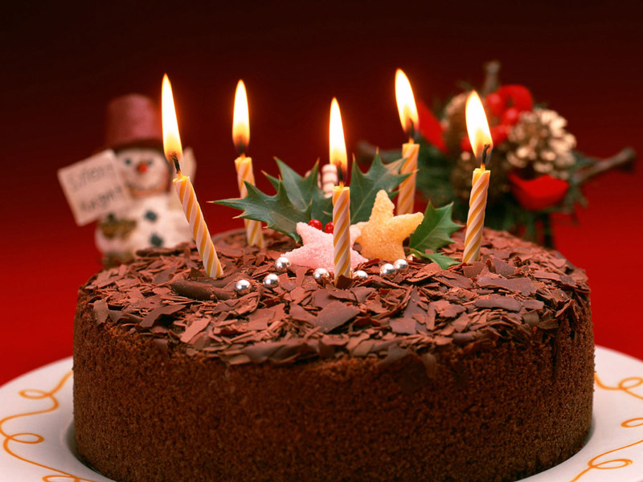
Would you like a cake?
….

Slide 17
…?
No, thank you.

Slide 18
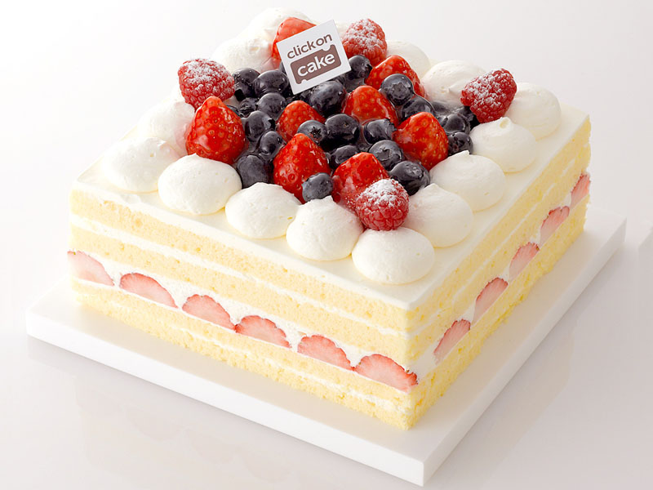
…?
Yes, please.

Slide 19
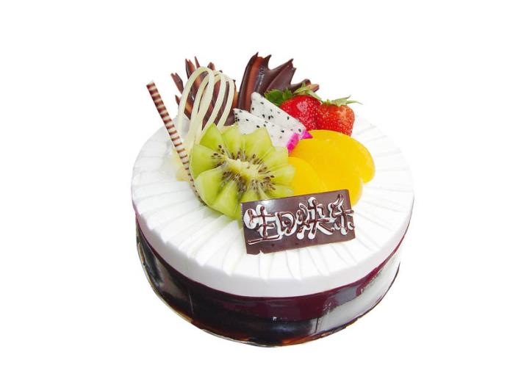
…?
….

Slide 20
Homework
1, talk with your friends about what they want.
2, collect the words of food.

Slide 21
Bye-bye

