Slide 1
七年级英语（JJ下）教学课件
Unit 4 After­School Activities
A Weekend with Grandma
WWW.PPT818.COM

Slide 2
Learning Targets
Key words & phrases:
phone, bookworm, anything, grocery, expensive,
talk to sb., read stories, get sth. for sb., of course, made up of...
Key sentences:
1. She is talking to her grandma on the phone.
2. I can read you one this weekend.
3. The bookstore is just two bus stops away.
4. Do you need anything from the supermarket？

Slide 3
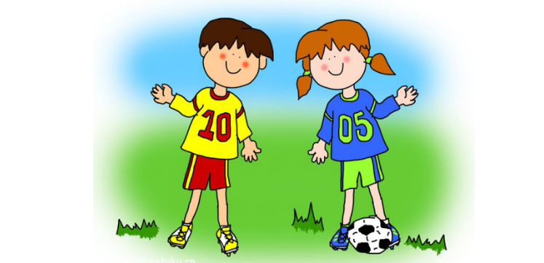
5. I can get it for you.
6. I always buy my groceries at the morning market.
7. The vegetables are fresh and not too expensive.
8. What are we going to have for dinner?

Slide 4
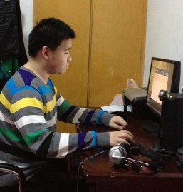
Lead in
Look and guess
What is Mike going to do this Sunday?
He is going
to ________
__________.
surf the
Internet

Slide 5
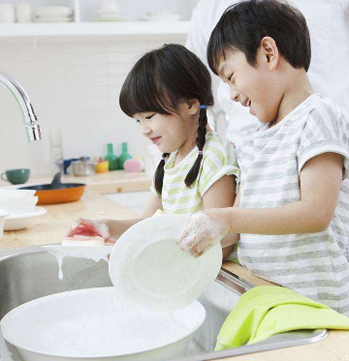
What are they going to do this weekend?
They are going to _______
_________
_______.
help with
the housework
PPT模板：www.1ppt.com/moban/ PPT素材：www.1ppt.com/sucai/
PPT背景：www.1ppt.com/beijing/ PPT图表：www.1ppt.com/tubiao/
PPT下载：www.1ppt.com/xiazai/ PPT教程： www.1ppt.com/powerpoint/
资料下载：www.1ppt.com/ziliao/ 范文下载：www.1ppt.com/fanwen/
试卷下载：www.1ppt.com/shiti/ 教案下载：www.1ppt.com/jiaoan/
PPT论坛：www.1ppt.cn PPT课件：www.1ppt.com/kejian/
语文课件：www.1ppt.com/kejian/yuwen/ 数学课件：www.1ppt.com/kejian/shuxue/
英语课件：www.1ppt.com/kejian/yingyu/ 美术课件：www.1ppt.com/kejian/meishu/
科学课件：www.1ppt.com/kejian/kexue/ 物理课件：www.1ppt.com/kejian/wuli/
化学课件：www.1ppt.com/kejian/huaxue/ 生物课件：www.1ppt.com/kejian/shengwu/
地理课件：www.1ppt.com/kejian/dili/ 历史课件：www.1ppt.com/kejian/lishi/

Slide 6
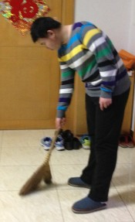
What is Tiantian going to do this weekend?
He is going to _______
_________
.
clean the
room

Slide 7
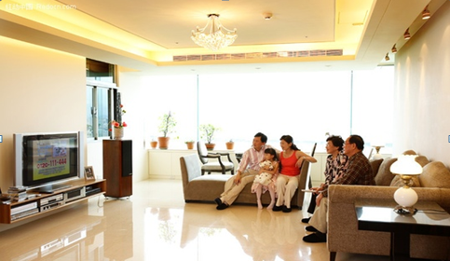
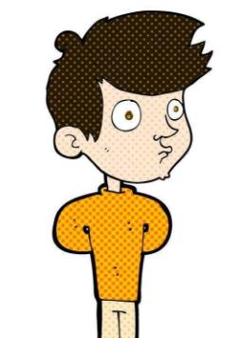
I am going to ________________ with my parents
and my grandparents at home this weekend.
watch TV

Slide 8
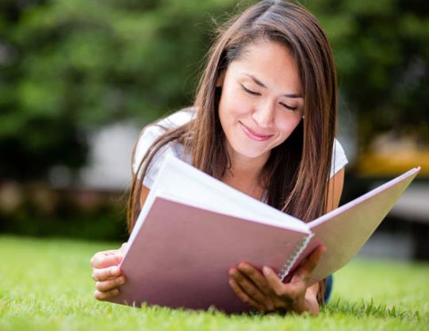
My best friend is going to ________________ next weekend.
read English books

Slide 9
Words and expressions
phone
bookworm
anything
grocery
expensive
talk to sb.
read stories
n. 电话 v.打电话
n. 书迷；书虫
pron. 任何事物；某事
n. 杂货
adj.昂贵的
和某人谈话
读故事

Slide 10
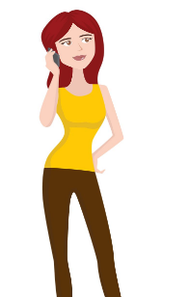
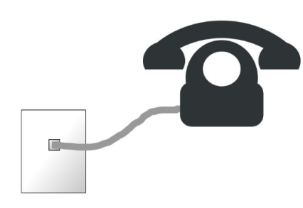
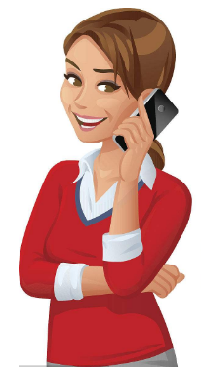
get sth. for sb.
of course
be made up of...
talk on the phone
给某人拿/买某物
当然
由……构成
讲电话；打电话

Slide 11
Presentation
Zhao Hanyu is a Grade 7 student. She is talking to her grandma on the phone.
Hanyu: Hello, Grandma! It’s me Hanyu.
Grandma: Hello, Hanyu. How is school going?
Are you doing well these days?
Hanyu: Yes. I am learning a lot of interesting things
at school. And I am reading some English stories.
I can read you one this weekend.

Slide 12
Grandma: Are you coming to visit us this weekend?
Hanyu: Yes, Grandma. I am going to come over
tomorrow. But I will go to the bookstore first.
Grandma: Sure, my little bookworm. The bookstore
is just two bus stops away. It’s very close.
Hanyu: Do you need anything from the supermarket?
I can get it for you.
Grandma: No. I always buy my groceries at the
morning market. The vegetables are fresh and not
too expensive.

Slide 13
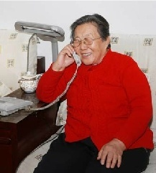
Hanyu: What are we going to have for dinner?
Grandma: Dumplings, of course.
Hanyu: Yay! My favourite food!

Slide 14
Read and then answer according to the passage.
1. How does Hanyu talk to her grandma?
She talks to her grandma on the phone.
2. Hanyu likes books very much,what does grandma call her?
Grandma calls her little bookworm.
3. What can grandma buy from the morning market?
Grandma can buy groceries at the morning market.
4. How about vegetables at the morning market?
The vegetables are fresh and not too expensive.

Slide 15
Let's Do It!
1
What is Zhao Hanyu going to do this weekend? Listen and tick the correct statements.
√
She is going to buy some books at the bookstore.
She is going to read an English story to her
grandma.
She is going to visit her grandparents.
She is going to buy some groceries at the market.
She is going to have dumplings with her grandparents.
√
√
√

Slide 16
2
Read the lesson and answer the questions.
1.How far is the bookstore from Hanyu's grandma's house?
2.Where does Hanyu's grandma buy her groceries? Why?
3. What are Hanyu and her grandparents going to have for dinner tomorrow?
It's just two bus stops away.
At the morning market. Because the vegetables are fresh and not too expensive.
Dumplings.

Slide 17
Now, fill in the blanks with the words or phrases in this lesson.
Zhao Hanyu is a Grade 7 student. She
to her grandma .
is talking
on the phone
talk to sb on the phone和…通电话
on the radio
on TV
on the Internet
on a/the plane
on a/the bus
on a /the bike
媒介，手段
使用交通工具

Slide 18
电话用语
It’s
Hanyu: Hello, Grandma! me,Hanyu.
Grandma: Hello, Hanyu. How is school going?
Hanyu: I a lot of interesting things at
school. And I some English stories.
I can read you ______this weekend.
Grandma: Are you coming to visit us this weekend?
am learning
am reading
one
同类人或事物中的一个，
不特指，复数用ones
read sb sth /read sth to sb
come,go ,leave,fly,arrive,move,start,begin,return

Slide 19
be …away
The school is far away.
The school is two kilometers away.
The school is two bus stops away from the factory.
Hanyu: Yes,Grandma. I come over tomorrow.
But I will go to the bookstore first.
Grandma: Sure, my little .The bookstore is just
two bus stops .It is very close.
Hanyu: Do you need from the supermarket?
I can get it for you .
Grandma: No. I always buy my ___________ at the morning
market. The vegetables are fresh and not
too .
am going to
bookworm
away
anything
need
1.情态动词：need+do
否定式：needn’t
2.实义动词：有人称数时态的变化，
人+need+to do/物+need+doing
否定式：don’t need
groceries
expensive

Slide 20
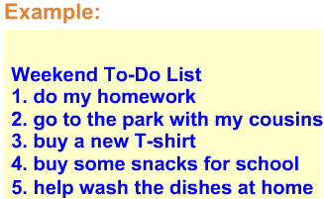
Pair work
3
What are you going to do this weekend? Make a to-do list for this weekend. Talk about your list with a partner and then write a report.

Slide 21
Report:
On Saturday evening, I’m going to do my homework. On Sunday morning, I’m going to the park with my cousins. On Sunday afternoon, I am going to buy a new T-shirt for my dad and some snacks for school. On Sunday evening, I am going to help my mum wash the dishes at home.

Slide 22
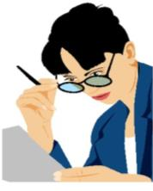
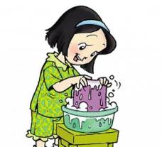
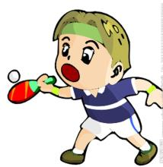
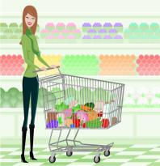
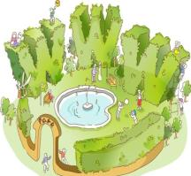
Let's Do Some Activity! Watch & Talk. Ms. Liu’s To-Do List
1. wash clothes
2. go to Huiyou Supermarket
3. play ping-pong with
my son
4. go to Huayang Park
5. prepare lessons

Slide 23
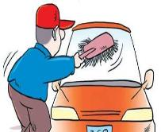
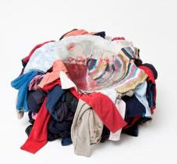
But he never does it.
Let's make a story of Mr. Going-to-do
Mr. Going-to-do usually says:
“__________________________.”
I'm going to wash my car tomorrow
Mr. Going-to-do usually says:
“______________________________.”
I'm going to clean my house tomorrow
Mr. Going-to-do usually says:
“___________________________________.”
I’m going to wash my clothes tomorrow

Slide 24
Language points
1. She is talking to her grandma on the phone.
on the phone 意为“在打电话，在通电话”。介词 on表示“通过某种方式”；phone 作名词，意为“电话”。例：My mother is busy. She is talking on the phone.我妈妈很忙。她在打电话。
【拓展】phone作动词，意为“打电话”，其后跟名词或者代词。常用短语：phone sb.＝call sb. (up) ＝give sb. a call＝make a phone to sb. 给某人打电话。
例：You can phone us anytime.你可以随时给我们打电话。

Slide 25
2. I can read you one this weekend.
one num. 一个; （数字）一
n. 一个人; 一体; 一点钟;
pron. 一个人; 任何人; 东西
【辨析】one、it 与 that
三者都可以作代词，区别在于：
one | 它既可以指代人，也可以指代物，主要用来泛指上文提到的同类人或事物中的另外一个，但是并非上文的那一个，即“同类异物”；如果是指代同类人或者物中的一些的话，要用ones。

Slide 26
it | 它用来特指前面提到的事物本身，即就是那个，“同类同物”。它既可以指代可数名词，也可以指代不可数名词。
that | 它只能用来指代物，不能指代人；可以指代可数名词和不可数名词；它指代的是同类事物中的另一个，也是“同类异物”，常用于比较级中；如果指代复数名词的话，用those。

Slide 27
【辨析】one、it 与 that
例 ：I can't find my hat. I think I must buy a new one. 我找不到我的帽子了。我想我该去买一顶新的。
The hat you bought is bigger than that I bought. 你买的那顶帽子比我买的大。
I can't find my hat. I don't know where I put it. 我找不到我的帽子。我不知道我把它放在哪了。
I have lost my umbrella. I'm looking for it. 我的雨伞丢了。我正在寻找它。

Slide 28
3. The bookstore is just two bus stops away.
该句是 “主语＋be动词＋数词＋量词＋away (from + 地点)的结构，意思是“……(距离某地)有多远”。
例：The nearest bus stop is about 5 miles away from the hospital. 最近的一个公交车站离这家医院大约有5英里远。
【拓展】be far away from... 离……远；远离……
例：He lives far from his school, so he gets up early. 他的住处离学校远, 所以他起得早。

Slide 29
4. It's very close.
close 作形容词，意为“近的，接近的”。常用短语：be close to 接近……；离……近。例：My house is quite close to the hotel. 我家离这个酒店很近。
【拓展】①close 作形容词时，还可意为 “紧密的，亲密的”，常用于形容关系的亲密程度。
例：He is a close friend of mine. 他是我的亲密好友。
②close 还可作动词，意为“关闭”。
例：Please close the windows, Jack. 杰克，请关窗。

Slide 30
5. Do you need anything from the supermarket？
need 作动词，意为“需要”。它在句中作实义动词，后面可接名词、代词、动词不定式或动词­ing形式作宾语。常用短语：① need to do sth. 需要做某事。例：They don't need to buy a new house. 他们没必要买新房子。② sth. need doing 某物需要被…… 此时的 doing有被动含义，可以用 to be done替代。例：My bike needs repairing/to be repaired. 我的自行车需要修了。

Slide 31
【拓展】need 也可以作情态动词，后跟动词原形，意为 “需要”。它通常用于否定句、疑问句和条件句中。needn't ＝don't have to 不必 (常用来否定回答must引出的疑问句)。
例：You needn't do it again. ＝ You don't have to do it again. 你不需要再做一次。
— Must I do my homework today? 我必须今天做作业吗？ — No, you needn't. 不，你不必今天做。

Slide 32
6. I can get it for you.
get sth. for sb. / get sb. sth. 给某人拿/取/捎/带/买某物，与 bring sb. sth. 和 bring sth. to sb. 同义。
例：Can you get me a cup of tea？＝Can you get a cup of tea for me？你能给我拿杯茶吗？
Actually you don't have to bring me a gift for my birthday. ＝ Actually you don't have to bring a gift to me for my birthday. 事实上，你没必要为我的生日买礼物给我。

Slide 33
7. The vegetables are fresh and not too expensive.
(1) too是副词，意为“太”，用来修饰形容词或者副词，强调的是程度超出了允许的范围。固定搭配：too...to... 太……而不能……；
can't be too... to... 再……也不为过/不过分。
例：The rain is too heavy. 雨太大了。
He is too young to go to school alone. 他太小了，还不能独自去上学。
You can't be too careful to drive your car. 开车时，你再仔细也不为过。

Slide 34
(2) expensive 作形容词，意为“昂贵的”。
其反义词为 cheap(便宜的)；其比较级为 more expensive(更贵的)；最高级为the most expensive (最贵的)。
【注意】修饰价格（price）常用 high（高） 和 low (低），不能直接用expensive 和cheap。
例：The pen is too expensive. 这只钢笔太贵了。
The price of the pen is too high. I don't have enough money. 这只钢笔的价格太高了。 我的钱不够。

Slide 35
Exercises
一、单项选择。
1. —Why don't you buy the sweater?
—It's too_____，and I don't have enough money
to buy it. (2017·湖北随州)
A．nice B．expensive
C．popular D．cheap
2. Fire is very dangerous.You can't be ________
careful with it！(2017·江苏盐城)
A．very B．quite C．so D．too

Slide 36
3. The island is quite hot all year round，because
it's ______ the equator（赤道）.
A．next B．close to
C．far from D．behind
4. —I'm a little hungry，Mum!
—There are some apple pies on the table，
you may take________. (2017·山东泰安)
A．it B．this C．that D．one

Slide 37
二、根据句意及首字母提示完成句子。
1. Is this sweater cheap or e_________, madam?
2. The market isn’t f ________ from here. We can walk there.
3. These vegetables look nice and f________. Would you like some?
4. There isn’t a ________ new in today’s newspaper. I’ll read a book then.
5. I’m going to the b________ to buy some books.
xpensive
ar
resh
nything
ookstore

Slide 38
三、根据汉语意思完成句子
1. 我在学校里学了一些有用的东西。
I learned __________ _________ at school.
2. 今天晚饭我们要吃什么？
What are we ______ ______ ______ ______
supper?
3. 邮局只有两站地远。你可以骑自行车去。
The post office is just two bus stops _______.
You can go there ______ ______.
something
useful
going
to
have
for
away
by
bike

Slide 39
4. 奶奶，明天我过来吃午饭。
Grandma, I am _______ ______ ______ ______ lunch tomorrow.
5. 李平，你能给我们读一下这个故事吗？
Li Ping, ______ ______ ______ this story to us?
6. 你在悉尼的生活怎么样？ _______ ______ your life in Sydney ______?
7. 莉萨学习努力，各科成绩都不错。 Lisa studies hard and ______ ______ in all her subjects.
coming
over
to
have
can
you
read
How is
going
does
well

Slide 40
四、用方框中的词补全对话。
meet exercise relax office bore
A: Hi, Mike! What do you often do after work?
B: Oh, I often listen to some music to (1) __________.
A: That’s a little (2) __________. You are good at
tennis. Why not join a tennis club?
B: A tennis club?
A: Yes. I’m a member of the club. We (3)__________ at 7:30 p.m. every Wednesday.
relax
boring
meet

Slide 41
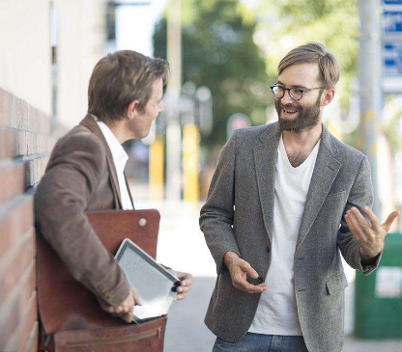
B: Where is it? A: It’s not far away from our (4)__________, just
next to the post office. B: It sounds good. A: You can get (5)________
and make new friends in
the club. B: OK. I’ll join you. A: That’s great.
office
exercise

Slide 42
Summary
What have we learned in this lesson?
1. We learned some new words and phrases: phone, bookworm, anything, grocery, expensive, on the phone...
2. We know how to use “be going to…”
3. We are going to visit …

Slide 43
Homework
1. Write a short passage about your parents’
weekend plan.
2. Finish the exercises of this lesson.
3. Review what we learned today.
4. Preview Lesson 24.

