Slide 1

Module 5
Look after yourself
Unit 2 Got off the sofa!
WWW.PPT818.COM
Notes:
1
www.enteacher.cn

Slide 2
Revision
Translate the phrases into English.
照顾，照料
追上，赶上
摔下来
失明
打电话求助
不很严重
取消
look after
catch up
fall over
go blind
call for help
nothing serious
call off

Slide 3

What do you like doing in your spare time?

Slide 4
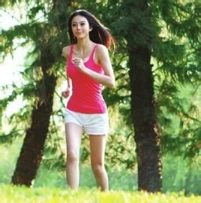

do exercise
enjoy music

Slide 5
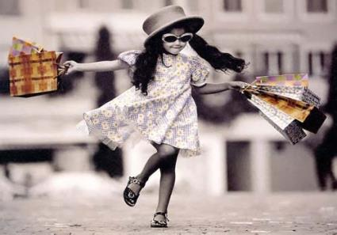
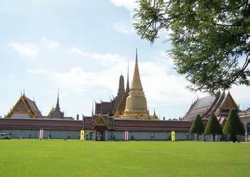
travel
go shopping

Slide 6
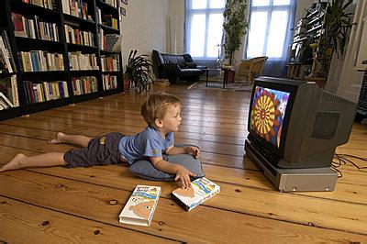
watch TV

Slide 7
We call people who spend too much time watching TV on the sofa ‘couch potato’.
Are you a couch potato?

Slide 8
Discussion
1. Do you think it’s good for your health to sit in the sofa and watch TV all day?
2. What can we do to keep fit?

Slide 9
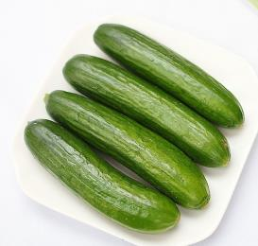
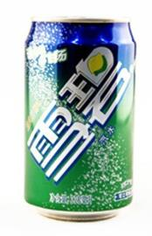
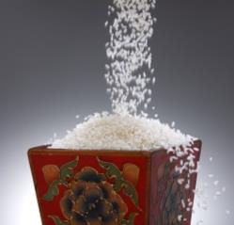
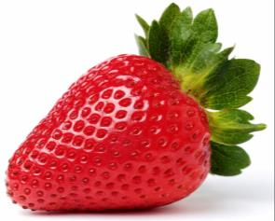
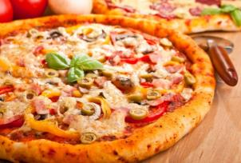
healthy or unhealthy

Slide 10
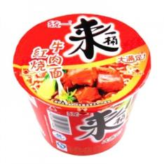
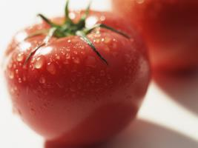
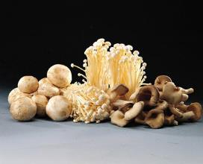
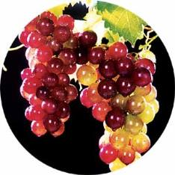
healthy or unhealthy

Slide 11
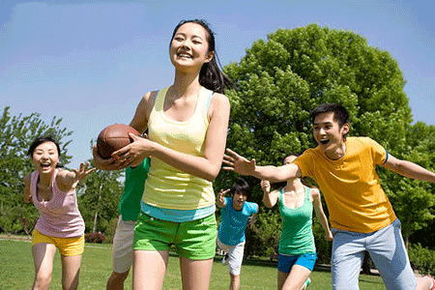
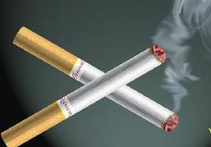
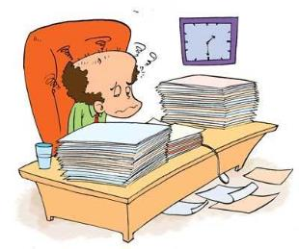
healthy or unhealthy

Slide 12
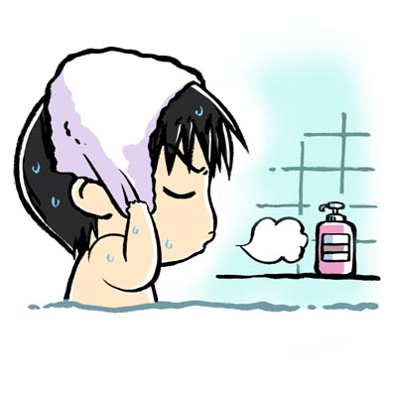
What should we do to be healthy?
We should / must keep our bodies clean.

Slide 13
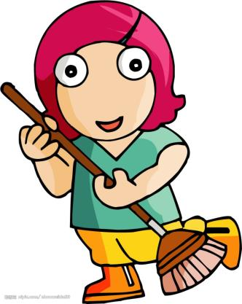
We should / must sweep the floor.

Slide 14
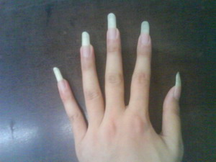
We shouldn’t / mustn’t keep fingernails long.

Slide 15
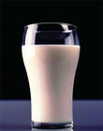
过期牛奶
We shouldn’t / mustn’t drink sour milk .

Slide 16

We should / must give up smoking.

Slide 17
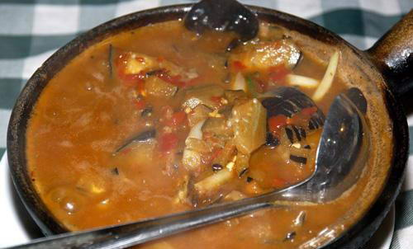
We shouldn’t / mustn’t eat bad food.

Slide 18
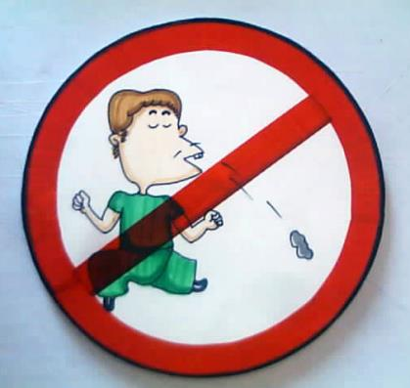
We shouldn’t / mustn’t spit in public.

Slide 19
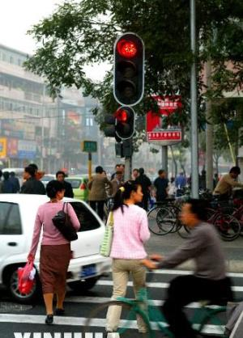
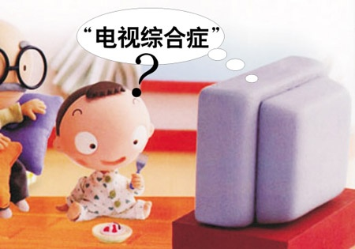
Look at the pictures. Please describe them in oral English. And tell us what is your feeling when you see them.

Slide 20
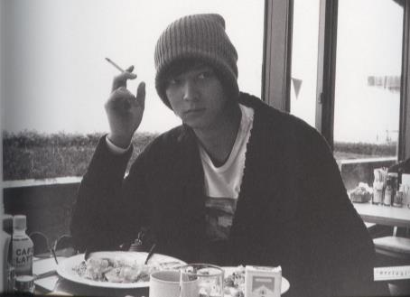
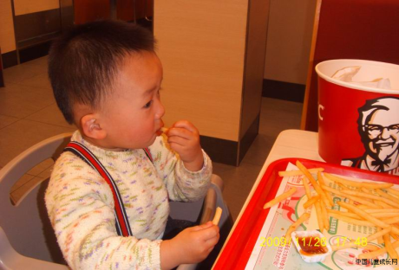
Notes:
中国英语教师网
20

Slide 21
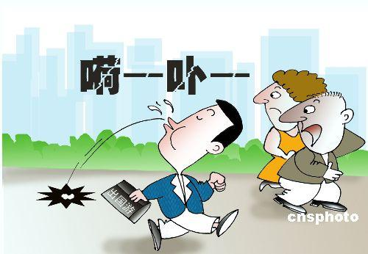
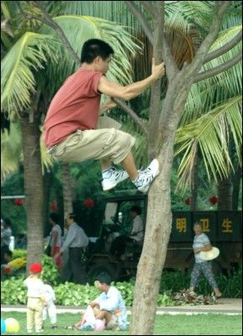
Notes:
中国英语教师网
21

Slide 22
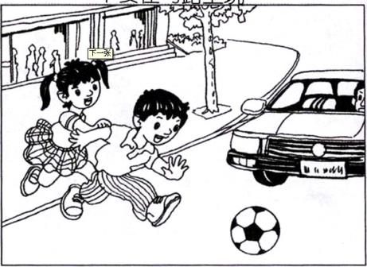
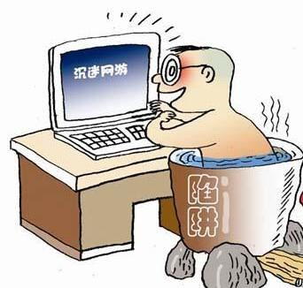

Slide 23

2
Read the passage and match the rules with the pictures.
Picture a — Rule 2
Picture b — Rule 4
Picture c — Rule 3
Picture d — Rule 5
Picture e — Rule 1

Slide 24
Read again and answer the questions.
1. What are the five rules for a healthy life according to the writer?
2. Are people today getting the same amount of exercise as they did in the past? Why?
The five rules are:
1. Take exercise; 2. Eat healthy food;
3. Rest and sleep when you can;
4. Do not worry. Be happy; 5. Don’t smoke.
No, they aren’t. People today get less exercise because their work requires less physical effort.

Slide 25
3. Why is it sometimes difficult to be a teenager?
4. Who do you think the passage is written for?
Teenagers have difficulties with school, exams and friendships.
The passage is written for teenagers.

Slide 26
Read the first part carefully and choose the best answers.
( ) 1. People who are born today can expect to live ______ years longer than those who were in the 19th century.
A. 15 B. 25 C. 35
( ) 2. There are more and more people celebrating their _______ birthday.
A. 80th B. 90th C.100th
C
C

Slide 27
Read the second paragraph carefully.
Decide “T” or” F”.
1.You should walk 1000 steps every day if you keep fit. ( )
2.People get the same exercise today as they used to. ( )
F
F

Slide 28
Read the paragraphs 3-5 carefully.
Fill in the blanks.
1.It is___________ to eat plenty of the right things. The wrong food will ______ your health.
2.Teenagers should have about_________ hours’ sleep.
3.If you are worried about something, talk to your ________ or your _______.
important
harm
eight
parents
teacher

Slide 29
Read the paragraph 6 carefully.
Answer the questions.
1. Does the writer think smoking is cool?
2. Why is smoking dangerous?
No.
Because it harms nearly every part of our body.

Slide 30

Do you know how to keep a healthy lifestyle? Share your ideas with your classmates.

Slide 31
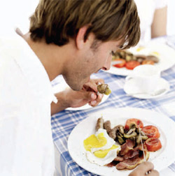
eat breakfast

Slide 32
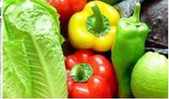
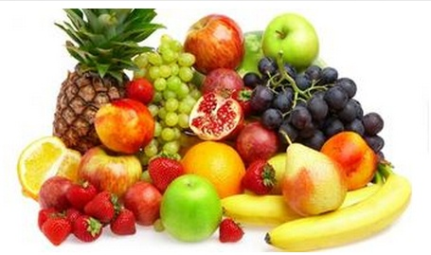
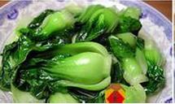
eat fruit and vegetables

Slide 33

play sports

Slide 34

have a good mood

Slide 35
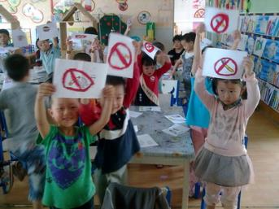
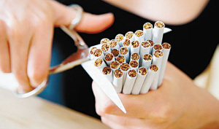
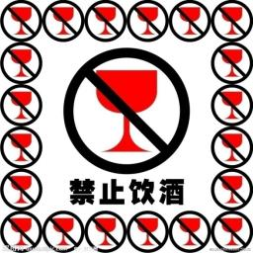
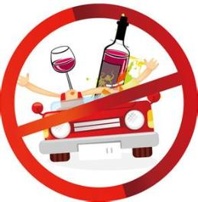
Keep away from drinking and smoking.

Slide 36
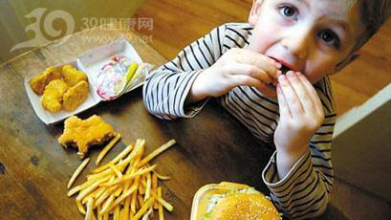
Don’t eat a lot of potato chips.

Slide 37
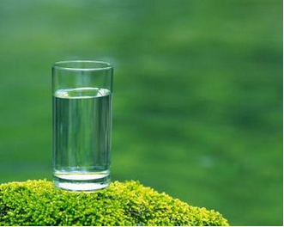
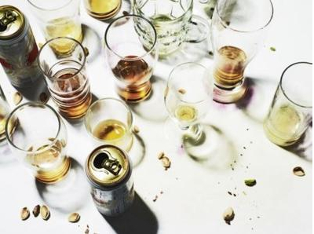
Drink water every day.
Don’t have lots of drinks.

Slide 38
Complete the passage with the words in the box.
effort expect harm health sofa
Exercise is very important. If you make a(n) ________ to do exercise for thirty minutes a day, you can _______ to be in good ________.
However, if you are always sitting on the _________ and do no exercise at all, you will put on weight and ________ your health.
effort
expect
health
sofa
harm

Slide 39

Talk about rules 1-5 simply.
Talk about what you should do /
shouldn’t do.

Slide 40
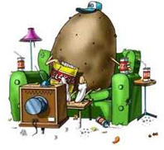
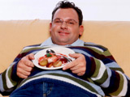
1. Get off the sofa.

Slide 41
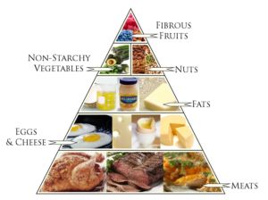
2. Eat healthy food.

Slide 42
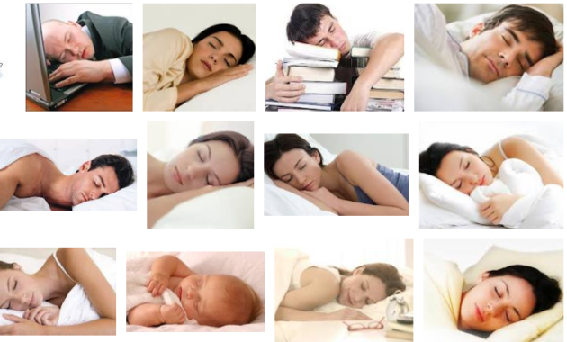
3. Rest while you can.

Slide 43
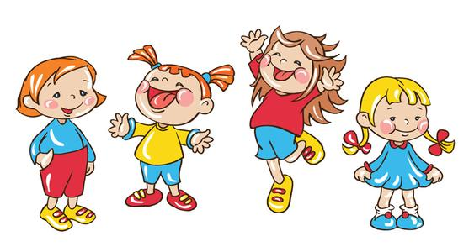
4. Do not worry. Be happy!

Slide 44
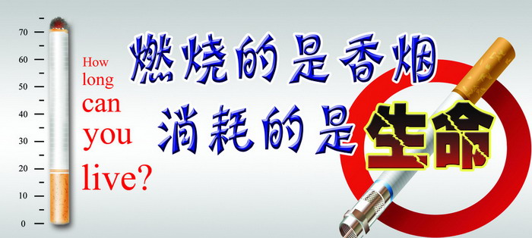
5. Say no to smoking!

Slide 45

Think of more rules and examples of your own.

Slide 46
Some tips
Eat healthy.
Eat a variety of fruits, vegetables, and
whole grains every day.
Limit foods and drinks high in calories,
sugar, salt, fat, and alcohol.
Eat a balanced diet to help keep a healthy
weight.
Notes:
中国英语教师网
46

Slide 47
Be active.
Be active for at least 2½ hours a week. Include activities that raise your breathing and heart rates and that strengthen your muscles.
Help kids and teens be active for at least 1 hour a day. Include activities that raise their breathing and heart rates and that strengthen their muscles and bones.
Notes:
中国英语教师网
47

Slide 48
Protect yourself.
Wear helmets, seat belts, sunscreen, and insect repellent.
Wash hands to stop the spread of germs.
Avoid smoking and breathing other people’s smoke.
Build safe and healthy relationship with family and friends.
Be ready for emergencies. Make a supply kit. Make a plan. Be informed.
Notes:
中国英语教师网
48

Slide 49
Manage stress.
Balance study and play.
Get support from family and friends.
Stay positive.
Take time to relax.
Get 7-9 hours of sleep each night.
Get help if needed.
Notes:
中国英语教师网
49

Slide 50

Write a passage.
My Rules for a Healthy Life
Include the rules and examples you have written in Activity 5 and Activity 6.

Slide 51
My Rules for a Healthy Life
Here are my rules for a healthy life. The first and most important one is to get enough rest. You must always get enough rest! If you are tired, you will not be able to concentrate properly, and you will be in a bad mood all the time. The second is to make sure that you eat properly. Make sure you eat enough rice, vegetables and meat. Stay away from fast food enough, and don’t overeat.

Slide 52

The third rule is to exercise twice a week. If you don’t exercise at least this much, your body will get stiff and weak. The fourth rule is to care for your friends and your family. Not only will your friends and family be happy, you will too!

Slide 53
(2011 四川宜宾) 第三节：书面表达
健康一直是人们关注的问题，我校要举行以关爱健康为题的主题班会,请根据以下内容谈 谈你的看法。
1) 保持健康的重要性；
2) 保持健康的方法：多吃水果蔬菜；每天锻炼一小时；再睡早起；勤洗手；
3) 自己的看法（至少一条）
注意：1.文中不能出现校名和自己的姓名；
2. 内容可适当扩展。
3. 字数为 60—80 词。

Slide 54
It is very important for us students to keep healthy. There are many ways to be healthy. We’d better eat more fruits and vegetables. Take exercise for at least one hour every day. We need enough sleep and rest so it is important to go to bed early and get up early. Besides, we should wash our hands as often as possible. In my opinion, we mustn't drink wine or smoke. They are bad for our health.

Slide 55
Do you know these sayings?
An apple a day keeps the doctor away.
每天一只苹果，健康有保障.
A close mouth catches no flies. 病从口入
Music is the medicine of the breaking heart.
音乐是医治心灵创伤的好药。
Heath is not valued till sickness comes.
有疾病方知健康的可贵。
Reading is to the mind what exercise is to the body.
读书养心，锻炼健身。

Slide 56
Wealth is nothing without health.
失去健康，钱再多也没用。
There is no medicine against death.
没有长生不老药。
Reading is to the mind while exercise to the body.
读书健脑，运动强身。
Health is better than wealth.
健康胜过财富。
Eat a mouthful less. Take a walk after dinner.
吃饭少一口，饭后走一走。

Slide 57
Language points
1. Thanks to better health care, ...
thanks to 由于，因为
Thanks to your help we were successful.
Thanks to the warm and sunny weather, oranges grow very well here.

Slide 58
[辨析]
because of, thanks to均表示“由于”之意。
because of: 着重某个结果的原因，在句中通常作状语。
thanks to: 突出一种感激之情，含“多亏”意味。

Slide 59
知识链接
thanks for是客套用语，thanks相当于 thank you，意为“因……而感谢”，for强调为何而感谢，其后可接名词或v-ing。
Thanks for your help.
Thanks for inviting us to your birthday party.

Slide 60
2. … can expect to live about …
expect v. 期望；预料
The journey was not as nice as we had expected.
旅途不像我们预料的那样好。
I expect that I will be back on Sunday.
我预计我会在周日回来。
We expected him to arrive yesterday.
我们原以为他昨天能到。

Slide 61
知识链接
expect其后可接 that 从句，若从句谓语为否定，注意否定的转移。如：
I don’t expect that he has done such a thing.
我预料他不会干出这种事来。
expect其后可接 that 从句，但不接疑问词引导的从句，若遇有疑问词，则要使用“疑问词+do you expect …”这样的句式。
When do you expect to leave?
你想什么时候离开?

Slide 62
【2011山东威海】34.What time do you expect her________?
A. arrive B. is arriving
C. arriving D. to arrive
【解析】考查动词的用法。expect sb. to do sth. 意为“期望/期待某人做某事”，符合题意。
D

Slide 63
— I haven’t seen Jack for three days, is he ill?
— _______. His mother told me that he was
in hospital.
A. I am afraid so B. I hope not
C. I don’t expect D. I am afraid not
【解析】一般来说我们不希望别人生病，如果不注意语境的话，就很可能误选为B或D。由下文His mother told me that he was in hospital. 可知Jack可能生病了。I am afraid so. 意为“恐怕是这样的”，常用来表示一种不太肯定的语气。正确答案为A。
A

Slide 64
— Do you think the Australian Cricket
Team will beat the New Zealand Cricket
Team?
— Yes. They have better players, so I
________ them to win.
A. prefer B. want
C. hope D. expect
D

Slide 65
3. To keep fit …
keep fit = keep healthy 保持健康
keep (sb. / sth.) + adj. 保持 / 护某人 /物 ……
keep our classroom clean 保持教室清洁
It's important for the college freshman
to keep his nose clean.

Slide 66
在现代社会, 越来越多人发现保持健康很重要。
In modern society more and more people find it important _______________.
to keep fit
/ to keep healthy

Slide 67
4. … required more physical effort.
require v. 要求；需要；命令
We'll let you know if we require further help.
我们如果需要更多帮助就告诉你。
The headmaster required her to keep silent.
校长命令她保持安静。

Slide 68
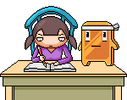
require sb. to do sth. 要求某人做……
sb. be required to do sth. 某人被要求做……
Our teachers require us to study hard.
We are required to study hard by our teachers.

Slide 69
(2013.扬州) --- Mr Li, I can't understand everything in class.
--- Don't worry! I'll _______ the main points at the end.
A. record B. review
C. require D. remember
B

Slide 70
知识链接
ask, require均有“要求，请求”之意。
ask:最普通用词，指向对方提出要求或请求，长、晚辈，上下级之间都可使用。
require:强调根据事业、需要或纪律、法律等而提出的要求。

Slide 71
effort n. 力气；精力
It doesn't need much effort.
那不需要太多的精力。
I will make every effort to arrive on time.
我将尽一切努力准时到达。
He spoke in English with effort.
他努力地用英语讲。
He lifted the rock without effort.
他毫不费力地举起了石头。

Slide 72
【2014 安徽】—More and more people come to visit Mount Huangshan.
—That’s true. It has become the ______ of Anhui.
A. pride B. effort
C. praise D. courage
A

Slide 73
effort
词 性 | 中文释义 | 词 组
不可数名词 | 努力，尽力 | put effort into sth.对某事付出很大力气
 |  | spare no effort 不遗余力
 |  | without effort 不费力
 |  | a waste of time and effort时间和精力的浪费
可数名词 | 努力的事； 努力的结果 | make an effort 努力
 |  | make every effort 竭尽全力

Slide 74
翻译句子
他为音乐会付出了很大力气。
He put a lot of effort into the concert.
2. 他们没费劲就把那块沉重的石头抬起来了。
They lifted the heavy rock without effort.
3. 我将尽一切努力写完这个报告。
I will make every effort to finish writing the report.

Slide 75
5. Do you get the same amount of exercise today as they did in the past?
the same as … 和……一样
— She looks the same as Lucy.
— They are the twin sisters.
她看起来和露西长的一样。他们是双胞胎姐妹。
反义短语： be different from

Slide 76
1). Most of teenagers don't like talking with their parents, but I am_____ them. I love to talk with my parents.
A. the same as B. different from
C. interested in D. strict with
2). It’s clear that this visit is different from last time.
It’s clear that this visit is not the ______ ______ last time.
B
same
as

Slide 77
3). Let’s meet at _______ place as we did yesterday.
A. a same B. same
C. the same D. same the
4). This is ______________ I lost yesterday.
这个书包和我昨天丢失的相似。
C
the same bag as

Slide 78
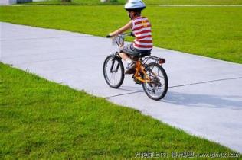
6. You should only have it once in a while.
once in a while 偶尔，有时
We go out for a walk once in a while.
我们偶尔出去散散步。
近义短语： at times
now and again
now and then
from time to time

Slide 79
7. … will harm your health.
harm v. 伤害；损害
Smoking harms our health.
吸烟有害健康。
I have never harmed anyone.
我从没伤害过任何人。

Slide 80
知识链接
harm n. 危害；伤害；损害
do harm to … 对 … 有害
Reading in bed will do harm to your eyes.
躺在床上看书对你的眼睛有害。
harmful adj. 有害的
Smoking is harmful to health.
吸烟对身体有害。

Slide 81
知识链接
harm, damage, hurt, injure, wound这组词的共同意思是“损害, 损伤”。
harm表示人的心理、健康、权力或事业上的损害, 程度较轻;
damage表示损害了表面, 损害了人或物的某个部分或使之完全失掉用途;
hurt多用来表示伤害身体或某一部位, 或表示剧烈的疼痛或精神上受到伤害;
injure表示身体或精神上各种性质及任何程度的伤害, 多表示意外受伤;
wound主要指在战斗中武器或凶器等造成的外伤或剧烈的痛苦。

Slide 82
8. … do not need as much sleep as babies.
as … as 结构的意思为“与……一样”，中间加形容词或副词原级。
The tree is as tall as the building (is)．
这棵树和那栋楼一样高。
You’ve made as many mistakes as I have.
你犯的错误和我犯的一样多。

Slide 83
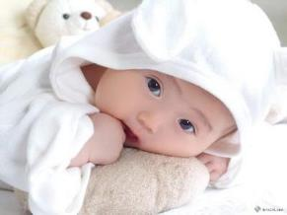
在否定句中，第一个as 可以用 so 代替,构成 “not so / as … as”, 例如：
He doesn’t study as / so hard as his brother.
他学习不如他弟弟努力。

Slide 84
Wang fang is young, but she plays ping-
pang _____ her mother.
A. as good as B. as well as
C. as better as D. as best as
Paul isn’t as ______ as Sandy. He often
makes mistakes in his homework.
A. careless B. more careful
C. more careless D. careful
B
D

Slide 85
【2013山东临沂】When an earthquake
happens, and you are outdoors, you should go
to an area as ______ as possible.
A. quickly B. quietly
C. loudly D. slowly
【2013广西玉林】Liu Ying is good at singing.
She sings ______ the famous singer, CoCo.
A. as well as B. as good as
C. as better as D. as the best as
A
A

Slide 86

【2013 上海】The volunteer spoke as _______ as she could to make the visitors understand her.
A. clearly B. more clearly
C. most clearly D. the most clearly
A

Slide 87
翻译句子
1. 李雷和吉母跑得一样快。
2. 约翰的年龄和你的不一样大。
3. 这部电视剧不如那部有趣。
Li Lei runs as fast as Jim.
John is not as / so old as you.
This TV series is not as / so interesting
as that one.

Slide 88
知识链接
as soon as 和…一样快；一…就…
as much as 和…一样多；多达
as long as 和…一样长；长达；只要
as well as 和…一样好；和 …一样
as far as 远达；就…来说
as … as possible / sb. can 尽可能…

Slide 89
9. Say no to smoking and drug!
say no / yes to …表示 “向…… 说不 / 行”，即“拒绝 / 同意”。如：
Did you say yes to (= accept) her invitation?
Their offer was so good that I couldn’t say no.

Slide 90
Practice Please translate them into
English.
thanks to
expect to do sth.
the hundredth birthday
keep (stay) fit / healthy
once in a while
harm one’s health
as … as
say no to …
多亏……
期望做某事
第100个生日
保持健康
偶尔
有损健康
和 … 一样
对……说不
Notes:
中国英语教师网
90

Slide 91
大多数的人生活地更健康、更长寿。
你有过去的人们那们多的运动量吗？
每晚拥有8个小时左右的睡眠很重要。
Most people are living healthier and longer lives.
Do you get the same amount of exercise as people did in the past?
It’s important to get about eight hours’ sleep a night.
Notes:
中国英语教师网
91

Slide 92

远离沙发。
尽量多休息。
对吸烟说不。
Get off the sofa!
Rest while you can!
Say no to smoking!
Notes:
中国英语教师网
92

