Slide 1
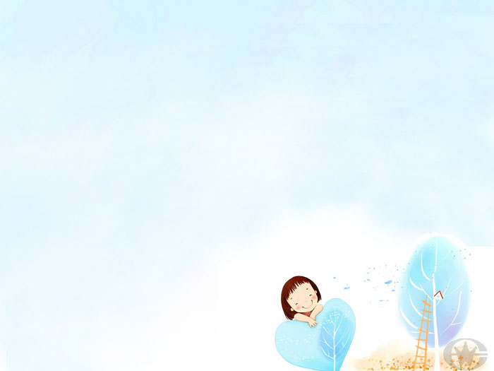
八年级 英语 上
Unit 3 A day out
Grammar (Ⅱ)
WWW.PPT818.COM

Slide 2
人称代词分为主格、宾格、形容词物主代词、名词性物主代词以及反身代词。反身代词也叫自身代词。要想掌握反身代词其实并不难。下面将反身代词的构成和用法介绍给大家：

Slide 3
人称代词
主 格 | I | you | he she it | we | you | they
宾 格 | me | you | him her it | us | you | them

Slide 4
物主代词
形容词性物主代词 | my | your | his her its | our | your | their
名词性 物主代词 | mine | yours | his hers its | ours | yours | theirs

Slide 5
反身代词
单数 | myself | yourself | himself | herself | itself
复数 | ourselves | yourselves | themselves

Slide 6
反身代词的用法
1. 反身代词不能作主语, 但是它可以作主语的同位语，放在主语后或句末。如：
我亲自去了电影院。
误：Myself went to the cinema.
正：I went to the cinema myself.

Slide 7
2. 反身代词可以作宾语的同位语。如：
I wish I could hear Beethoven himself
play this music.
3. 反身代词可以作介词的宾语。如：
I mended the bike by myself.
She said to herself: “what’s wrong
with my eyes?”

Slide 8
4. 反身代词作动词的宾语。一般放在这些动词后面： enjoy, help, hurt, teach, wash, look after, get, dressed, buy等。如:
Did you enjoy yourselves at the weekend?
He teaches himself English at home.
“Help yourselves to some fish.”

Slide 9
5. 反身代词可以作表语。如:
I am not quite myself today.
He doesn’t seem himself this morning.

Slide 10
What happened at South Hill?
Finish the exercises on Page 36.

Slide 11
Practice
1. My bike is broken. May I use _____ (you)?
2. I taught ______ (I) Russian for three years.
3. Help _________ (you) to some fish, children.
yours
myself
yourselves

Slide 12
4. She fell off the bike and hurt ______ (she).
5. We enjoyed ________ (we) just now.
herself
ourselves

Slide 13
Homework
Remember the use of Reflexive pronouns.

