Slide 1
I'm watching TV.
Section A 第1课时
WWW.PPT818.COM

Slide 2
use
wash
read a newspaper
make soup
go to the movies
eat out
drink tea
just
tomorrow
house

Slide 3
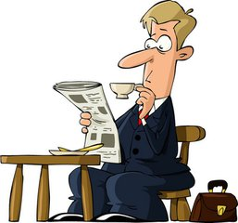
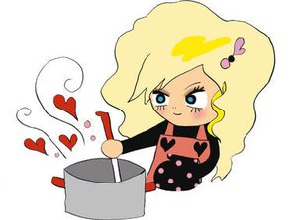
My father is reading a newspaper.
newspaper /'njuːzpeɪpə(r)/ 报纸
read a newspaper 看报纸
My mother is making soup.
soup /suːp/ 汤
make soup 做汤

Slide 4
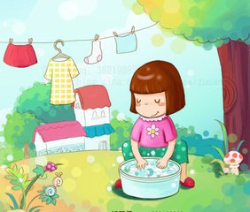
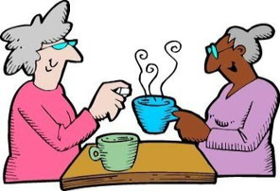
Linda is washing clothes.
wash /wɒʃ/ 洗
wash clothes 洗衣服
They are drinking tea.
drink /drɪŋk/ v. 喝 n. 饮料
drink tea 喝茶

Slide 5
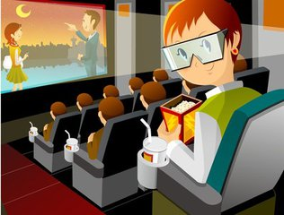
movie /'muːvi/ 电影
go to the movies 去看电影
tomorrow /tə'mɒrəʊ/ 明天
eat out 出去吃饭
---Do you want to go to the movies with me tomorrow?
---Of course. Then we can eat out.

Slide 6
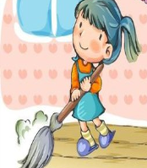
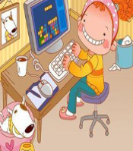
just /dʒʌst/ 只是、恰好
house /haʊs/ 房子
use /juːz/ 使用 -- using
---What are you doing now?
---Not much. I'm just cleaning the house. What about you?
---I'm using the computer.

Slide 7
根据汉语意思或首字母提示完成句子
1. I'm thirsty. I want something to d______.
2. My grandpa is ______________. （喝茶）
3. I want ___________________.（去看电影）
rink
drinking tea
to go to the movies

Slide 8
完成句子
1. Can you _____________?
你会做汤吗？
2. My brother is ________ the computer.
我的弟弟正在使用电脑。
make soup
using

Slide 9
副 词
just tomorrow
词 组
动 词
read a newspaper
make soup
go to the movies
eat out
drink tea
use
wash
key words
名 词
house

