Slide 1
Unit3 It’s a pineapple.
人教精通版四年级上册
WWW.PPT818.COM

Slide 2
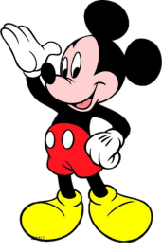
Play a game
Review
What’s this?

Slide 3
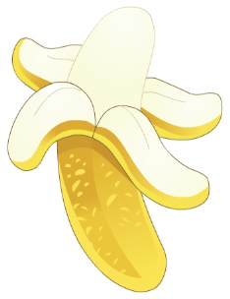
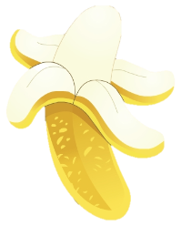
Let’s learn
Presentation
a
banana
bananas

Slide 4
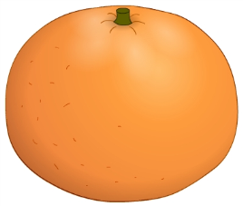
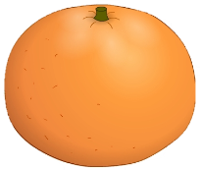
Let’s learn
Presentation
an
orange
oranges

Slide 5
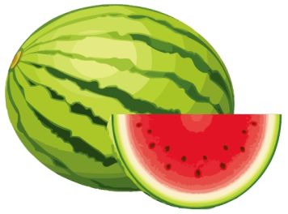
Let’s learn
Presentation
a
watermelon
watermelons

Slide 6
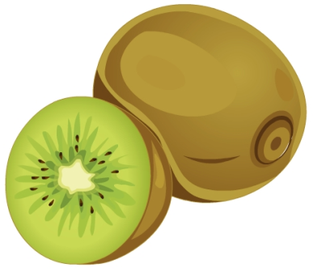
Let’s learn
Presentation
kiwi fruit
单复数同形
kiwi fruit

Slide 7
Practice
Game 1
魔法手指
orange banana
watermelon kiwi fruit

Slide 8
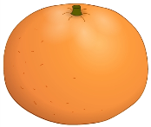
Practice
Game 2
What’s missing?

Slide 9
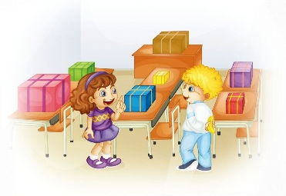
Presentation
Look and say
What are they talking about?

Slide 10
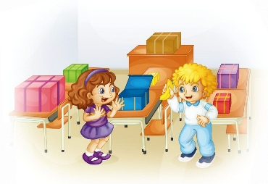
Presentation
Listen and imitate
2
1
Look! It’s a banana.
What’s this?

Slide 11
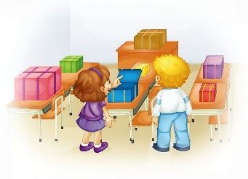
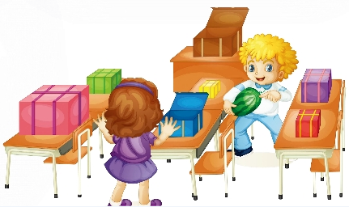
Presentation
Listen and imitate
3
What’s that?
4
Look! It’s a watermelon.
5
Oh, it’s a big watermelon.

Slide 12
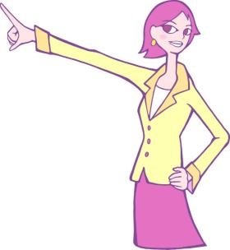
Presentation
this“这，这个”
指代距离近的物品。
this
that“那，那个”
指代距离远的物品。
that

Slide 13
Just read and write
Presentation

Slide 14
Show time
两人一组，练习对话并表演，其他同学评价。
 | 模仿录音中的语音语调，有感情地朗读。
 | 可以脱离课本，适当改动其中部分，语音地道。
 | 适当添加内容，意思完整，有创新，表演生动。
Good
Great
Excellent

Slide 15
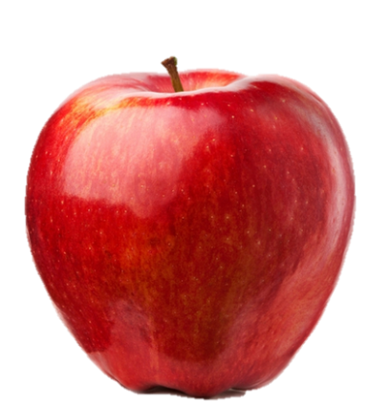
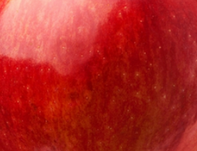
Look and guess
Guess! What’s that?
It’s an apple.

Slide 16
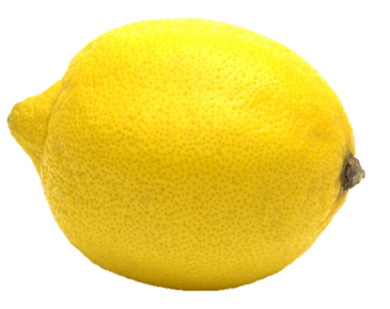
Look and guess
Guess! What’s that?
It’s a lemon.

Slide 17
Look and guess
Guess! What’s that?
It’s a watermelon.

Slide 18
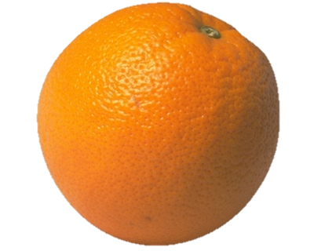
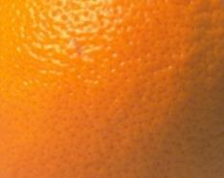
Look and guess
Guess! What’s that?
It’s an orange.

Slide 19
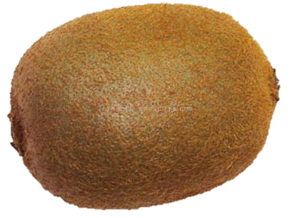
Look and guess
Guess! What’s that?
It’s a kiwi fruit.

Slide 20
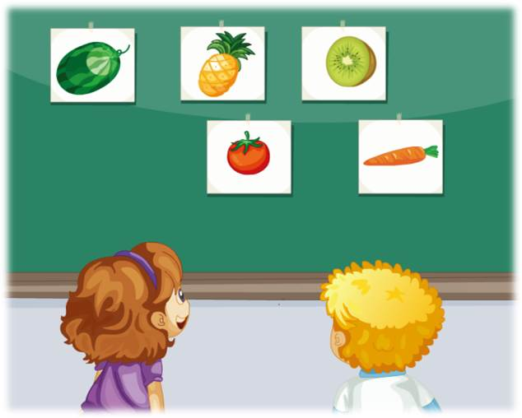
Pair work
两人一组，看图并仿照本课对话，编写一段新的对话。

Slide 21
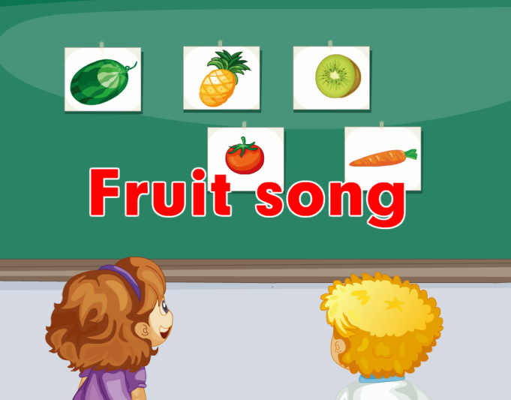
Let’s sing
Practice

Slide 22
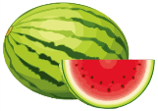
Summary
本课学习的水果类单词有:
orange
banana
watermelon
kiwi fruit

Slide 23
Summary
如何询问距离远的物品是什么并做相应回答呢？
—What’s that?
—It’s a/an ...

Slide 24
Homework
1. 跟读Just talk部分的课文录音，并注意语音、语调。
2.在生活中运用本课所学句型“What’s that?”来询问你的父母或朋友对于距离远的物品。
3. 预习Lesson15。
Close

