Slide 1
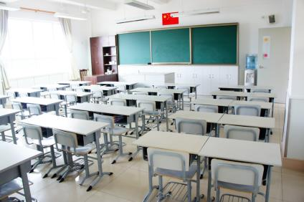
In the classroom
7
第三课时
WWW.PPT818.COM

Slide 2
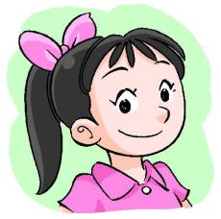
Listen and act
Close the window.
Open the mouth.
Close the eyes.
Look at the light.
Open the book.
Clean the desk.
Look at the blackboard.
Thank you. Good job!
Open the door.
Clean the chair.
Look at the flag.

Slide 3
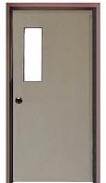
Point and say
Close
Open
Close the door.
Clean
Look at

Slide 4
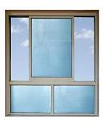
Point and say
Look at
Close
Open
Clean

Slide 5
Point and say
Clean
Look at

Slide 6
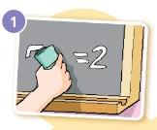
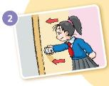
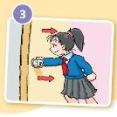
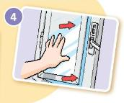
Match and say
Close the door.
Clean the blackboard.
Open the window.
Open the door.

Slide 7
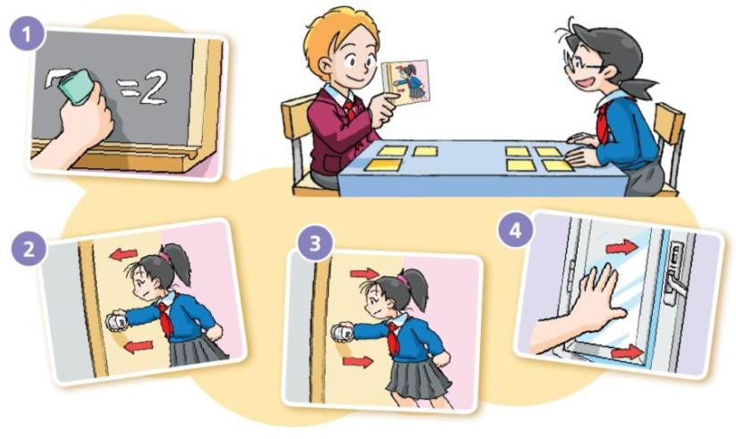

Slide 8
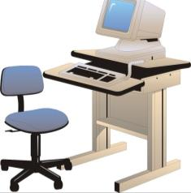
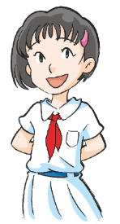
Think and say
May I come in?
come in
Miss Fang’s office
Come in, please.

Slide 9
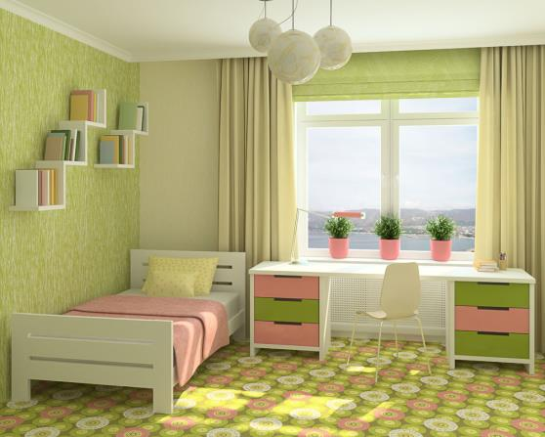
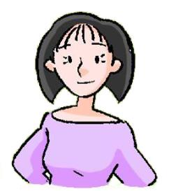
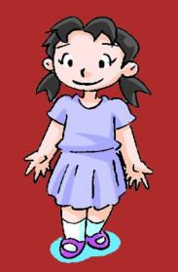
Think and say
May I ______?
_______, please.

Slide 10
A riddle
What has hands but no feet, a face but no eyes, tells but does not talk?
a clock

Slide 11
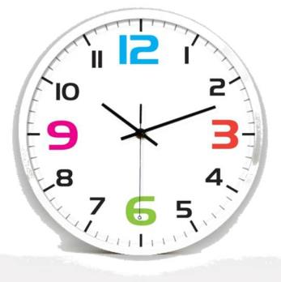
Point and say
hour hand
minute hand
Look at the clock.
It’s round.
It has hands but no feet.
It has a face but no eyes.
It tells us the time every day.
second hand

Slide 12
Think and say
Q: What time do you come to school?
Around _________ o’clock.
7:00
8:00

Slide 13
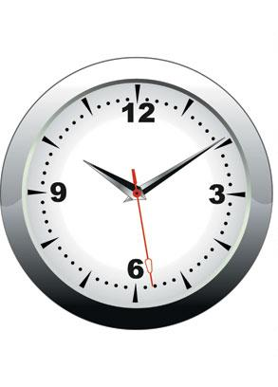
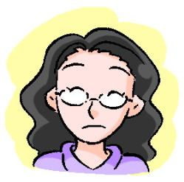
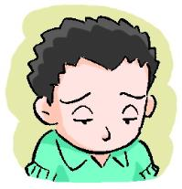
Think and say
Look at the clock!
You’re late.
late

Slide 14
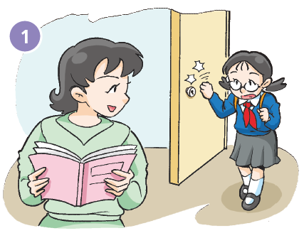
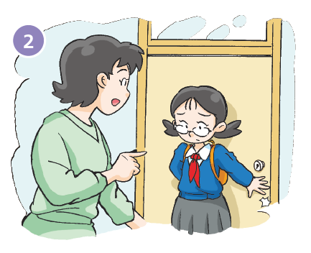
Close the door.
Come in, please.

Slide 15
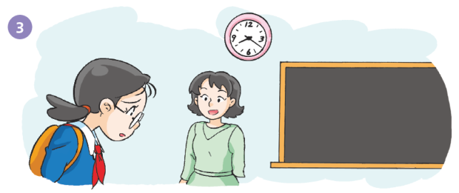
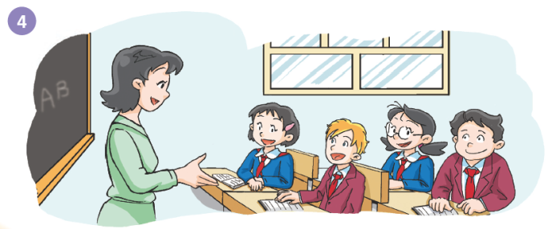
You’re late, Kitty.
I’m sorry, Miss Fang.
Look at the blackboard, please.

Slide 16
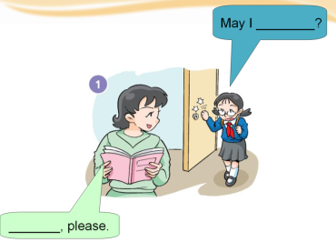
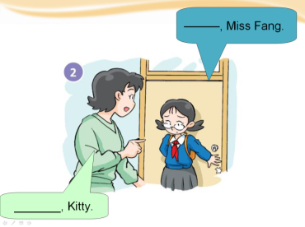
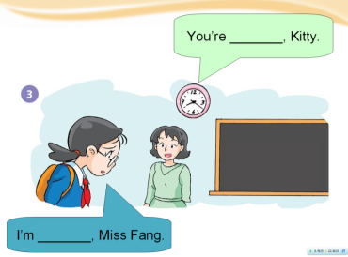
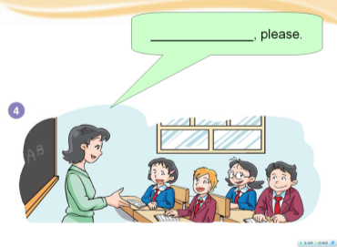

Slide 17
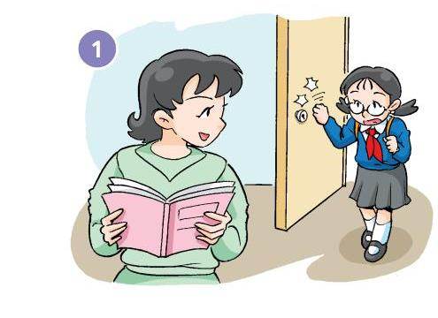
May I ________?
_______, please.

Slide 18
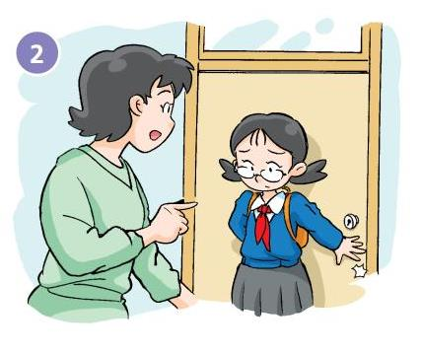
________, Miss Fang.
_______, Kitty.

Slide 19
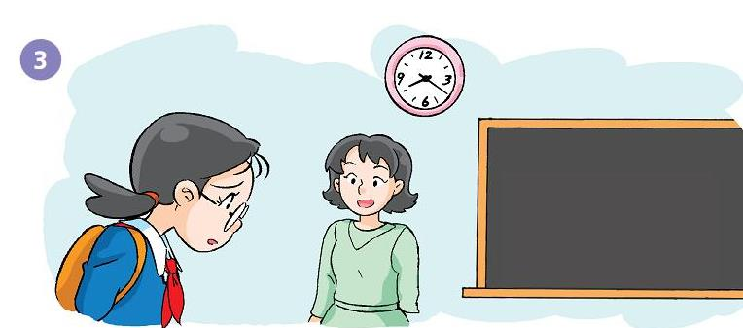
You’re _______, Kitty.
I’m _______, Miss Fang.

Slide 20
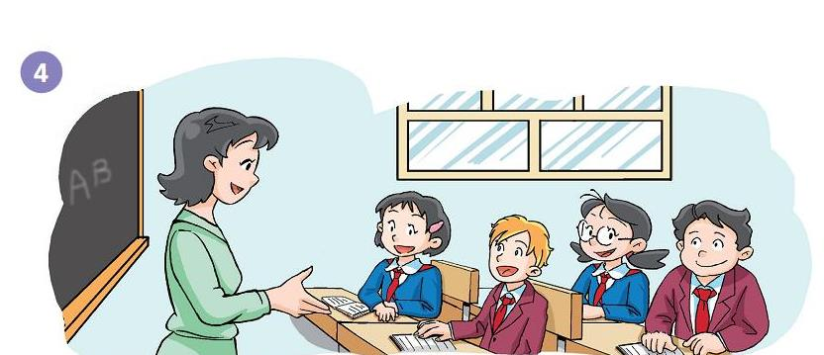
______________, please.

Slide 21
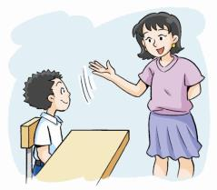
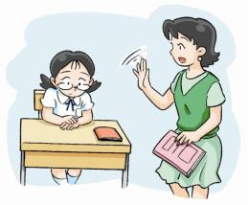
Let’s chant
One, two, three, four.
Come in, please.
Close the door.
Five, six, seven, eight.
Look at the clock!
You’re very late.
Nine, ten, nine, ten.
Don’t be late for school again.

Slide 22
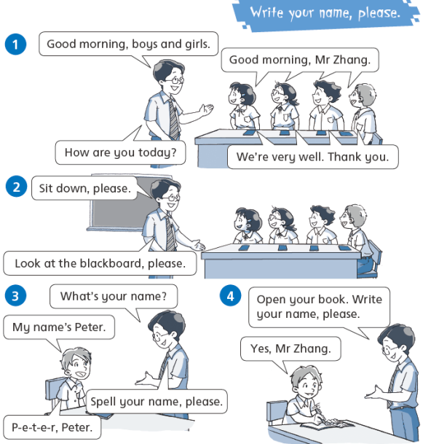
Let’s learn more!

Slide 23
Homework
1 Copy the sentences.
Come in, please. Look at the clock.
You’re late, Kitty. I’m sorry, Miss Fang.
2 Listen and read Page 36.
3 Say the chant.

