Slide 1
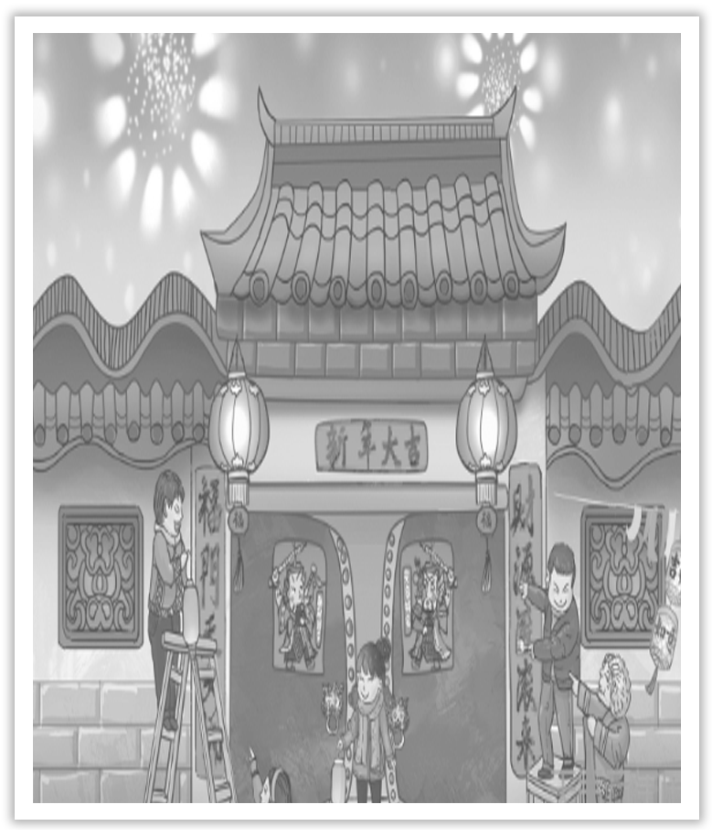
Unit 1 Festivals And Celebrations
Section Ⅷ Assessing Your Progress
WWW.PPT818.COM

Slide 2
Ⅰ.单词拼写
1.Changes in the climate are due to pollution of the ____________(大气).
2.The ____________(月球的) stone is different from earth’s.
3.On the ____________(前夕) of her departure he gave her a little parcel.
4.Address an ____________(信封) and put the letter in it.
5.She turned away her face with a ____________(愉快的)，ringing laugh.
6.The crowd of demonstrators ____________(行进) along the main street.
7.He likes，and is good at solving ____________(谜).
8.It is not clear what these symbols were intended to ____________(代表).
atmosphere
lunar
eve
envelope
merry
marched
riddles
represent

Slide 3
Ⅱ.单句语法填空
1.There were two red ____________(lantern) hanging over the door.
2.You’re all dressed ____________.Are you going somewhere?
3.I send you my warmest ________________(congratulate) on your success.
4.She was ____________(joy) of her good result of the scientific experiments.
5.Who will undertake the job of ____________(decorate) the auditorium?
6.I admire his passionate ____________(believe) in what he is doing.
7.He hadn’t eaten anything except ____________ one forkful of salad.
8.Robots and computers are often act _______________(autonomous)，that is，without human intervention.
lanterns
up
congratulations
joyful
decorating
belief
for
autonomously

Slide 4
Ⅲ.用动词-ing形式补全句子
1.Her job is _________________________________.
她的工作是照顾患病的老人。
2. ________________________________ is big enough to hold 800 people.
我们学校图书馆的阅览室足够容纳800人。
3.The task of this class is __________________________.
这节课的任务是练习这些习惯用语。
looking after the sick old people
The reading room of our school library
practising the idioms

Slide 5
4.What you said ______________________.
你所说的真鼓舞人心。
5.The meeting ________________ is very important.
正在召开的会议很重要。
6.The boy ______________________ is Tom.
站在门口的男孩子是汤姆。
is really inspiring
being held
standing by the gate

