Slide 1
初中英语仁爱版七年级下
Unit7 Topic 1
When is your birthday?
Section C
WWW.PPT818.COM

Slide 2
Review
1
Presentation
2
Consolidation
3
Summary
4

Slide 3
Warm-up
Ask and answer
2012年2月
15
2008年5月
12
2000年6月
22
-What’s the date? -It’s …
2008年8月
8
2013年9月
1
2025年11月
20

Slide 4
Presentation
Kangkang’s birthday is coming.
I have a present for him.
礼物

Slide 5
Guess
1.What’s the shape of the present?
形状
What shape is the present?
2.What color is it?

Slide 6
Learn and practice in pairs.
A:What shape is it?
B:It’s a/an …
square
triangle
circle
rectangle
oval

Slide 7
Listen to 1a and try to answer these questions.
What’s the shape of Maria’s present?
What color is it ?
Is it a soccer ball?
It’s round.
It’s black and white.
Yes, it is.

Slide 8
Read 1a and complete the table.
Present | Shape | Color
a soccer ball
round
black and white

Slide 9
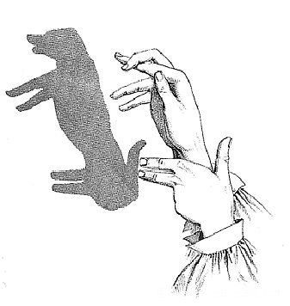
Consolidation
What is it like?
It is like a dog.
像
What is it like?
It is like a bird.
Was it like a bird before?
No, it wasn’t.
It was like a dog.
之前

Slide 10
2a
Ask and answer
What is it like?
It is like a fish.
What is it like?
It is like a tree.
Was it like a tree before?
No, it wasn’t.
It was like a fish.

Slide 11
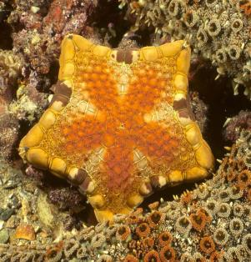
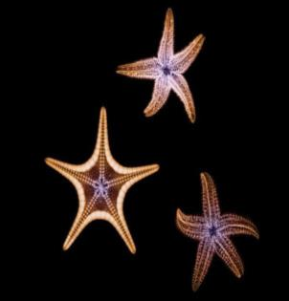
What is it like?
It is like a flower.
What is it like?
It is like a star.
Was it like a star before?
No, it wasn’t.
It was like a flower.

Slide 12
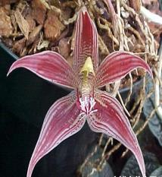
Pair Work
两人一组，用下面的句型进行对话演练
Example:
A:What is it like?
B: It is like a flower.
A: Was it like a flower before?
B: No, it wasn’t. It was like a star.
a star
a flower

Slide 13
2a
Ask and answer after the example.
Example:
A: What shape is it now?
B: It's a circle.
A: What shape was it before?
B: It was a square.
a square
a circle

Slide 14
Pair Work
两人一组，用所学的句型进行对话演练
circle
triangle
rectangle
oval

Slide 15
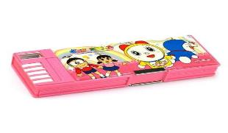
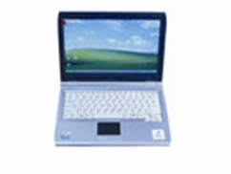
Ask and answer questions with the following structures.
2a
pencil-box
24cm×6.4cm
MP4
9cm×6cm
computer
35cm×27cm
A:What shape is it? B:It's...
What’s the shape of ... ?
A:How long/wide is it? B:It’s...centimeters long/wide.
A:What do we use it for? B:We use it to...

Slide 16
4a
Listen and circle the word you hear in each pair.
1.know now 2.slow snow
3.phone photo 4.touch country
5.town own 6.house horse
7.mouse mouth 8.down brown
9.through group

Slide 17
4b
Read the following sentences aloud, paying attention to the underlined letters and the stress.
1. 'Row the 'yellow 'boat.
2. 'Work in 'groups.
3. 'Touch your 'mouth.
4. 'Look at the 'window of the 'house.
5. 'Follow the 'mouse and the 'elephant.

Slide 18
Summary
Learn some words about the shape:
shape, circle, square, triangle, rectangle, oval
Learn how to talk about the shape.
Example:
What’s the shape of your present? It’s round.
Was it like a flower before?
No, it wasn’t. It was like a star.
What shape was it before? It was a square.
Learn how to talk about the length and width.
Example:
How long is it? It’s 24 centimeters long.
How wide is it? It’s 6. 4 centimeters wide.

Slide 19
Homework:
1.Read 1a and practice 3 with others.
2.Finish Setion C in your workbook.

