Slide 1
Module 2 Unit 2
It will rain in Beijing.
WWW.PPT818.COM

Slide 2
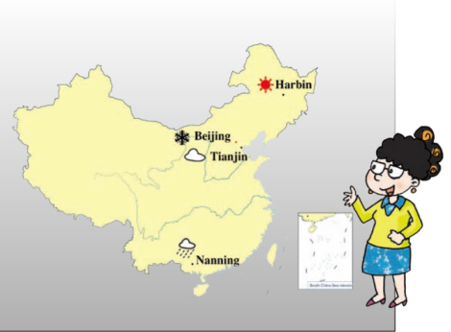
创设情境
Let’s chant
It will be sunny in Harbin.
It will be cloudy in Tianjin.
It will snow in Beijing.
It will rain in Nanning.

Slide 3
启发思考
Match signs with meanings!
sunny
snow
cloudy

Slide 4
Word class
sunny adj.
snow v.
cloudy adj.

Slide 5
Match signs with meanings!
rain
windy
hot

Slide 6
Word class
rain v.
windy adj.
hot adj.

Slide 7
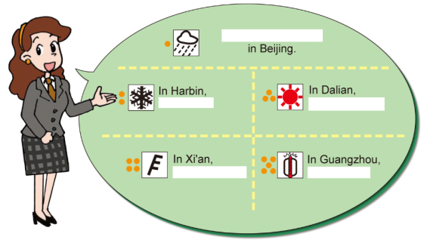
自主或小组探究
What will the weather be like in Xi’an/Beijing/Dalian/Guangzhou and Harbin?
Let’s listen and answer.

Slide 8
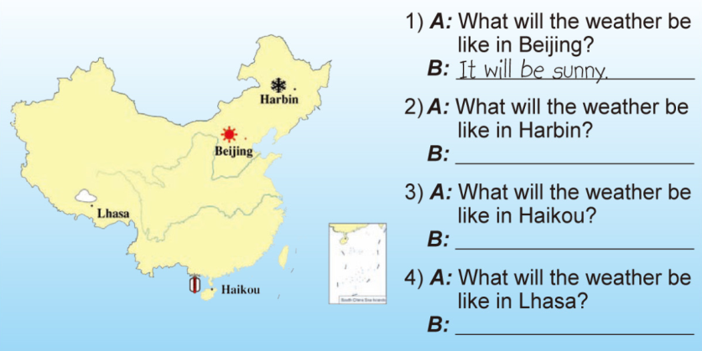
Look and write
It will snow.
It will be hot.
It will be cloudy.

Slide 9
Collect words
sunny 晴朗的
snow n.雪 v.下雪
cloudy 多云的
rain n.雨 v.下雨
windy 多风的

Slide 10
What will the weather be like tomorrow?
Mime and guess
Will it be hot?
Will it be windy?
Yes, it will.
Yes, it will.

Slide 11
Watch and fill

Slide 12
总结提高
重点句型
What will the weather be like in XX?
It will V/ be+Adj

Slide 13
Homework
1.完成 配套练习。
2.观看今天的天气预报，用英文整理指定城市的天气情况。

