Slide 1

Unit 5 Lesson 2
It’s snowing.
WWW.PPT818.COM

Slide 2


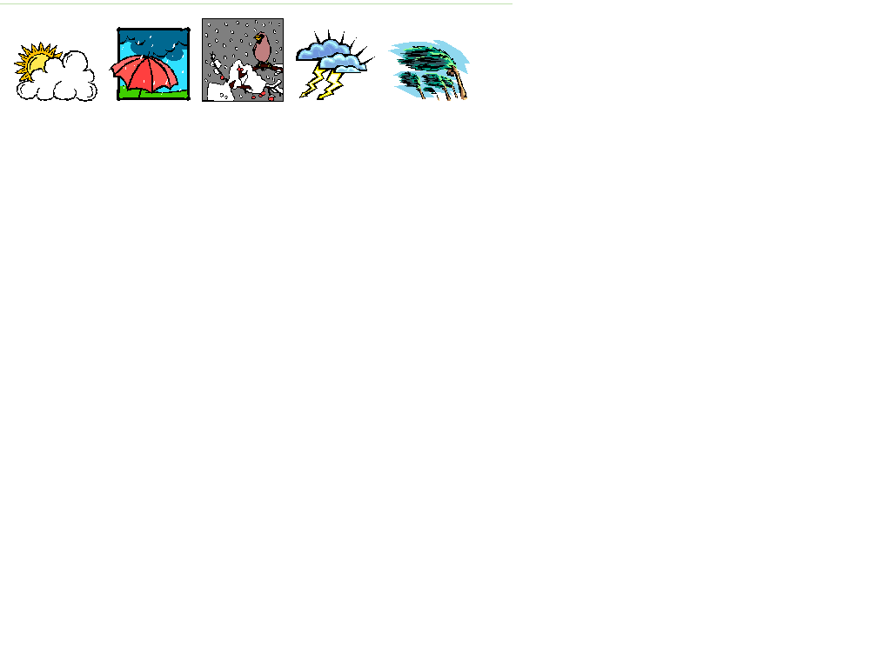
-How’s the weather?
-It’s …
sunny
rainy
/raining
cloudy
snowy/
snowing
windy

Slide 3
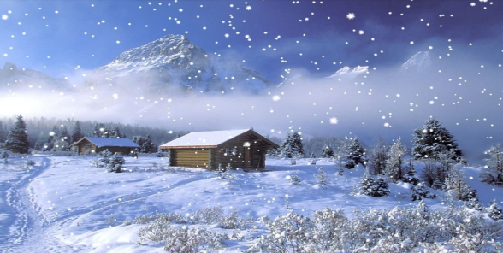
How’s the weather today?
It’s snowing.

Slide 4
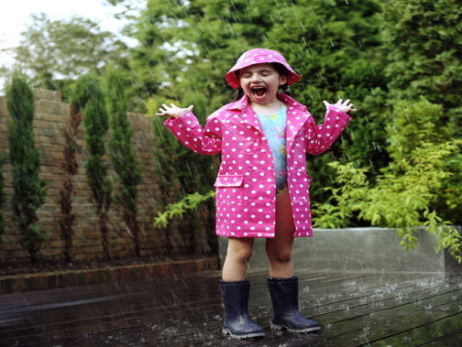
How’s the weather today?
It’s raining.

Slide 5
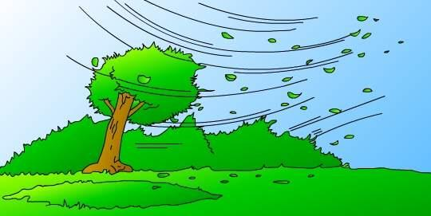
How is the weather today?
windy

Slide 6

How is the weather today?
cloudy

Slide 7

How is the weather today?
sunny

Slide 8
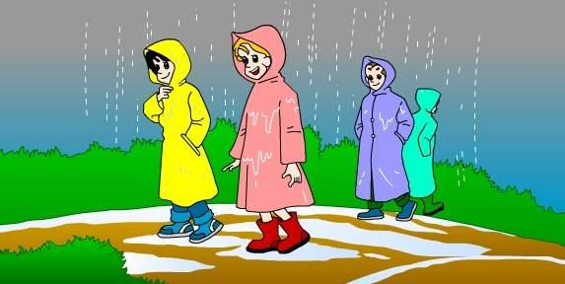
How is the weather today?
rainy/raining

Slide 9
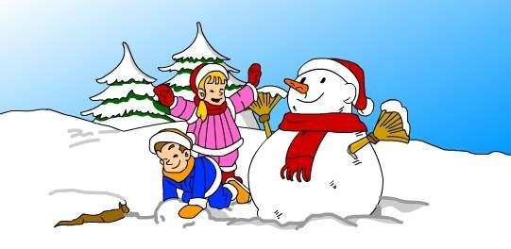


How is the weather today?
snowy/snowing

Slide 10





How is the weather ? =
What’s the weather like?
It’s….
windy
cloudy
sunny
rainy/raining
snowy/snowing

Slide 11
It’s warm. 温暖
It’s cool. 凉爽
It’s hot. 炎热
It’s cold. 寒冷

Slide 12

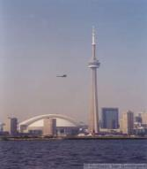
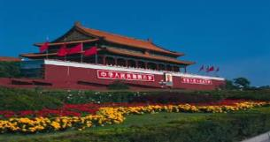


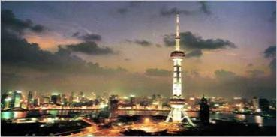
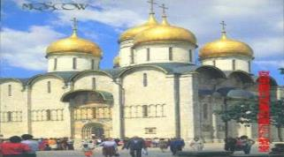



How is the weather in... today?
Boston
Beijing
Toronto
Shanghai
Moscow

Slide 13
Pair work : talk about the weather.
A: How is the weather in…?(What’s the weather like in…?)
B: It’s raining/snowing…

Slide 14
Homework
Listen to today’s weather report about the
cities around you & tell it to your friends.

Slide 15
Thank you!
Goodbye!

