Slide 1
Module 6 Unit 2
The WWF is working hard to save them all.
WWW.PPT818.COM

Slide 2
Free talk
1. Have you ever been to the zoo?
2. What animals do you like best?
Do you like pandas? What do they eat?
4.Do you know they are in danger now?
5. What can we do for them?

Slide 3
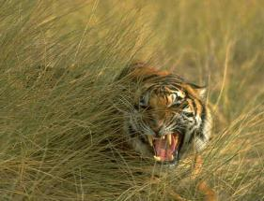
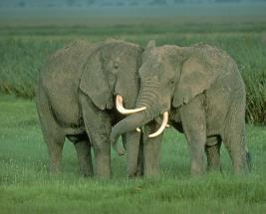
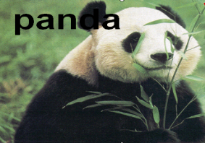
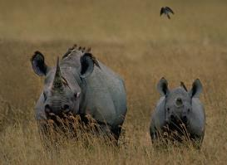
elephant
tiger
panda
rhino

Slide 4
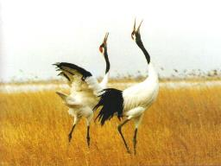
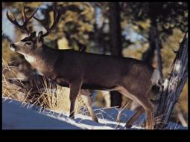
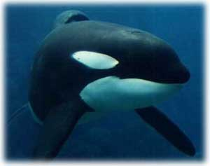
red-crowned
crane
milu deer
whale
golden Monkey

Slide 5
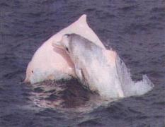
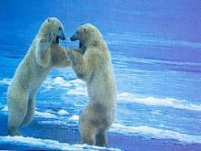
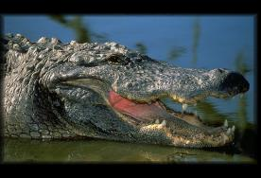
dolphin
Polar bear
bald ibis秃鹮
Crocodile

Slide 6
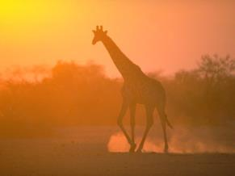
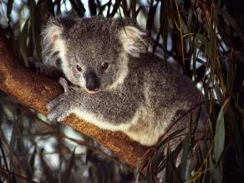
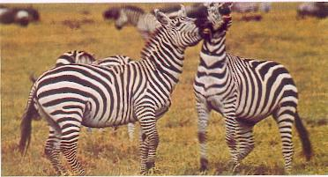
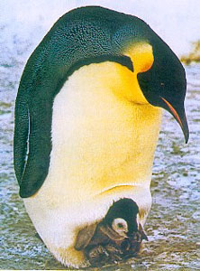
Giraffe
K o a l a
Zebra
Penguin

Slide 7
What’s the problem of
these Animals commonly
facing?

Slide 8
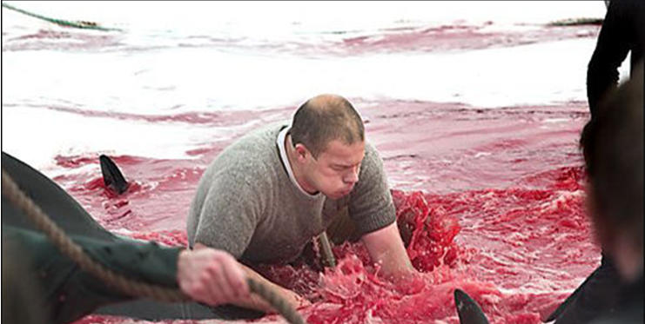

Slide 9
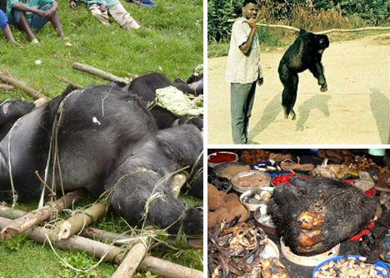

Slide 10
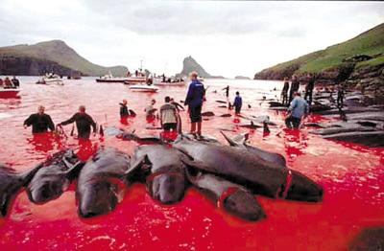
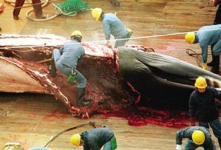

Slide 11
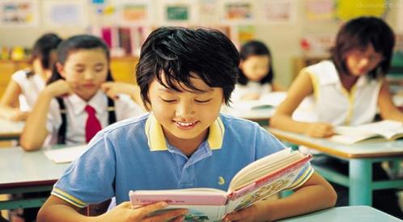
Reading and vocabulary

Slide 12
Words and expressions
/'rI:sɜtʃ; /rI'sɜ:tʃ/
/'beIbi/
/'sItʃu'eIʃn/
/'saIəntIst/
/prə'dju:s/
/'saʊθ'west/
in order to
/ 'gʌvnmənt /
研究；探讨n.
research
婴儿；婴孩n.
baby
situation
形势，情况n.
科学家n.
scientist
produce
生育；繁殖v.
西南 n.西南的adj.
southwest
为了
government
政府n.

Slide 13
/set/
set up
/'neItʃə/
nature park
/dI'veləp/
/fi:d/（fed/fed）
/'sImbl /
set
设置；设定 v.
开办；设立；创办；建立
nature
大自然；自然界n.
danger
自然公园
研制；制定v.
develop
喂养；饲养
feed
象征；标志n.
symbol

Slide 14
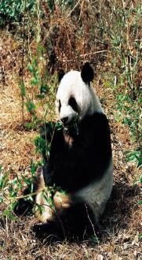
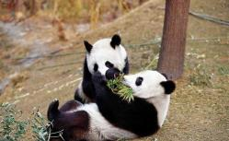
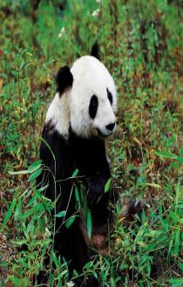
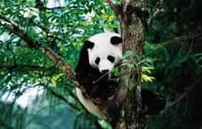
Before reading
1. Look at the pictures. Say what you know about pandas.
Let’s talk

Slide 15
Learning to learn
Sometimes you can learn new words through translation. For example, when you learn “government”, you can take a card and write the English word on one side and the Chinese on the other. Practice saying the English words and check that you remember the meaning.

Slide 16
2. Read the passage and match the
headings with the paragraphs.
a) Nature parks for pandas
b) WWF and animas in danger
c) The panda’s home
d) An animal in danger

Slide 17
1__________
Pandas are in danger. There are only about 1,600 pandas in the wild today. Zoos and research centers are looking after about 340 pandas. Pandas do not have many babies, and baby pandas often die. The situation is getting very difficult. Scientists are doing a lot of research to help pandas produce more babies and help baby pandas live.
d

Slide 18
2_________
Pandas live in the forests and mountains of Southwest China. Each panda needs to eat a lot of bamboo every day. The bamboo forests are getting smaller, so pandas are losing their
home. And there are not many pandas left.
3_________
In order to protect pandas in the wild, the government is setting up nature parks and developing other plans. The nature parks will be big and there will be more bamboo to feed
c
a

Slide 19
the pandas. Pandas born in zoos may go back to live in the nature parks.
4_______
The World Wide Fund for Nature (WWF) wants to protect all animals. And it chose the panda to be its symbol. We do not want to lose tigers, elephants or any other animals, so the
WWF is working hard to save them all.
b

Slide 20
2.Read paragraph 1 and answer the following questions:
How many pandas are living in the wild today?
About 1,600.
2. What do scientists do a lot of research?
To help pandas produce more babies and help baby pandas live.

Slide 21
3.Read paragraph 2 and complete the sentences:
bamboo
Pandas mainly live on ________.
______________________________________________________________,
so pandas are losing their home.
The bamboo forests are getting smaller

Slide 22
4.Read paragraph 3 and answer the questions:
What is our government doing?
Our government is setting up nature parks and developing other plans.

Slide 23
5.Read paragraph 4 and check the sentences:
The panda is one of the best-known animals in the world.
2. Elephants have become the symbol of all animals in danger.
3. We have a long way to go to save the animals in danger.
T
F
T

Slide 24
Match
6.Match the beginnings with the endings to make sentences.
1. Pandas eat bamboo…
2. The government has made a new plan…
3. They will make bigger reserves…
4. The Chinese government is working hard…
a. …to save pandas and other animals.
b. … to live.
c. … to protect pandas better.
d. … to make bigger forests and plant more bamboo.

Slide 25
Answer questions
7.Answer the questions.
1. Why do pandas have less and less land to live on?
Because people are using the land.
2. What do pandas need to eat?
They need to eat bamboo.

Slide 26
Answer questions
3. How is the government trying to
save the panda?
The government has made a new plan to help pandas. They are making bigger reserves and helping pandas go back to live in the nature.
4. Why do you think there is a long
way to go to help the panda?
Because pandas don’t have many babies and baby pandas often die, etc.

Slide 27
Answer questions
3 Complete the sentences.
Pandas eat bamboo to live
1 Scientists do a lot of research_____________
_______________________________________
2 The government is setting up nature parks
_____________________________________
3 The WWF chose the panda_______________
4 The WWF is working hard
______________________________________
to help pandas produce more babies and help baby pandas live.
to protect pandas in the wild.
to be its symbol.
to save all the animals.

Slide 28
1. Complete the passage with the words
in the box.
baby government nature produce
save scientists situation symbol
Zoos and research centres protect animals.
(1)_________do a lot of research to help pandas
(2) ________more babies. Very few (3)________
Scientists
produce
baby

Slide 29
pandas are born outside zoos. Many people are worried about the panda's (4)__________ . Luckily, the (5) __________is developing plans to (6) __________pandas, and is setting up
(7) _________parks to protect them.
People all over the world love pandas, and the panda has become a (8) ________of China.
situation
government
save
nature
symbol

Slide 30
Writing
1. Pair work Choose an animal in
danger and answer the questions.
1 What is the animal?
2 Where does it live?
3 What does it feed on?
4 Why is it in danger?
5 How difficult is the situation?
6 What can we do to save it?

Slide 31
2. Write a passage about an animal in
danger. Use your answers in Activity 5
and the following example to help you.
Pandas live in the southwest of China. They are in danger and the situation is getting very difficult. First, pandas do not have many babies, and baby pandas often die. Second, pandas eat bamboo, but the bamboo forests are getting smaller. So the government is setting up nature parks with a lot of bamboo to help protect pandas.

Slide 32
Exercise
1. 我忘记还你的书了。
I ______________ your books.
2. 乔治希望有天能来中国。
George wish _______ to China one day.
forget to return
to come

Slide 33
3. 她来中国是来学习汉语的吗？
Does she come here ______________?
4. 他们的教材越来越难.
The texts in their textbooks are
______________ difficult.
to learn English
more and more

Slide 34
写同义句
1. To answer the question is easy.
____ easy ___ answer the question.
2. To study hard is necessary.
__ __ necessary __ study hard.
3. It’s good to do sports.
__ ___ sports is good.
It’s
to
It
is
to
To
do

Slide 35
单项选择
C
1. We have two rooms ______, but I can’t decide ______.
A. to live, to choose which one
B. lived, choose which one C. to live in, which one to choose
D. live, which one
2. He’ll use what he has _______ her a new dress.
A. bought B. to buy
C. buying D. been bought
B

Slide 36
A
3. –Mum, can I have something ________?
–Oh, dear. You can only drink some water. There is
________ in the kitchen.
A. to drink; nothing else B. drinking; something else
C. to eat; something else D. eating; nothing else
4. -_______ more about tomorrow’s weather, call 121.
-OK, I will. Thank you.
Know B. Knowing C. To know D. Known
5. Please don’t forget ________ the room while I am
away in Beijing.
A. clean B. to clean C. cleaned D. cleaning
C
B

Slide 37
Homework
Discuss with your partners how to protect the animals around you.

