Slide 1
U4 weekend
Sometimes I do housework.
WWW.PPT818.COM

Slide 2
Show time

Slide 3
Let’s sing.
Days of the week

Slide 4
What day is today?
It’s Wednesday.

Slide 5
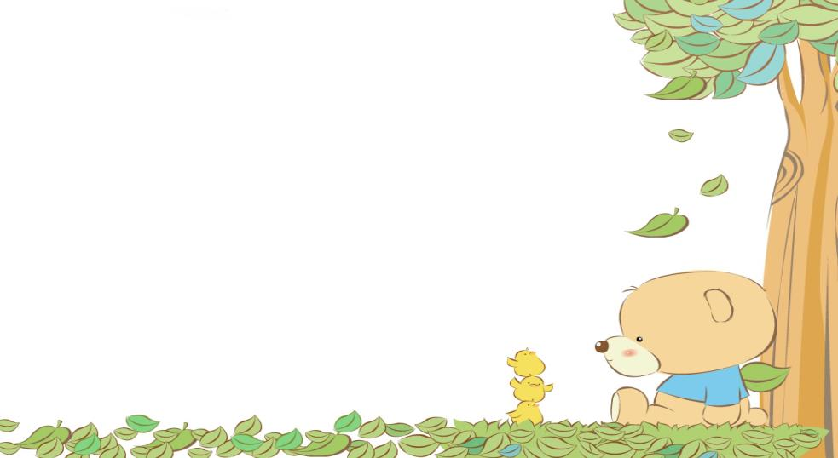
Saturday and Sunday
at the
weekend
周末
在
week周 end结束

Slide 6
Do you want to know my weekend?

Slide 7
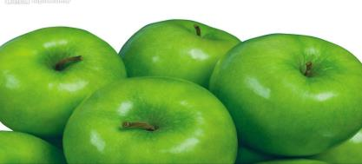
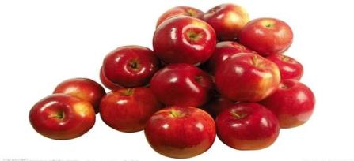
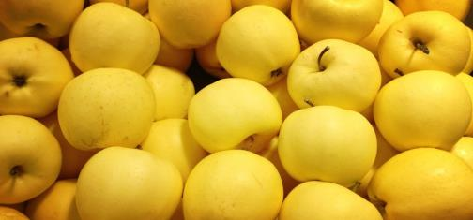
I often (经常) buy(买) apples at the weekend.
What color are they?

Slide 8
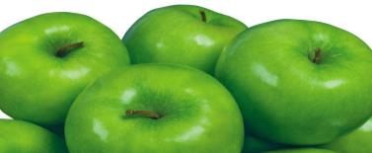
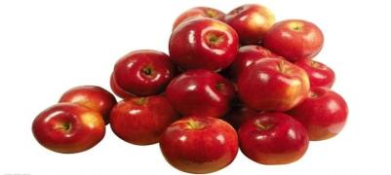
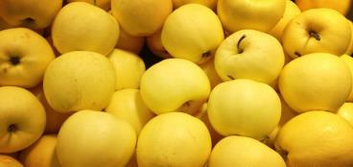
Sometimes (有时)I buy
green apples.
Sometimes I buy red apples.
Sometimes I buy yellow apples.

Slide 9
频率副词
often | apples | apples | apples | apples | apples
sometimes |  |  | red apples | red apples

Slide 10
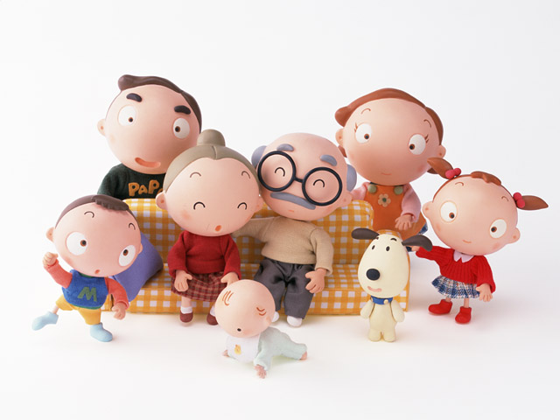
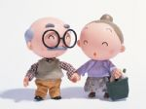
grandparents
拜访祖父母
visit grandparents
I often visit grandparents at the weekend.

Slide 11
What about Li Ming and Tom’s weekend?

Slide 12
Listen and answer:
1. What does Li Ming do at the weekend?
2. What does Tom do at the weekend ?
He often visits their parents.
Sometimes he does housework.
Sometimes he goes to the museum.

Slide 13
Listen and repeat

Slide 14
Role play
3-4 students work in groups. One is Li Ming, one is Tom and anther is Miss Zhang.(俩人可以饰演一角)

Slide 15
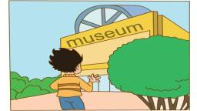
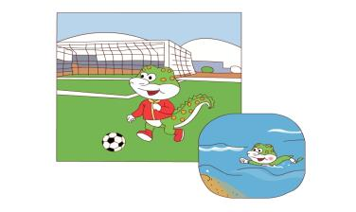
Dialogue(对话)
A: Hello! What do you do at the weekend？
B: I .
What do you do at the weekend？
A: Sometimes I .
I .
often go to the museum
play football
Sometimes
go swimming

Slide 16
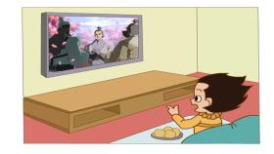
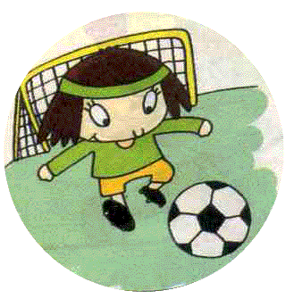
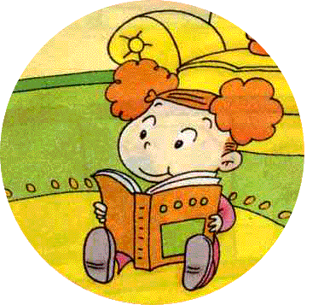
A: Hello! What do you do at the weekend？
B: I watch TV.
What do you do at the weekend？
A: I .
I read books.
often
Sometimes
play football
Sometimes

Slide 17
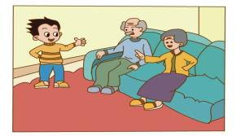
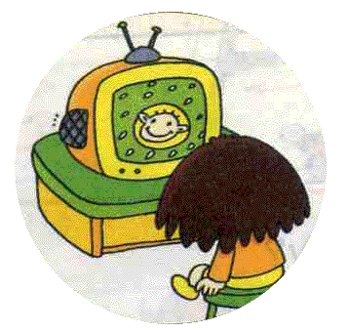
A: Hello! What do you do at the weekend？
B: I .
What do you do at the weekend？
A: Sometimes I .
Sometimes I .
often visit my grandparents
read books
watch TV

Slide 18
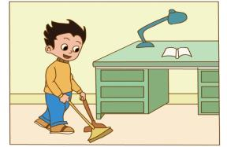
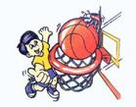
A: Hello! What do you do at the weekend？
B: I do housework.
What do you do at the weekend？
A: Sometimes I .
Sometimes I .
often
play football
play basketball

Slide 19
Make a survey:
One student asks. The other students answer the question one by one.(一学生问,其他同学依次回答)
Name | What do you do at the weekend ?
Danny | I often do housework/…….. Sometimes I go to the museum/….

Slide 20
Thank you!

