Slide 1
Unit3 Holiday fun
WWW.PPT818.COM

Slide 2
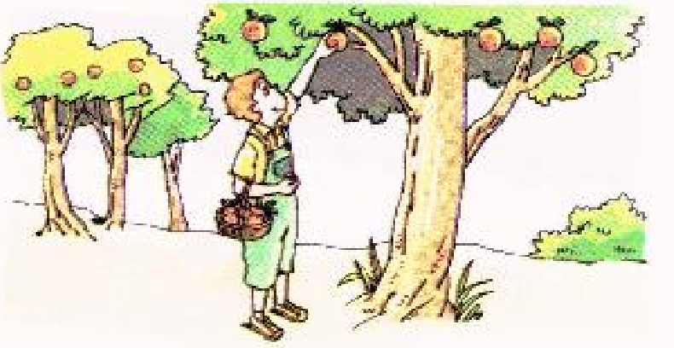
>>Warm-up
Sound time
………………....
Intonation
Hey! Please pick an orange for me.
I want an orange from the tree.
Hey! Please catch a fish for me.
I want a fish from the sea.

Slide 3
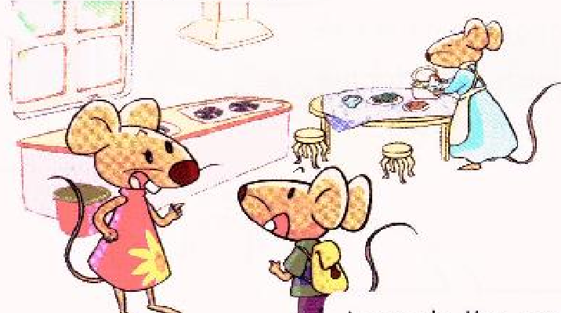
>>Presentation
Look and say
………..…………....
It is time for dinner. Bobby comes home late.
Where did you go, Bobby?
I was in the park. We had a fashion show there.

Slide 4
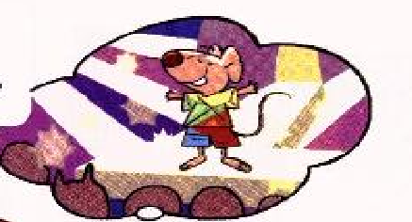
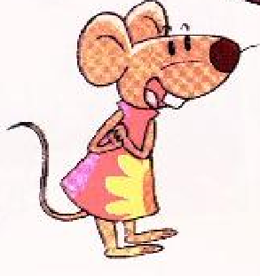
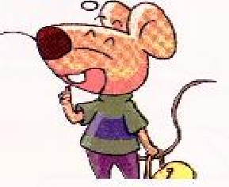
>>Presentation
Look and say
………..…………....
Tina loves beautiful clothes. She is excited about the show.
Wow, I love fashion shows. What did you wear, Bobby?
I wore a paper T-shirt and paper shorts.
Ha! Ha! That’s cool.
What great fun!

Slide 5
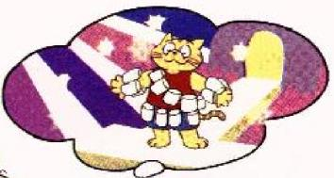
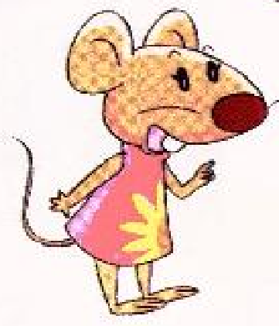
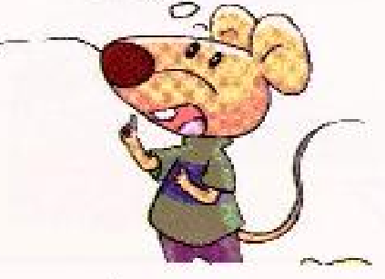
>>Presentation
Look and say
………..…………....
Tina asks Bobby about Sam.
Did Sam wear paper clothes too?
Wow, that’s interesting!
No. He wore a lot of bottles.

Slide 6
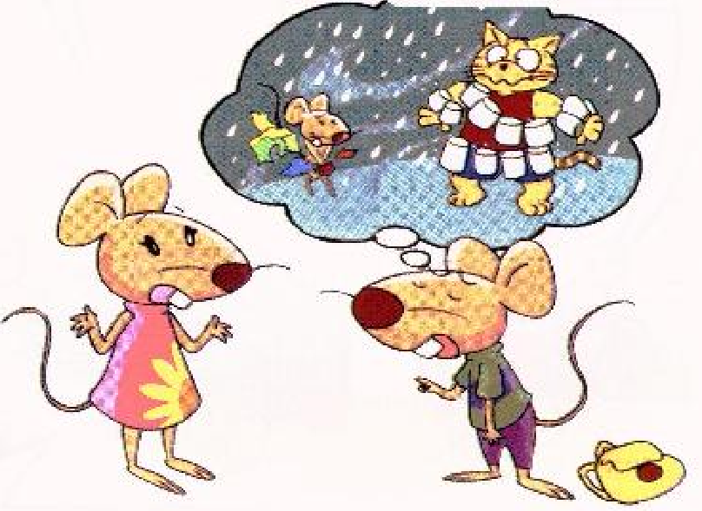
>>Presentation
Look and say
………..…………....
Tina asks about the show.
Did the show go well?
Oh, that’s too bad!
It was wonderful at first, but then there was heavy rain.

Slide 7
>>Practice
Team work
….……...……….

Slide 8
>>Summary
正确运用一般过去式叙述Cartoon time课文故事。

