Slide 1
Unit 7 What's the highest mountain in the world?
Section B 第2课时
WWW.PPT818.COM

Slide 2
Teaching Aims
1. To learn the article in 2b
2. To learn new words: bamboo, research,
keeper, awake, excitement, illness, wild,
government, oil, protection, huge…

Slide 3
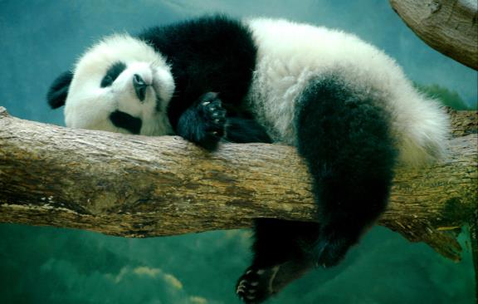
Do you like pandas?
What do you know about them?

Slide 4
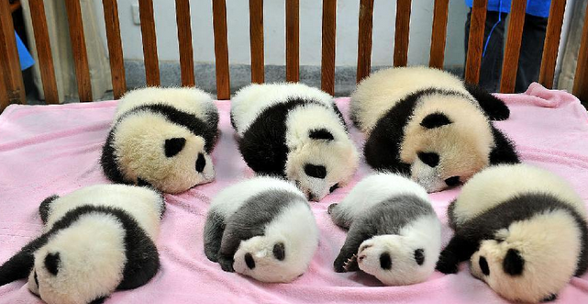
大熊猫最奇特的一点是新生儿在出生时相当的不成熟，体重仅是它母亲体重的0.1%，平均为145克左右，约为成年的千分之一。照顾孩子是一项非常艰巨的任务，通常历时18个月，有时长达两年，直到她的下一个孩子出生。

Slide 5
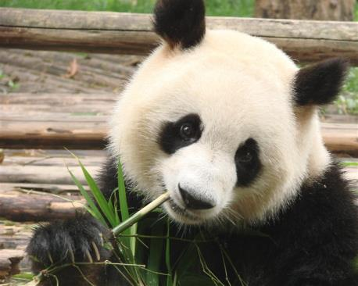
2a
Talk about pandas in your class. Use these words to help you.
big bamboo zoo
popular cute black and white
Sichuan famous endangered
beautiful forest protect

Slide 6
Read the article to find out what these numbers mean: 10, 12, 300, 2,000.
2b
阅读策略：Scanning
This means moving your eyes quickly down the page to find specific information.

Slide 7
略读时，只需读每一段第一句话（较长的段落，读前两句）。第一句话常是整段讨论的主题。在结论段，重点可能在最后一句。阅读时，把文本标出来，是帮助回答问题好方法。可将关键词画线或在段落旁写下本段主题，一两个字就够了，关键在于涵盖全文的速度。 略读时遇到不懂单词，试观察前后字来猜出意思。比如，在不懂的单字前面是形容词，那么这个字可能会是名词；在不懂的单字之前是副词，那么这个字可能会是动词。只要了解段落大意就好了。

Slide 8
It is 8:30 a.m. at the Chengdu Research Base. Panda keepers are preparing milk for the baby pandas' breakfast. At 9:00 a.m., they find that most of the babies are already awake and hungry. When the babies see the keepers, they run over to them with excitement and some of the young pandas even walk into their friends and fall over!
Lin Wei, one of the panda keepers, says, "They're so

Slide 9
cute and lovely. I take care of them like they're my own babies. I wash, feed and play with them every day. They're very special to me." In fact, many people around the world love these black and white animals. Pandas have become so popular that they are now a symbol of China.
Scientists say there are now fewer than 2,000 pandas living in the forests. Another 300 or so live in zoos or research centers in China and other countries. Pandas do not have many babies, maybe only one every two years. The

Slide 10
babies often die from illnesses and do not live very long. Adult pandas spend more than 12 hours a day eating about 10 kilos of bamboo. Many years ago, there were a lot more bamboo forests and pandas in China, but then humans started to cut down these forests. As the forests get smaller and other human activities cause more problems, pandas cannot find enough to eat and they are having fewer babies.
An education program in Chengdu teaches children about pandas and other endangered wild animals. They send people to schools to tell children about the

Slide 11
importance of saving these animals. And the Chinese government is trying hard to help save the pandas.
Scientists are doing research to better understand the habits of pandas. We all hope that in the future there will be a lot more pandas.

Slide 12
Read the article again and write short answers to the questions.
2c
What is Lin Wei's job?
2. What do the baby pandas have for breakfast?
He is responsible for taking care of the pandas,
including washing, feeding, playing with them.
They drink milk for breakfast.

Slide 13
3. Why are pandas endangered?
4. What does the education program in
Chengdu do?
On one hand, the baby pandas don't live long
because of illnesses; on the other hand, pandas
feed on bamboo, but humans cut down the
bamboo forests.
It teaches children about pandas and other endangered wild animals.

Slide 14
5. Why are scientists doing research?
Scientists are doing research to better understand the habits of pandas.

Slide 15
2d
Complete the sentences using words from the passage.
The panda _______ at the Chengdu Research Base are awake very early in the morning to _______ breakfast for the baby pandas.
keepers
prepare
2. In _________, pandas have become so _______ that they are now a symbol of China.
the world
popular
3. Adult pandas do not have babies very ______, and some of the babies only live for a short time because of ________.
often
illnesses

Slide 16
4. A special program in Chengdu teaches _________
about why pandas are ____________.
5. The Chinese government is helping to _____ the
pandas. Scientists also want to better ___________
the habits of pandas.
children
endangered
save
understand

Slide 17
What other ways do you think children can help to save the pandas?
2e
Do not bother the pandas and let them live peacefully in the wild.
Volunteer to do some work helping to protect the pandas.
To do some advertisement about protecting the pandas.

Slide 18
HOMEWORK
Make sentences to tell about Pandas.

