Slide 1
Lesson1 Do you like running?
WWW.PPT818.COM

Slide 2
Do you like … ？
English Chinese
art music
maths science
PE computer studies

Slide 3
Do you like sports<运动>？
Yes， I do.
No， I don’t.

Slide 4
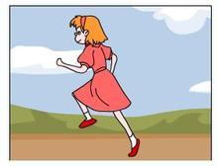
run
ning
running, running, I like running.

Slide 5
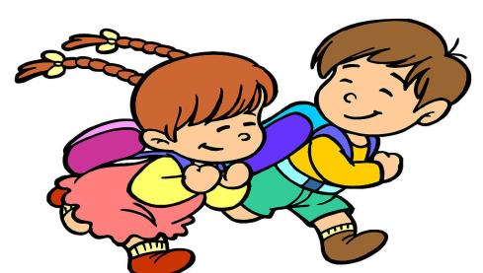
Do you like running？
Yes， I do.

Slide 6
Do you like running?
No, I don't.

Slide 7
skip
ping
skipping, skipping, I like skipping.

Slide 8
Do you like skipping?
Yes, I do.

Slide 9
Running， running
Do you like running？
Yes,I do. Yes, I do.
Skipping， skipping
Do you like skipping？
No,I don't. No, I don't

Slide 10
Let's watch and judge.真真假假。
Tom likes basketball.( )
Tom likes running. ( )
Tom likes skipping.( )

Slide 11
√
Tom likes basketball.( )
Tom likes running. ( )
Tom likes skipping.( )
×
√

Slide 12
Do you like basktball?
Do you like running?
Do you like skipping?
Yes,I do.
No, I don't.

Slide 13
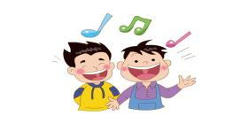
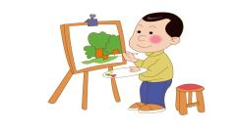
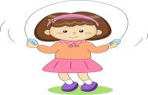
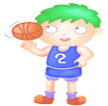
Do you like singing？
Yes，I do./No，I don’t.
drawing
Do you like drawing？
Yes，I do./No，I don’t.

Slide 14
Make a new dialouge.编一个新对话。
S1：I like running. Do you like running?
S2: No, I don't.( Yes, I do.)
S1: What do you like?(你喜欢什么？）
S2: I like skipping.

Slide 15
Love sports
Love life.

Slide 16
Goodbye

