Slide 1
Module 12 Western music
Vienna is the centre of European classical music
WWW.PPT818.COM

Slide 2
新课导入
Vienna is a beautiful city. Can you tell
me something about Vienna?

Slide 3
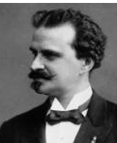
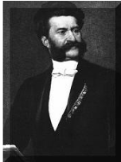
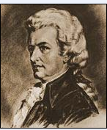
Strauss the elder
Strauss the younger
Mozart

Slide 4
musician
centre
European
classical
century
composer
elder
waltz
dance music
another
n.乐手；音乐家
n. 中心
adj. 欧洲的
adj. 经典的；古典的
n. 世纪
n.作曲家
adj.年长的
n.华尔兹(曲)
舞曲
pron.又一个；再一个

Slide 5
piece
poor
perfect
n. (写作、音乐或艺术的)作品
adj.贫穷的
adj.完美的

Slide 6
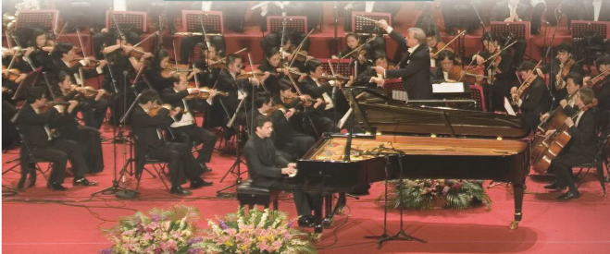
1 Describe the picture. Use the words from the box to help you.
concert musician piano violin

Slide 7
Check (√)the true sentences.
1. Many musicians came to study and work in Vienna.
2. Strauss the younger played the piano, the violin and
the drums at the age of six.
3. Mozart’s family took him around Europe.
4. The father, Johann Strauss, died in 1791.
5. Mozart wrote The Blue Danube.
√
√

Slide 8
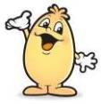
Activity 3
Answer the questions.
1. Where is Vienna?
2. What music did Johann Strauss the elder write?
3. How many waltzes did Johann Strauss the younger write?
It is on the River Danube in the centre of Europe.
He wrote and played the music called waltz.
He wrote over 150 waltzes.

Slide 9
Answer the questions.
4. When was Mozart born?
5. How old was Mozart when he died?
He was born in 1756.
He was only 35.

Slide 10
Complete the passage with the correct form of the words from the box.
another elder European perfect poor popular
Both Strauss the (1) ________ and Strauss the younger
wrote some very (2) ________ music. (3) _________
successful composer from Vienna was Mozart, but he
became very (4) ________ and died at the age of thirty-five.
Many people think Mozart’s music is (5) ________.
All three were great (6) __________ musicians.
elder
popular
Another
poor
perfect
European

Slide 11
Some phrases
1. in the centre of 在……的中心
2. take sb. around 带某人参观
3. give concerts 举办音乐会
4. hundreds of 数以百计的
5. two composers called ... 两位名叫……的作曲家

Slide 12
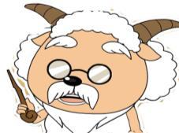
Language Points
1. older 与elder：两者都是old 的比较级，
（1）elder 年龄较大的，资格较老的，尤指家庭成
员之间的长幼关系，通常作定语，不用于than引
导的比较状语从句
He is my elder brother.
他是我的哥哥。

Slide 13
（2）older 指 “年龄较大的；较老的；较旧的”，
既可以作定语，也可以作表语，可用于than引导
的比较状语从句
She is two years older than me.
她比我大两岁。

Slide 14
2. His dance music made him famous all over Europe.
他的舞曲使他享誉全欧洲。
make 的常见用法：
(1) make sb. do sth.使某人做某事
make sb. not do sth.使某人不做某事
Parents always make their children learn many things.
父母总是让他们的孩子学习很多东西。

Slide 15
(2) make sb./sth. +adj. 使某人/物……
The bad news made him very sad.
这个坏消息使他很伤心。
all over 遍及
all over the world 全世界
all over the country 全国
all over China 全中国
We have friends all over the world.
我们的朋友遍天下。

Slide 16
famous 用法：
Mo Yan is the most famous writer in China now.
现在莫言是中国最有名的作家。
be famous for 因……出名
潍坊因风筝而出名。
Weifang is famous for kites.
be famous as 以……出名
周杰伦以歌手而出名。
Jay Chou is famous as a singer.

Slide 17
2. …he played not only the piano but also the
violin.
……他不但能弹奏钢琴，而且还能演奏小提琴。
not only…but also…“不但……而且”是一个表并列
关系的连词，用来连接两个并列关系的句子成分。
I can speak not only English, but also French.
我不但会讲英语，而且还会讲法语。

Slide 18
如果not only…but also…连接的是主语，谓语动词应该遵循就近原则。如：
Not only I but also Tony likes playing basketball.
不但我而且托尼也喜欢打篮球。
Not only Tony but also I like playing basketball.
不但托尼而且我也会打篮球。

Slide 19
3. another “又一个；再一个”，
构成短语：another + 数词 + 可数名词复数
= 数词+ more + 可数名词复数
I want another two apples = I want two more apples.
我想再要两个苹果。
4. …died in 1791 when he was only thirty-five.
他死于1791年，年仅35岁。
when sb. be…years old “在……岁时”，相当于at the age of …
At the age of 15, she became very famous. 她15岁就出名了。
=When she was 15 years old, she became very famous.

Slide 20
5 Use the notes to write a passage
about the Chinese composer Xian Xinghai
Xian Xinghai
famous for the song The Yellow River
wrote it in 1939
one of the great composers of classical and traditional music
born in Macao,China,1905
died young, 1945
called the “People’s Musician”

Slide 21
used traditional Chinese music
studied in Paris
songs are still popular today
Xian Xinghai is one of the great composers of classical and
traditional music. He was born in….

Slide 22
Possible answer:
Xian Xinghai is one of the great composers of classical and traditional music. He was born in Macao, China, In 1905,and studied in Paris. He used traditional Chinese music to write songs. He was famous for the song The Yellow River. He wrote in 1939 in only a few days. He died young at the age of 40 in 1945. His songs are still popular today. He is called the “People’s Musician”.

Slide 23
当堂小练
一、根据句意及首字母提示，用单词的适当形式填空。
1.Germany is a E_________ country.
2.Xian Xinghai is a very f_________ Chinese composer.
3.Mozart wrote hundreds of w_________ pieces of music.
4.Practice makes p_________.
5.They are twins.Can you guess who is the e______?
uropean
amous
onderful
erfect
lder

Slide 24
当堂小练
二、根据句意用括号内所给单词的适当形式填空。
1.Tony ____________________(not like) pop music,does he?
2.I like pop.It’s lively and good ______ (dance) to.
3.There were two composers _________ (call) Johann Strauss.
4.Mozart_______________ (die) for many years.
5.He ______________(be) a teacher since 1992.
doesn’t like
to dance
called
has been dead
has been

Slide 25
当堂小练
三、完成句子,每空一词。
1.约翰•小施特劳斯甚至比他的父亲更成功和受欢迎。
Johann Strauss—the younger is _________ _________ _________ _________ _________ than his father.
2.它是奥地利的首都，也是欧洲古典音乐的中心。
It’s the capital city of Austria and ___ _____ ____ European classical music.
more
successful and popular
even
the centre of

Slide 26
当堂小练
3.我们的朋友遍天下。
We have friends ____ ____ ______ ______.
4.现在莫言是中国最有名的作家之一。
Mo Yan is one of _____ ______ _____ writers in China now.
5.他的家乡是位于长江河畔的一个小城。
His hometown is a small city _________ ______ _________ _________.
all over the world
the most famous
Changjiang
River
on the

Slide 27
课堂小结
Unit 2 Vienna is the centre of European classical music.
1.New words:
musician, centre, European, classical, century, composer, elder, waltz, dance music, another, piece, poor, perfect
2.Structures:
①Vienna is a beautiful old city on the River Danube in the
centre of Europe.
②The son, Johann Strauss the younger, was also very
successful and popular.
③But he became very poor and died in 1791 when he was
only thirty-five.
归 纳

