Slide 1
Lesson 54 :
How Embarrassing!
WWW.PPT818.COM

Slide 2
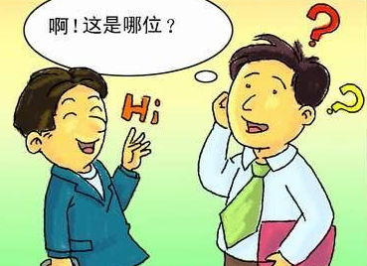
Thinking!
How do you feel if you meet an old friend and he or she can’t remember your name?

Slide 3
学习目标
1. To learn about expressions:
run into; return to; hear from; make plans; remind of
2. To learn about talking one’s experience.
3. To realize talking about problems is better than keeping them as secrets.

Slide 4
预习检测！
自主学习
1.瞬间
2.轻拍
3.熟悉的
4.承认
5.挥手
____________
____________
____________
____________
———————
moment
tap
familiar
admit
wave

Slide 5
Listening
自主学习
Listen to some kids talking about their most embarrassing moments and fill in the blanks.
One day I was in class. The whole class was quiet. ______________ my cell phone rang. Many heads _________ my direction. The teacher walked up to me. My face turned red. I felt so nervous that I could ________ breathe. Then I heard myself say in a shaking voice "You want it?" How embarrassing!!!
All of a sudden
turned in
hardly

Slide 6
Listening
自主学习
My most embarrassing moment was during an award ceremony at the end of the year. I was sitting at the front. The host announced a special _______ and I heard my name, so I went up on the ______. It turned out that it was the other girl. The ______ part was walking back to my seat in front of everyone! Imagine how embarrassed I was!
award
stage
worst

Slide 7
听读课文
自主学习
What is Ling Ming's embarrassing experience?

Slide 8
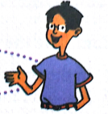
Retelling
合作学习
Read and retell Li Ming’s embarrassing experience using the hints below.
run into… familiar… couldn’t remember…awful…chat…

Slide 9
合作探究
Read and find out the key phrases in the text.
_______________
_______________
_______________
_______________
_______________
1.偶然遇见
2.接到某人的来信
3. 返回
4.使某人想起某事
5.制定计划
run into
hear from
return to
remind sb of sth
make plans

Slide 10
Practice
巩固训练
Fill in the blanks with the correct forms of the words or phrases in the box.
run into， return to， hear from， make plans
1. After living abroad for 30 years, the couple __________ the small town.
2. We’d love to go to the party, but we ______________for that day.
returned to
have made plans
heard from
3. They ___________their son yesterday. They were very happy.
4. I _________ an old friend on my way to school yesterday.
ran into

Slide 11
Exercise
达标检测
根据句意和所给的首字母用适当的词语填空。
1. Danny a________ his mistakes at last.
2. His uncle w____ hands to him and then went away.
3. This story often r________ me of my hard life.
4. Mr. Zhang has been a_______ for many years and he’ll return next month.
5. They are making a p___ to play against us.
dmitted
aved
eminds
broad
lan

Slide 12
Use the third person and past time!
能力提升
Rewrite Li Ming's embarrasssing pexperience.
This week, Li Ming had an embarrassing moment. He _____ an old friend, Gao Yuan. Gao said hi to Li Ming, but he _______. Gao seemed familiar to Li Ming, but he ______. He felt ______. Finally, he had to admit that _______. Later, Li Ming called _____. They made plans ________. Li Ming got back his ______by _________. From Li Ming's story, we know that a _________ is more powerful.

Slide 13
Sum up:
1. Key Phrases
run into; return to; hear from; make plans; remind of
2. We Know from Li Ming's story that: talking about problems is better than keeping them as secrets.

Slide 14
Homework
Write about your embarrassing experience.

