Slide 1
Unit 12
I know a short cut
WWW.PPT818.COM

Slide 2
New words

Slide 3
Let’s learn

Slide 4
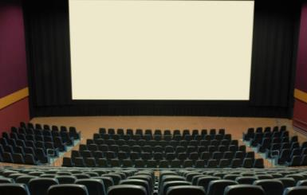
Where were John and Joan going?
They were standing in front of their house

Slide 5
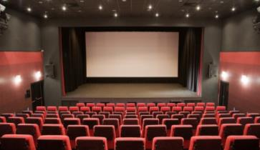
How long do they need to get cinema?
They need 15 minutes to get there.

Slide 6
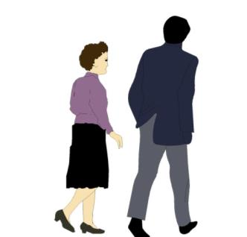
We need to walk quickly.
Don’t worry. We have time.
I know a short cut.

Slide 7
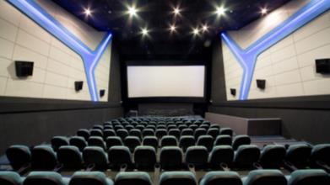
How did they get to the cinema?
They crossed the main street and turned left into the park.

Slide 8
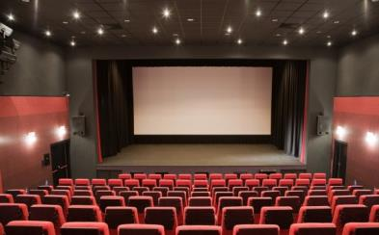
Why was John happy?
They go to the cinema on time.

Slide 9
Let’s learn

Slide 10
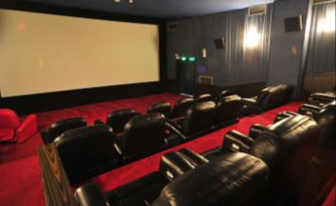
Where were John and Joan going?
You the cinema.

Slide 11
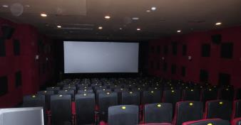
How long do they need to ?
They need 15 minutes to get there.

Slide 12
We need to walk quickly.
Don’t worry. We have time.
I know a .

Slide 13
How get to the cinema?
They crossed the main street and turned left into the park.

Slide 14
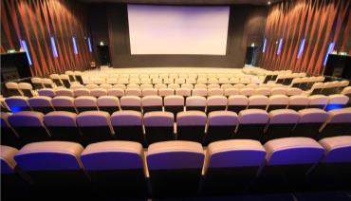
Why was John happy?
They go to the cinema .

Slide 15
were going to get cinema short cut did they on time

Slide 16
1.练习所学单词发音，熟读单词。 2.将所学单词每个单词抄写10遍，注意抄写格式。

Slide 17
Thank you

