Slide 1
Unit 6
I’m watching TV.
Section A 第1课时
WWW.PPT818.COM

Slide 2
Read and speak out the Chinese immediately.
newspaper
read a newspaper
use
soup
make soup
n. 报纸
看报纸
v. 使用；运用
n. 汤
做汤

Slide 3
wash
movie
go to the movies
just
eat out
v. 洗
n. 电影
看电影
adv. 只是；恰好
出去吃饭

Slide 4
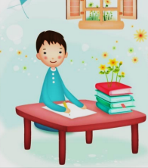
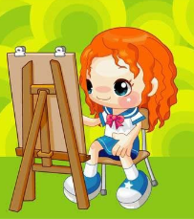
Lead-in
write
read
run
paint/draw
walk
sing
swim

Slide 5
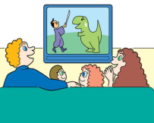
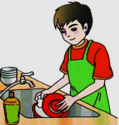
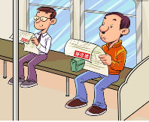
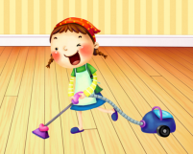
watch TV
wash the dishes
use computer
read a newspaper
talk on the phone
clean

Slide 6
Guessing game
Please guess what people are doing！

Slide 7
What’s she doing?
She’s painting.
painting
paint

Slide 8
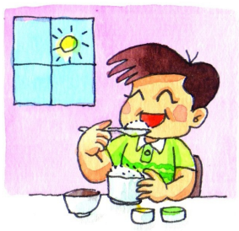
What__ he______?
He_________.
’s
doing
is eating
eating
eat

Slide 9
What ____ they _____?
They____________.
are
doing
are dancing
dancing
dance

Slide 10
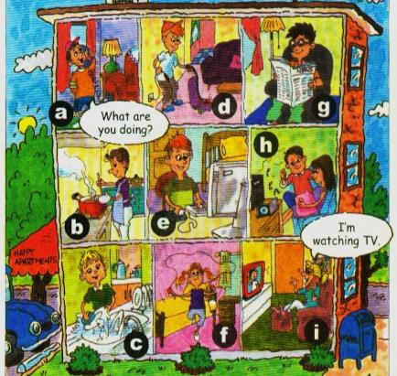
1a
Match the activities with the pictures.
i
1. watching TV __
2. cleaning __
3. reading a newspaper __
4. talking on the phone __
5. listening to a CD __
6. using the computer __
7. making soup ___
8. washing the dishes __
9. exercising ___
d
g
a
h
e
b
c
f

Slide 11
Listen. What are these people doing? Write the numbers from 1a.
1b
a. Jenny ___ b. John ___ c. Dave and Mary ___
1
8
5

Slide 12
Listen again and answer questions.
1. What’s Jenny doing?
2. What’s John doing?
3. What are Dave and Mary doing?
She’s watching TV.
He’s washing the dishes.
They’re listening to a CD.

Slide 13
Tapescripts
Bob: Hello, Jenny!
Jenny: Hi, Bob.
Bob: Jenny, what are you doing?
Jenny: I’m watching TV.
Bob: Do you want to play tennis?
Jenny: No, this TV show is interesting. What’s John doing?
Bob: He’s washing the dishes.
Jenny: Well, what are Dave and Mary doing?
Bob: They’re listening to a CD.

Slide 14
Ask and answer questions about what people are doing in 1a.
1c
What’s he doing?
He’s using the computer.
They’re listening to a CD.
What are they doing?

Slide 15
— What ____ ____doing?
— __________________.

Slide 16
Language points
1.—What are you doing? 你在做什么？
—I'm watching TV. 我正在看电视。
what引导的现在进行时的特殊疑问句，用来询问“某人正在做什么？”
句式：“What +be +主语+动词的现在分词？”
答句：“主语+be (not)+现在分词+其他.”

Slide 17
2. talking on the phone正在电话中交谈
talk to/with sb. about sb./sth.
意为“与某人谈论关于某人某事”。
on the phone意为“通过电话”。
on是介词，在此处意为“通过，以……的方式”。

Slide 18
2a
Listen and match the answers with the questions.
1. What is Steve doing?
2. What is Jack doing?
a. He is watching TV.
b. He is listening to a CD.

Slide 19
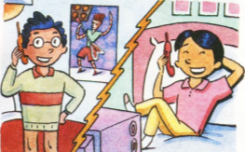
2b
Listen again. Fill in the blanks.
Jack: Hello, Steve.
Steve: Hi, Jack.
Jack: What _____ you ______, Steve?
Steve: I’m ___________. What about you?
Jack: I’m _______________, but it’s kind of _______.
Steve: Yeah, my TV show is also not very __________.
Do you want to _____ the movies?
Jack: That sounds good.
are doing
watching TV
listening to a CD
boring
interesting
go to

Slide 20
Tapescripts
Jack: Hello, Steve.
Steve: Hi, Jack.
Jack: What are you doing, Steve?
Steve: I’m watching TV. What about you?
Jack: I’m listening to a CD, but it’s kind of boring.
Steve: Yeah, my TV show is also not very interesting.
Do you want to go to the movies?
Jack: That sounds good.
听起来不错

Slide 21
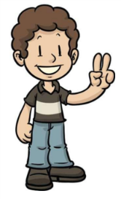
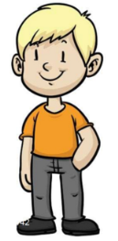
2c
Role-play the conversation in 2b.
Hello, Steve. What are you doing?
I’m reading a book. What about you?

Slide 22
I’m listening to a CD, but it’s kind of boring.
Me too. Do you want to go to the movies.
That sounds great.

Slide 23
2d
Read the conversation and answer the questions.
1.Are they talking on the phone?
2.What is Laura doing?
Yes, they are.
She is washing her clothes.

Slide 24
3.What is Jenny doing?
4.Does Laura want to have dinner with Jenny?
5.Where do they meet?
She is watching TV.
Yes, she does.
They meet at Jenny’s home.

Slide 25
2d
Role-play the conversation.
打电话常用语
Jenny: Hello? This is Jenny.
Laura: Hi, Jenny. It’s Laura here.
Jenny: Oh, hi, Laura. What are you doing?
Laura: Not much. I’m just washing my clothes.
What about you?
Jenny: I’m watching TV. Do you want to join me for dinner?
My parents aren’t at home. We can eat out.
Laura: Yeah, I’d love to.
Jenny: Let’s meet at my home first. Come at half past six.
Laura: OK. See you then.
(口语)没什么大事
出去吃饭；在外面吃饭

Slide 26
Read the dialogue in 2d, then fill in the blanks.
Jenny: Hello? This is Jenny.
Laura: Hi, Jenny. ____ Laura here.
Jenny: Oh, hi, Laura. __________________?
Laura: Not much. I’m just ________________.What about you?
Jenny: I ______________. Do you want to ________________?
My parents aren’t at home. We can _______.
Laura: Yeah. I’d love to.
Jenny: Let’s meet at my home first. _____ at half past six.
Laura: OK. ____________.
It’s
What are you doing
washing my clothes
am watching TV
join me for dinner
eat out
Come
See you then

Slide 27
Fill in the blanks according to the conversation.
Laura is washing her clothes, and Jenny is
___________. Jenny’s parents aren’t _______.
So she asks Laura to join her __________, and they can ________. They will meet at Jenny’s home _____________.
watching TV
at home
for dinner
eat out
at half past six

Slide 28
Language points
1. Do you want to go to the movies?你想去看电影吗？
want to do sth.意为“想做某事”,后常接动词不定式。
他想和他的朋友一起玩。
He wants to play with his friends.
go to the movies意为“去看电影”。

Slide 29
2. This is Jenny.我是珍妮。
这是打电话常用语,相当于“This is Jenny speaking.”
(1)向外拨打电话：May/Could I speak to…？
我可以和……通话吗？
Is that/this…（speaking)?你是……吗？

Slide 30
(2)接听电话：This is…(speaking).我是……
Who's that (speaking)？你是谁？
Who is speaking?谁在讲话？
This is the wrong number.你打错电话了。

Slide 31
3. Not much. (口语)没什么大事。
= Nothing much
你在做什么事，琳达？
没什么大事。我在读一本书。
What are you doing, Linda?
Not (Nothing) much. I’m just reading a book.

Slide 32
4. Do you want to join me for dinner?
你想跟我一起吃晚饭吗?
join sb. for sth.意为“与某人一起做某事；参与或加入到某人的行列中一起做某事”。
你愿意跟我们野餐吗？
Would you like to join us for a picnic?

Slide 33
5. I'd love to.我很乐意。
I'd love/like to.经常用于礼貌地接受他人的邀请。
你愿意和我一起去看电影吗？
是的，我非常愿意。
—Would you like to go to the movies with me?
—Yes, I'd love/like to.

Slide 34
【拓展】
当婉言拒绝他人邀请时，多用I'd love to, but…
或Sorry, I'm afraid I can't because

Slide 35
Exercise
一、用所给词的适当形式填空。
1.—What are they doing?
—They __________(talk)on the phone.
2.Mike is ______(use) the computer now.
3.The students are _______(run) on the playground.
4.Jane often _____(do) her homework after dinner.
5.She isn't ________(listen) to music. She is reading.
are talking
using
running
does
listening

Slide 36
二、根据汉语意思完成下列句子。
1.她正在做什么？
______ she______ ?
2.他们正在锻炼。
They_____ _________．
3.你父母正在看电视吗？
____your parents ________ TV?
4.看！那些学生正在打扫卫生。
Look！The students _____ ________．
What's
doing
are exercising
Are
watching
are cleaning

Slide 37
5. 他们正在电话中交谈。
They are talking ____ ____ _____.
6. 咱们七点钟见吧！
_____ _____ at 7 o’clock.
7. 你想和我们一起吃晚饭吗？
Do you want to ____ us ____ dinner?
8. 明天晚上见！
____ _____ tomorrow evening!
on the phone
Let’s meet
join for
See you

