Slide 1
Unit 6 Christmas
I will put the lights on the tree.
WWW.PPT818.COM

Slide 2
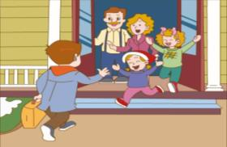
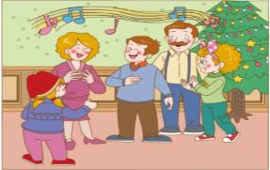
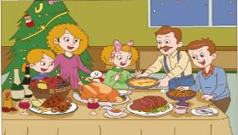
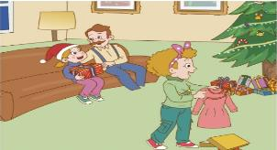
What do they usually do at Christmas?

Slide 3
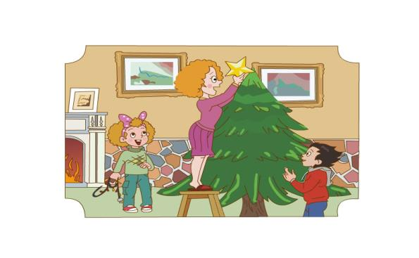
Mum:Come on ,children. Let’s decorate the Christmas tree.

Slide 4
I will put the star here
Mum: ______________________.

Slide 5
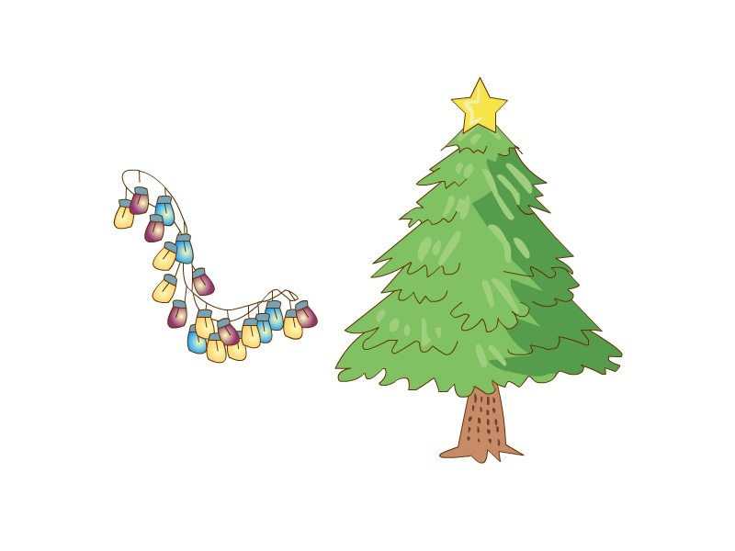
I will put the lights on the tree
Jenny:___________________________________.

Slide 6
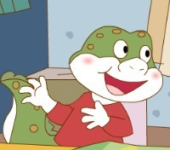
I wil l put the balls on the tree.
Danny:__________________________________

Slide 7
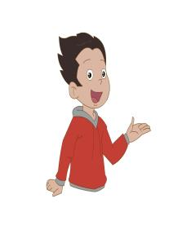
LiMing:_____________________
Shall we put the stoking on the tree.

Slide 8
stocking

Slide 9
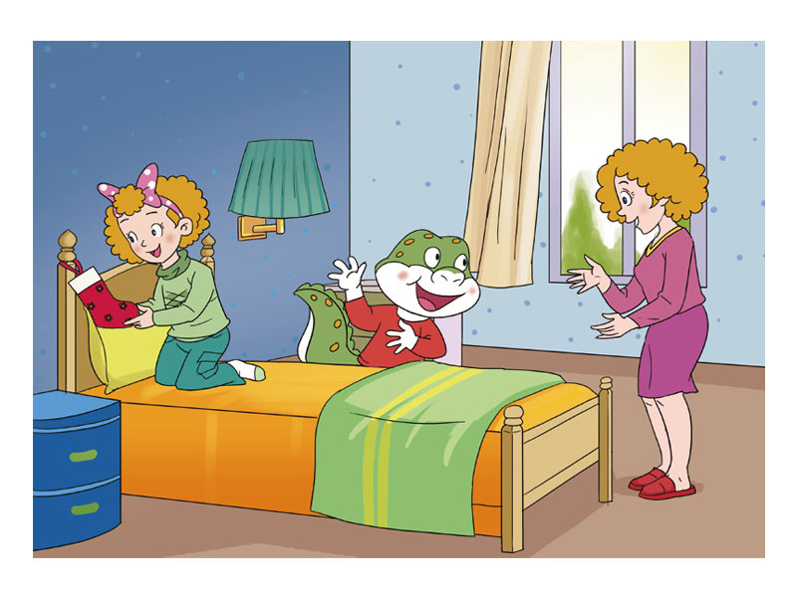
I will put it at the end of my bed.
Jenny:_______________________________________.
end
端，尽头

Slide 10
A: Let's decorate the Christmas tree.
What will you do?
B: I will put the star on the tree.
替换单词：
star , lights , ball…

Slide 11
一、根据课文，选一选。
1、Let’s ______ the Christmas tree ,children.
A、write B. decorate
2、Mum will put the ____on the tree.
A. lights B、star
3、Shall we put the_____ on the tree?
A. light B、stocking
4、What will you do, Jenny?
A.I put the balls on the tree.
B.I put the lights on the tree.
5、I will put it at the ____of my bed.
A、end B、bag
达标检测

Slide 12
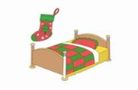
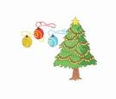
二、 Let's decorate the Christmas tree. What will you do?
I will ___________________________.
I will ____________________________.
I will ________________________________.
I will _______________________________.
设计意图： 通过练习检测学生对课本的掌握情况并考查学 生的单词书写以及让学生综合练习所学重点句型，培养学生运用语言的能力。

Slide 13
Homework：
1、 小组内分角色读熟课文。
2、调查自己身边的朋友如何装饰自己理想的圣诞树。下节课交流。

