Slide 1
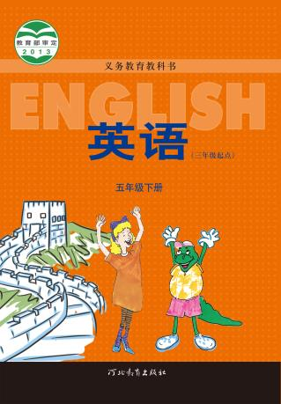
河北教育出版社 五年级 | 下册
Unit 3 Lesson18
Little Zeke Sends an Email
WWW.PPT818.COM

Slide 2
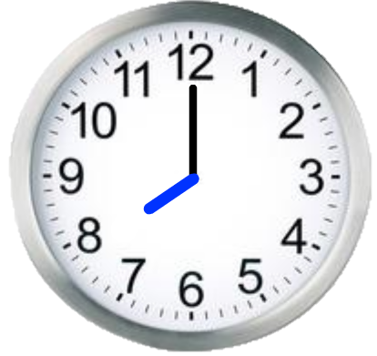
河北教育出版社 五年级 | 下册
Beijing

Slide 3
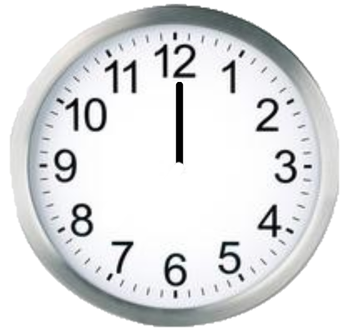
河北教育出版社 五年级 | 下册
Ottawa

Slide 4
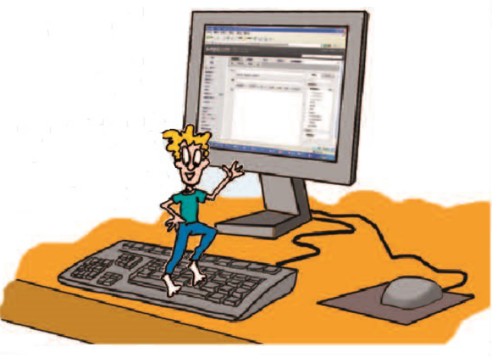
河北教育出版社 五年级 | 下册

Slide 5
河北教育出版社 五年级 | 下册
Listen and Answer
Where does Emma live?
A. Beijing
B. Ottawa
C. London

Slide 6
河北教育出版社 五年级 | 下册
Read and Answer
1.Is the time in Ottawa the same as in Beijing?
2.Where does Little Zeke sleep?
A. in the bed.
B. in the sock.
C. on the sofa.

Slide 7
河北教育出版社 五年级 | 下册
Read and judge True(T) or False(F)
（ T ）1. They are sending an email to Emma.
（F）2. Li Ming wants to go to the restaurant to have lunch.
（F）3. Does Emma send the email to Jenny?
（T）4. Emma is sleeping in her bed, but Zeke sleeps in the sock.

Slide 8
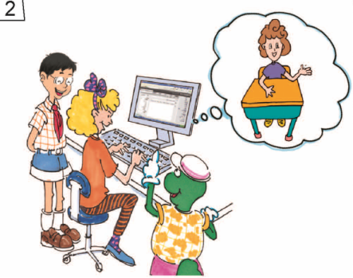
河北教育出版社 五年级 | 下册
Jenny: … send an email to …
Danny: Where … live?
Jenny: … Ottawa, … about our trip.

Slide 9
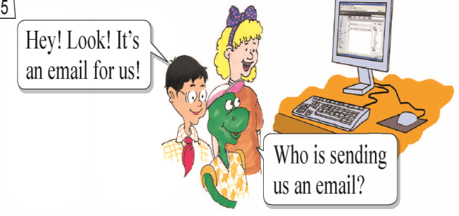
河北教育出版社 五年级 | 下册
Li Ming: … an email for us!
Danny: Who …
Jenny: … Ottawa. … Emma!
Danny: … everybody in Ottawa sleeping …

Slide 10
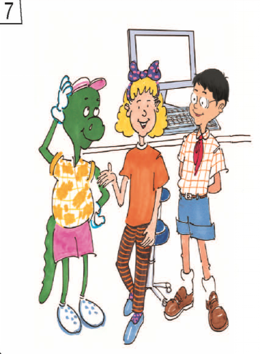
河北教育出版社 五年级 | 下册
Danny: … sentence
wrong? …
go to bed?
Li Ming: Who is …?
Jenny: I don’t know!

Slide 11
河北教育出版社 五年级 | 下册
Homework
Tell this story to your friend.
告诉你的朋友这个故事。

