Slide 1
Unit6 It’s a grapefruit.
WWW.PPT818.COM

Slide 2
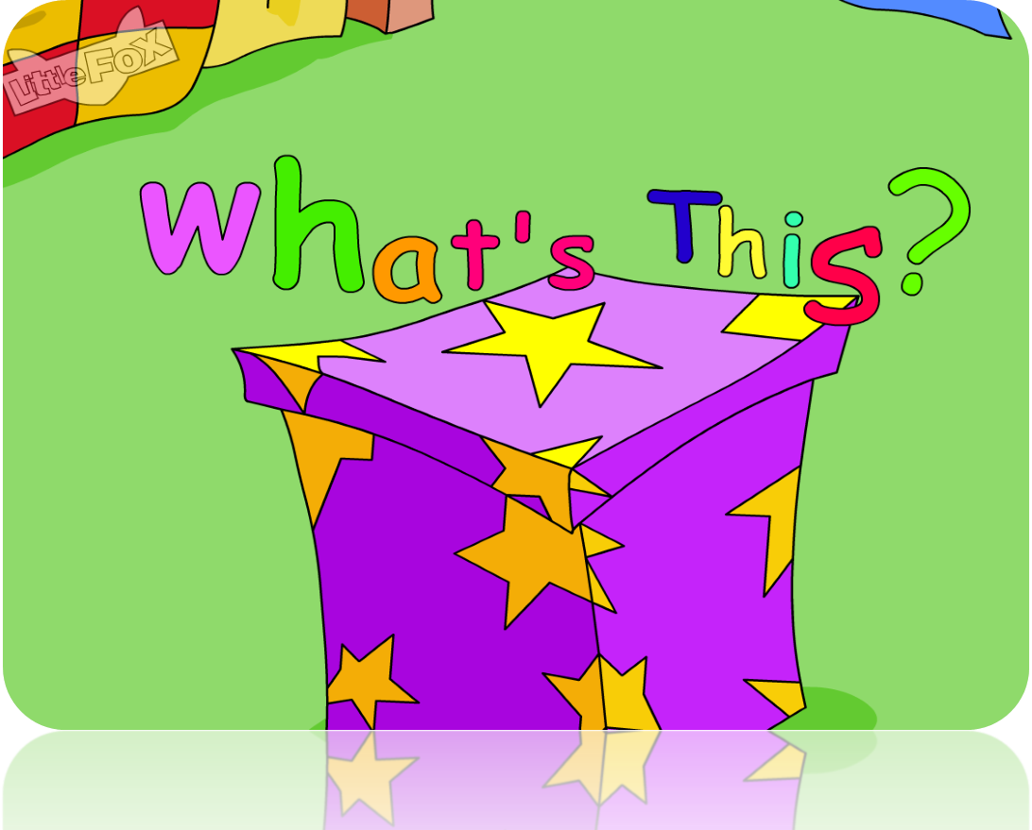
>>Warm-up
Let’s sing

Slide 3
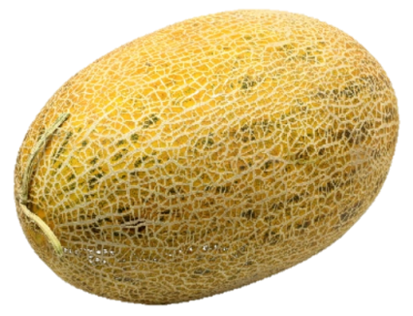
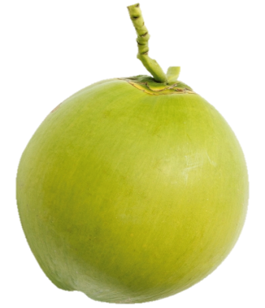
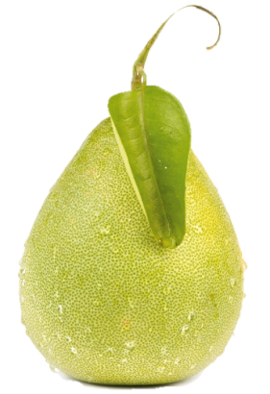
>>Warm-up
Let’s review
?
?
hami melon
?
coconut
grapefruit

Slide 4
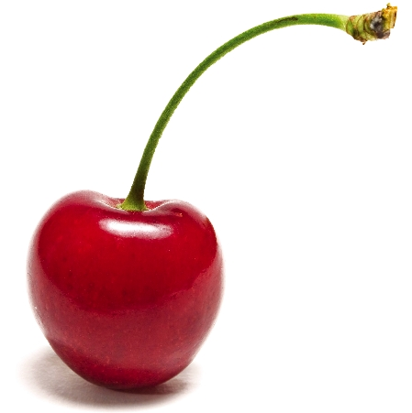
>>Presentation
Look and say
What’s this?
cherry
It’s a cherry.

Slide 5
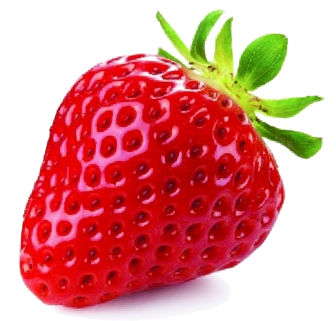
>>Presentation
Look and say
What’s that?
It’s a strawberry.
strawberry

Slide 6
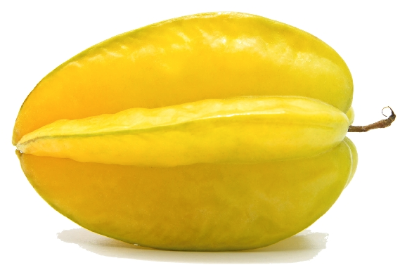
>>Presentation
Look and say
star
+
fruit
star fruit（杨桃）
It’s a star fruit.

Slide 7
>>Practice
Game1
大小声
hami melon
coconut
grapefruit
star fruit
cherry
strawberry

Slide 8
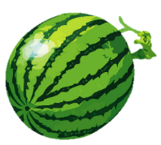
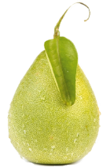
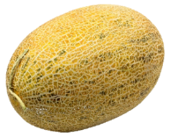
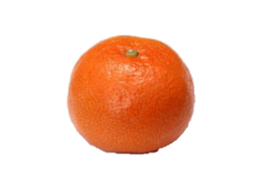
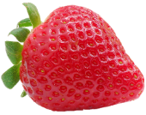
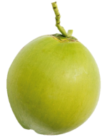
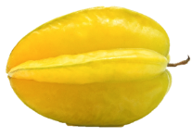
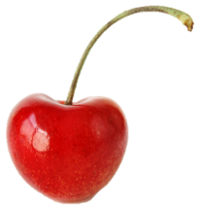
>>Practice
Game2
魔法大转盘

Slide 9
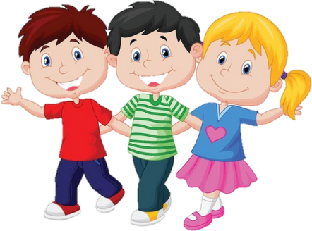
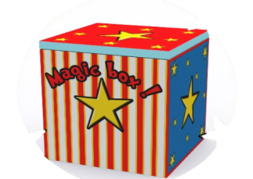
>>Presentation
Guess
Is this a cherry?
Yes, it is.

Slide 10
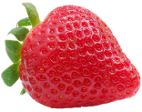
>>Presentation
Guess
Is that a cherry, too?
No, it isn’t. It’s a strawberry.

Slide 11
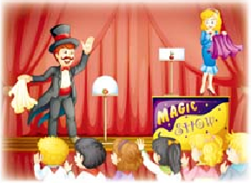
>>Presentation
Just talk

Slide 12
>>Practice
Read it by yourself for one minute .
自读对话一分钟。
一分钟倒计时
60
Learning tip :
10
10
50
自己读对话，比一比看谁能在一分钟内读完，并且读得准确、流利！
20
20
40
30
30
开始

Slide 13
>>Practice
Show time
小组合作，练习对话并表演，其他同学评价。
Pronunciation (语音) |  | Fluency (流利) | Cooperation (合作)
Good!
Great!
Super!

Slide 14
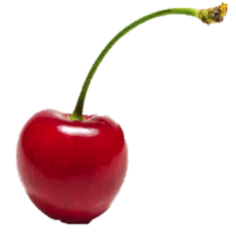
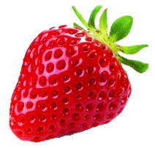
>>Summary
本课新学习的水果类单词有：
cherry
strawberry
star fruit
本课学习的重点句型：
—Is this/ that …?
—Yes, it is. / No, it isn’t.

Slide 15
>>Practice
活动
Do a survey
四人一组，调查小组成员最喜欢吃的食物及水果。
Name
fruit
food

Slide 16
An apple a day keeps doctor away. 一天一苹果医生远离我。

Slide 17
Thank you!

